Slide 1
Training Forecasters for
Extreme Situations
YOUR
Number ONE Priority!
Notes:
1

Slide 2
What do YOU do about EXTREME weather forecast training?
Notes:
The questions:
How are you doing your training?
Why don’t you do it?
Is it important to give this type of training?
If it is important....then why aren’t you doing it?
What could be the consequences when it goes wrong?
- People could die
- Damage you institute

Slide 3
OUR Problem
Notes:
Why did I start using the simulator in my training...
Do you know a serious situation like a kid drowning and everyone is looking but doing nothing to help??? It looks like they are frozen.....
That was why we started......

Slide 4
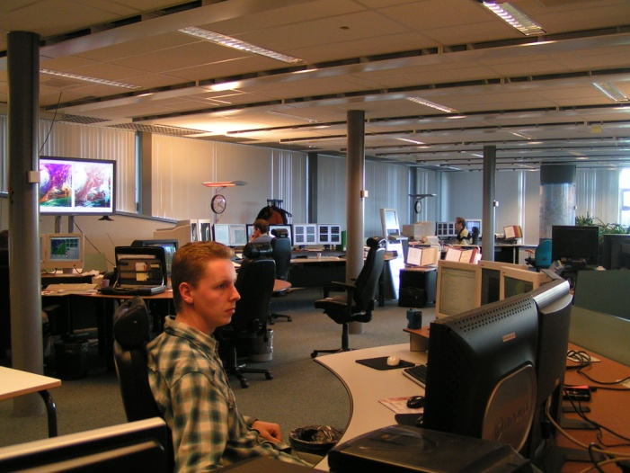
Why? Forecasters’ roles have been changing
Automation
Rare events
Dependency
When and how can the forecaster add value?
Decision making psychology
Notes:
Why? The role of our forecasters have been and are changing.
The tendency within the operational meteorology is that more and more forecast are being automated and less forecasters will be on shift
2) For our forecasters this means that they will work more often in weather dependent shifts and spend less time in forecasting office.
3) Luckily real serious situations are luckily very rare and when it happens often there will be a different forecaster on shift. This means a challenge for the forecaster to keep the operational knowledge updated.
4) Also models are getting better, which makes the forecaster more dependent on the model. For the forecaster it is important to know when and how they can add something to the model when they make their forecast for extreme situations.
5) Next to the objective site of serious situations we have a subjective site, like the human factor, psychology in the decision process and the opinion of the outside world, are getting more important. And this is something the forecaster has to learn how to deal with....otherwise it will cause stress...

Slide 5
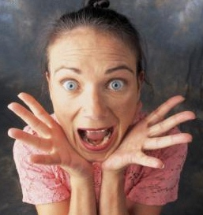
AND
OUR training programme was NOT effective!
Notes:
Then we had a review of a serious event and a forecaster told me that he could not remember where to find an important telephone number of a key organisation and he was not able to log into the system.
So our training programme appeared NOT effective!

Slide 6
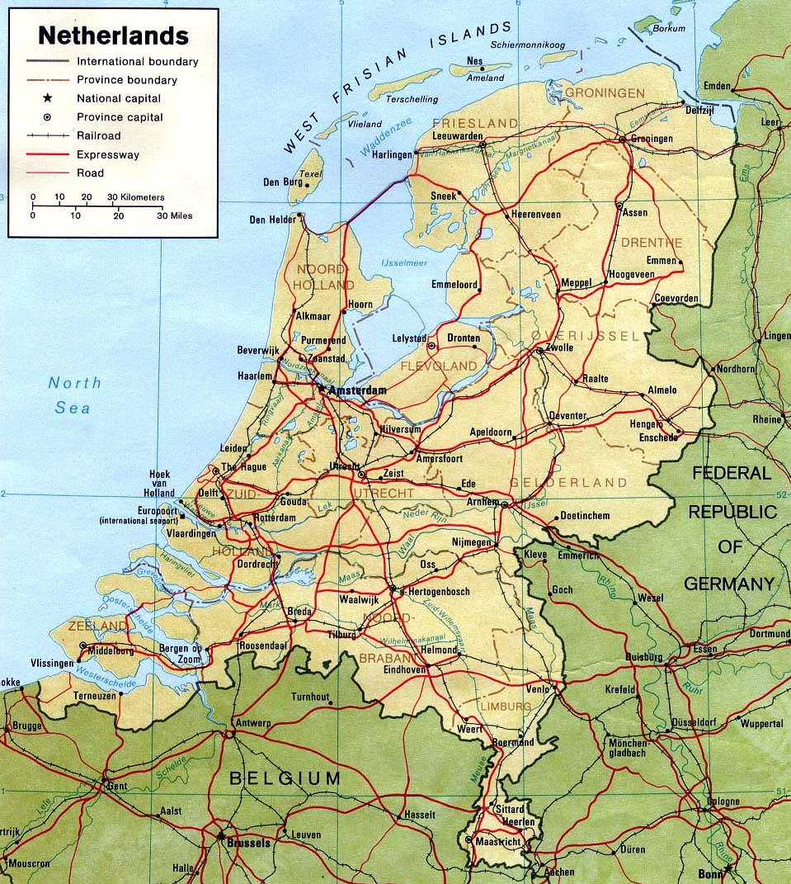
Notes:
Here you see the Netherlands…completely surrounded by water. In bad situations water comes from the North Sea in extreme high thides with a strong west north westerly wind and from the south (Central Europe and Alps) in case there is a lot of rain or snow melt.

Slide 7
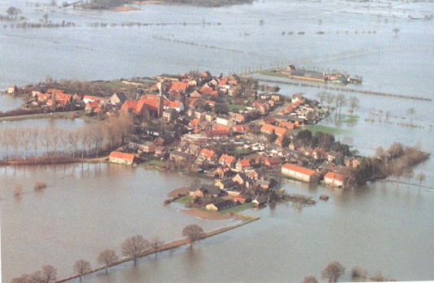
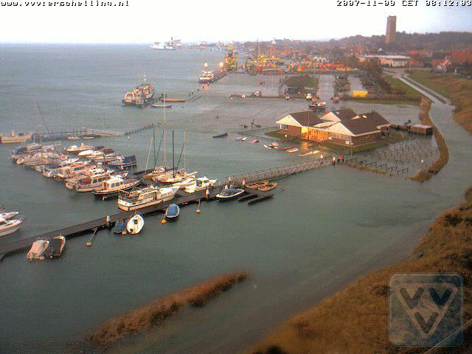
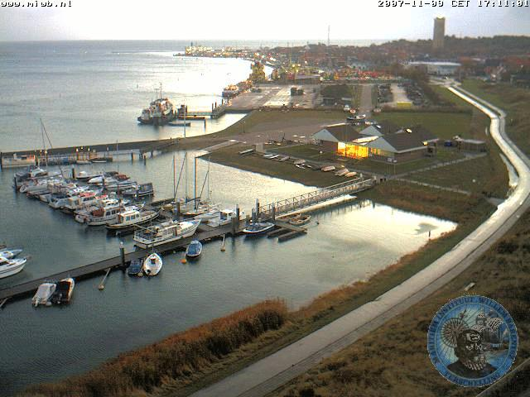
“The Storm Surge Warning Service”
MORE SPECIALIZED TRAINING WAS NEEDED!
Notes:
7
This is a picture from a harbour on a Frisian Isle at a normal high tide
The second picture with an extreme high tide.
The third picture…is when it does wrong……mostly when the rivers have to deal with loads of melt water from the alps in combination with a lot of rain and high tides

Slide 8
The way WE solved this problem

Slide 9
We realized
1) The education phase
2) The training phase
3) The practice phase
Notes:
When you want your people to be fully competent for their task we have 3 phases in learning:
1) The education phase: A phase in which you gain knowledge
2) The training phase: In this phase you make knowledge to skills
3) The practice phase: A phase to secure skills also in situations with a lot of pressure
Looking back I think our way of training the calamity people falls in the practice phase and we stepped over the first two points.
I also think for the education and training phase we should split the content and procedure training. Then the forecasters will be better prepared
I think we have to
9

Slide 10
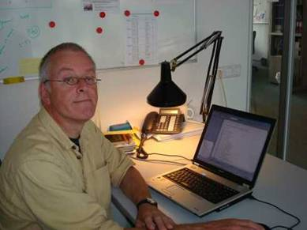
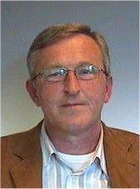
How did it start in 2006
Responsible for training SVSD people
Responsible for training maritime forecasters in calamity situations
Train our people together in semi real situations!
Notes:
10
This is John van der Tol, some of you may know him. Some years ago he was responsible for the
training for maritime forecasters for calamity situations.
This is Jan Kroos from the Storm Surge and Warning Sevice He had to train many new people
for their task. These people have completely different tasks during their daily life

Slide 11
The concept
Forecaster
with met data + prod tool
Follow all emergency procedures
3x normal speed
Example
Customer
with their systems
No pre-filled guidance products
Notes:
The concept was a simulation exercise with the storm surge warning service group sitting in a room next to our maritime forecasters working on a simulation of an extreme high flood. The storm surge warning service had their own system they could use to play their historic data and we brought our own systems, which were a system they use in forecasting office and they could now use to make an estimation of the expected flood height and CAL module.

Slide 12
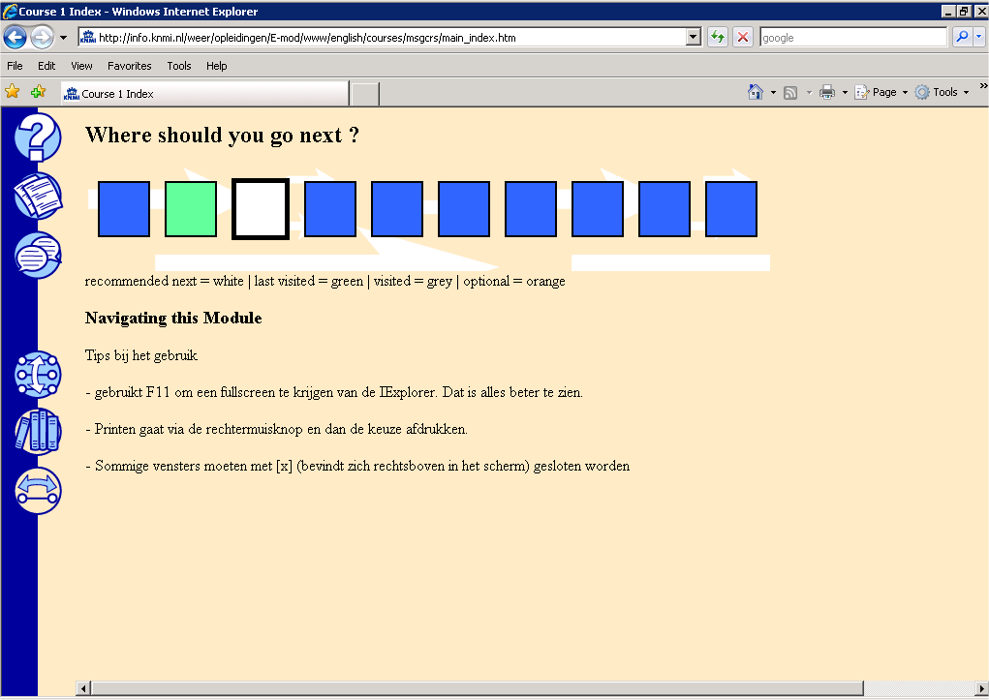
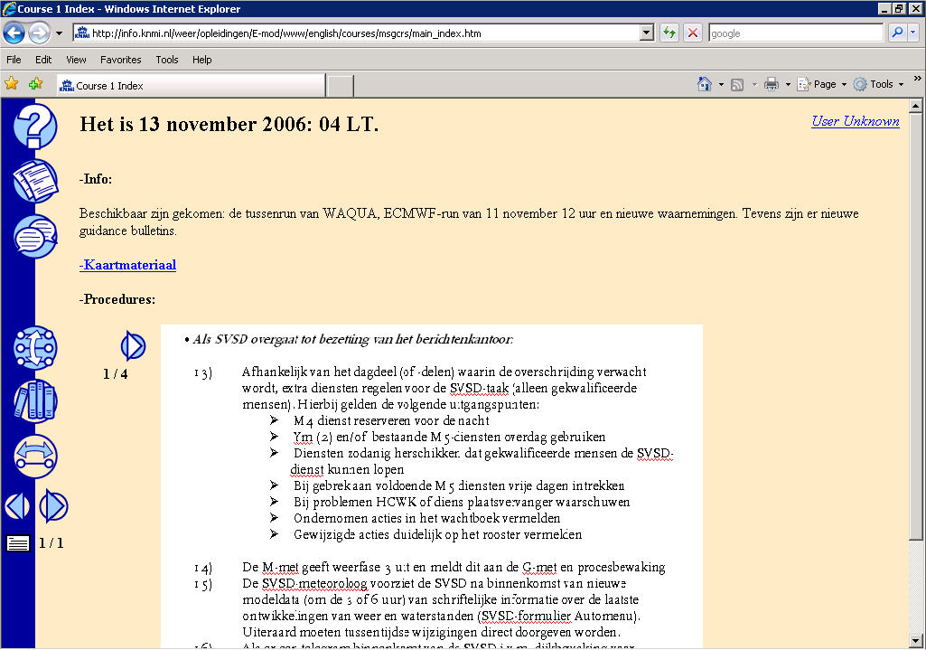
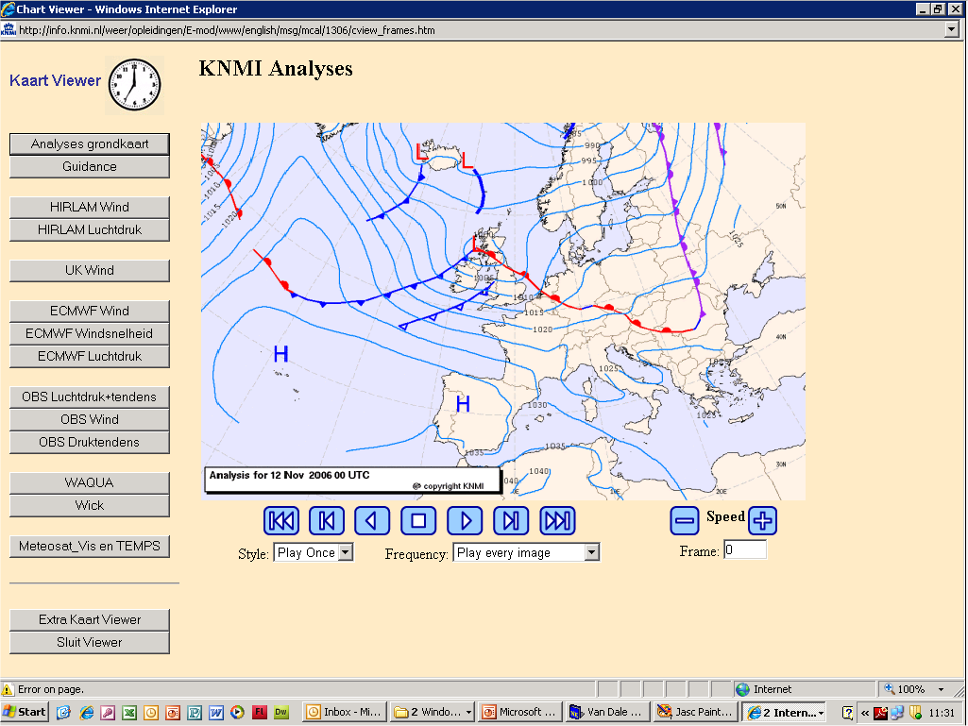
The first training exercise
KNMI 2009
Notes:
12
This is the first “simulator application made by Sjon. There were predefined time steps, which
were the times a new model information came.
2) At each time step we found the information of the newly arrived products, the procedures
which needed to be done around this time step and
3) We had a weather chart viewer with all needed meteorological information
4) For example click on a surface map.

Slide 13
This is relative easy to realize!
ALSO FOR YOU!!
Notes:
13

Slide 14

In 2008
The SVSD asked for a joined training
We all had very good experience with the SVSD training of Sjon
Our then co-ordinator training grumbled about the fact that it was not possible to run a situation in a simulation mode
I did a course Flash and ActionScript 3.0

Slide 15

Quotes about Flash from Wikipedia
Adobe Flash is a computer program what can be used to build animations, web videos and web applications like games and complete websites.
AND
Flash is build like an animated cartoon. For every unit of time the developer defines what visitor will see.

Slide 16

That is what we want when we build a simulator!
For every unit of time the developer defines what visitor will see.

Slide 17
To repeat
Forecaster
with met data + prod tool
Follow all emergency procedures
3x normal speed
Example
Customer
with their systems
No pre-filled guidance products
Notes:
To repeat the concept:
It was a simulation exercise with the storm surge warning service group sitting in a room next to our maritime forecasters working on a simulation of an extreme high flood. The storm surge warning service had their own system they could use to play their historic data and we brought our own systems, which were a system they use in forecasting office and they could now use to make an estimation of the expected flood height and simulation Meteorological Workstation.
Here the link to the SVSD training! And Explain what the simulator is like and what we are able to do with this simulator….
17

Slide 18
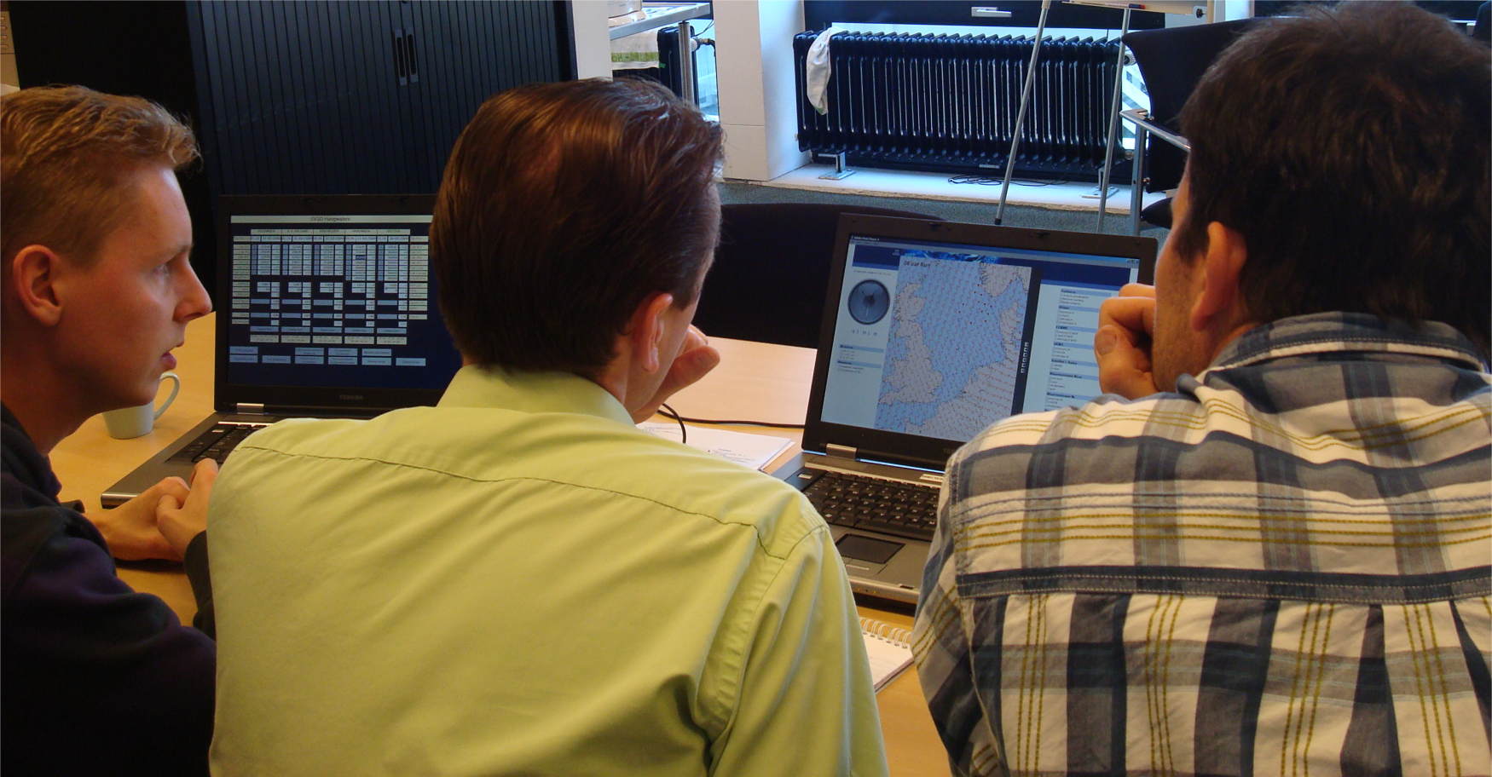
How are we doing it at KNMI
A very experienced forecaster always works with a beginner.
Direct communication with costumer.
Everyone is obliged to spend some time at “the other side”, to experience what is going on.

Slide 19

The simulation exercise was a success
Participants were very satisfied
Flash module
Minor improvements are planned

Slide 20
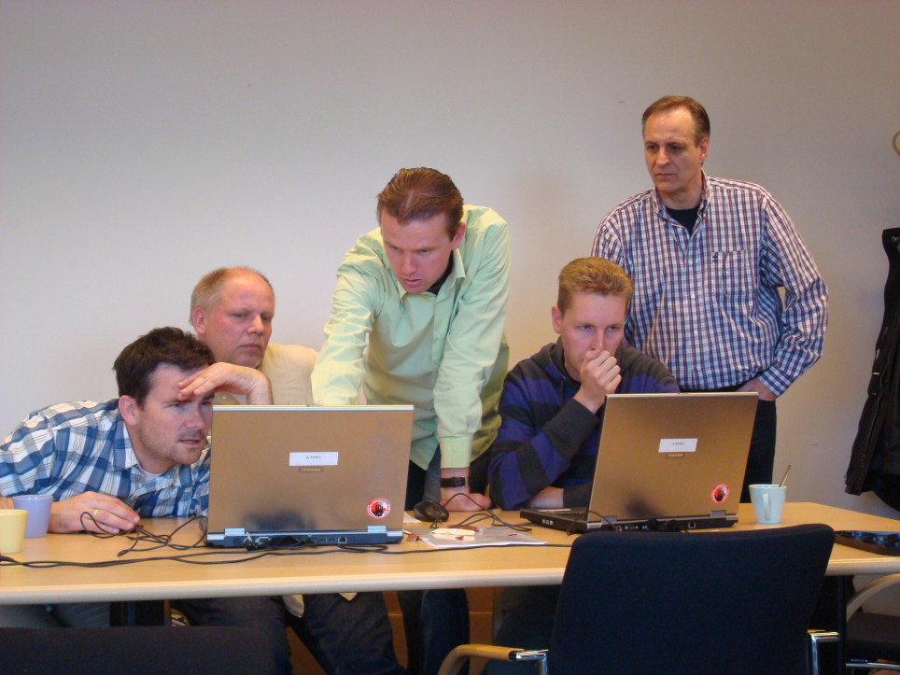
Advantages
Everyone has worked “under pressure” in a simulation situation and is sharp again.
If you do it right: the novice learns from the experienced.
Because the used products are empty, the forecaster has to think again about the origin of the input of the product.
Better relationship among the forecaster and customer.
Notes:
The advantages we found of working this way:

Slide 21
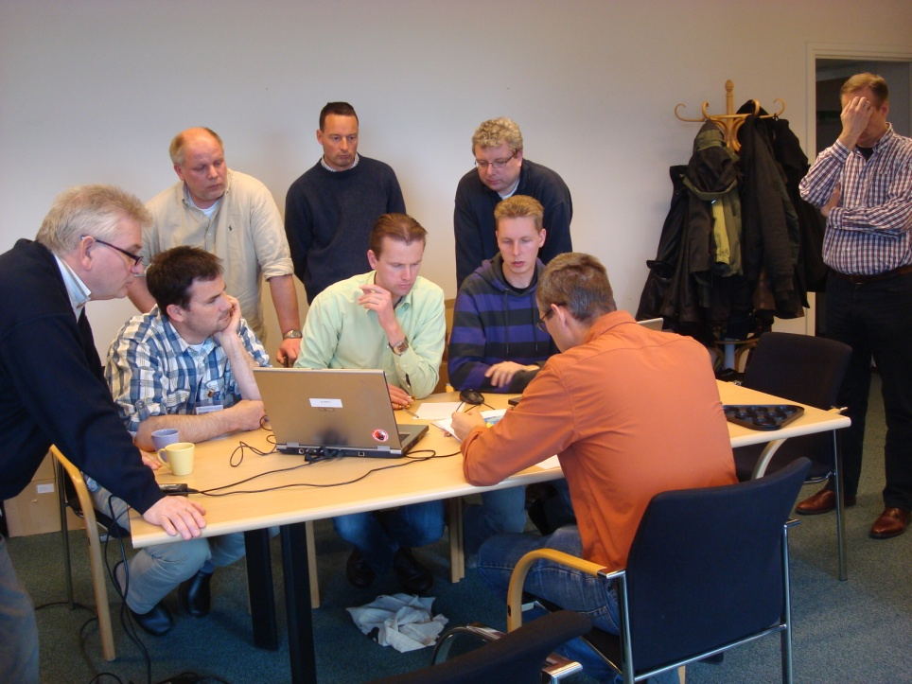
Better relationship because of:
Face to face
Kitchen
Discussion
KNMI
How
Customer
Why
Notes:
customer and forecaster meet each other “face to face” instead of on the phone.
forecaster gets a look in the kitchen of the customer and experiences what the customer is doing with his product.
customer gets a look in KNMI’s kitchen and experiences how the forecast is made
4. there is a possibility to discuss about how and why without time stress of a real situation

Slide 22
Disadvantages
different way of working.
a little overwhelming. Preparation time is needed
Sometimes too fast. Difficult to follow emergency scenario in a proper way.
danger of missing opportunities.
Notes:
Working with a Flash module is different than working with a MWS. Every forecaster has got his own working method and uses different products.
Some forecaster (mostly the new ones) feels a little overwhelmed by the start of the exercise. Keep in mind that the forecaster in reality has time to prepare on the shift to come. Build this into your exercise.
With the clock 3 times faster than usually and the forms empty time sometimes goes too fast to follow the emergency scenario in a proper way.
There is a danger that the focus will go more to the content o then to the advantages like the possibility of training procedures and contact with you customer (meeting each other and “the look in each other’s the kitchen”) are neglected.

Slide 23
MOST IMPORTANT
THIS TRAINING HELPED OUR FORECASTERS!

Slide 24
Not only possible to simulate Extreme high floods!

