Slide 2
How to use a simulator in practice
Notes:
2
Today we are going to talk about how we can use simulators during our training.
I do this workshop because I have build a simple simulator for the training of my forecasters and I am convinced that it helps my forecasters to be ready for their job.
Please keep in mind….I do have some experience with training people with the help of simulators, but don’t see myself as the expert yet.
I still learn a lot and today I hope learn from you all too! So please speak out your thoughts ……

Slide 3
This workshop <> about Technology = about the Philosophy behind it
Notes:
3
I have choosen not to talk about technology during this workshop, but about the philosophy behind using simulators in your training.
The things you need to think of when you organise a simulator training.
I want you to think and to learn how you could use a simulator during your training at home.

Slide 4
Who already trains people with A simulator at home????
Notes:
So I am wondering. Who does already use a simulator for training at home??
Please raise you hand....
If yes, What are you doing with a simulator and who do you train with that??

Slide 5
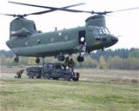
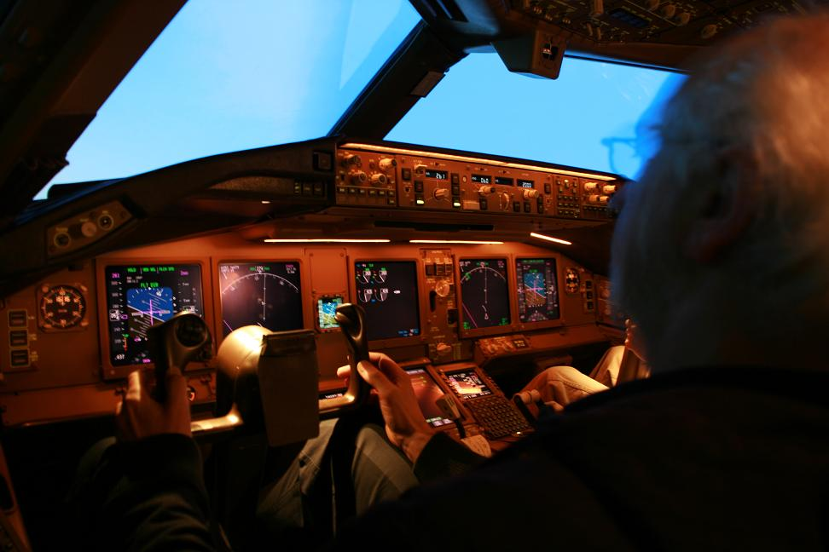
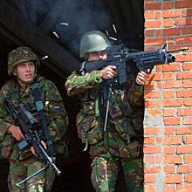
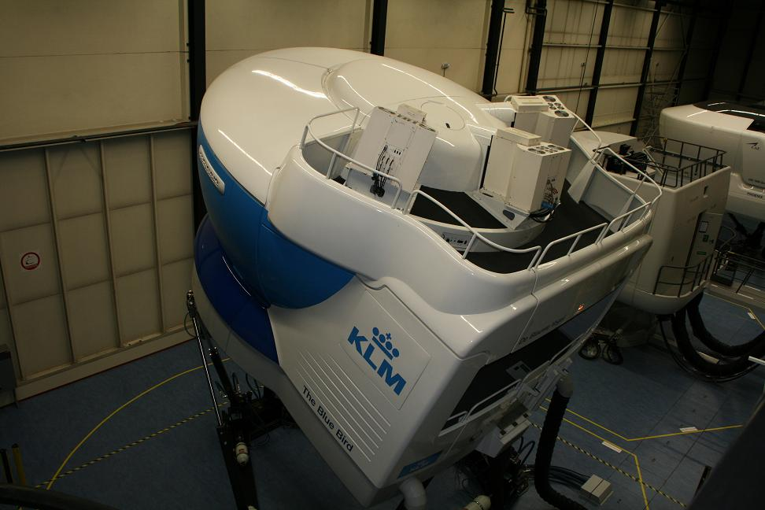
De Health Service of The Hague had a simulation exercise in which a SARS epidemic had to be handled
Notes:
I picked some examples of simulator training I know of
Pilots are trained in a simulator. At the KLM 5 times training and 2 exams in a simulator
We had a large simulation exercise where the army had to concur and airport in the Netherlands... of all the parts of our army were working together in this simulation .
The Health service The Hague had a simulation exercise

Slide 6
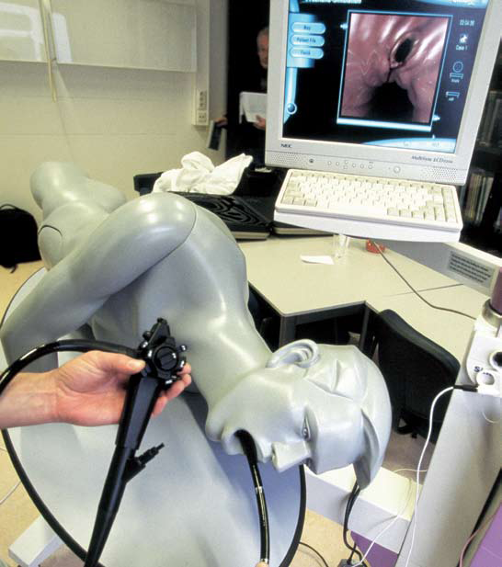
Notes:
Doctors use simulation people

Slide 7
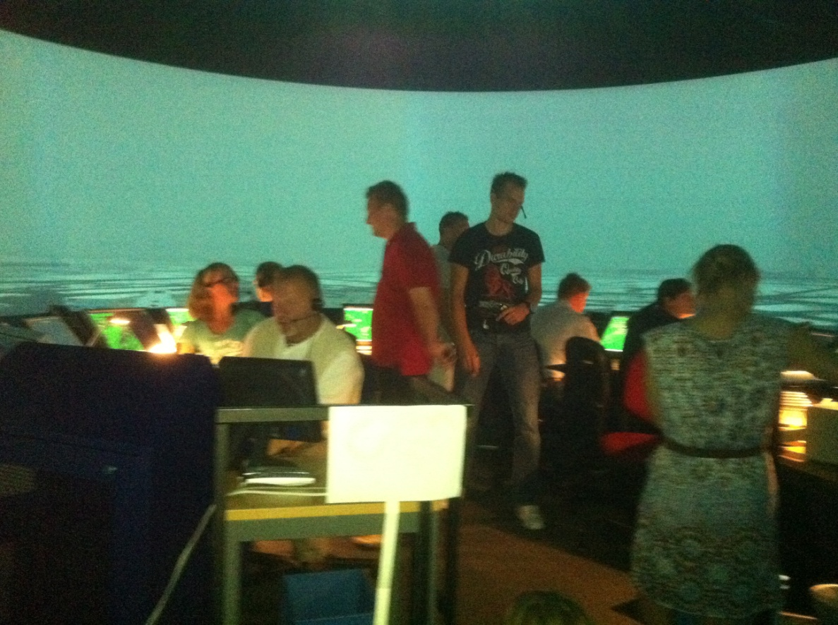
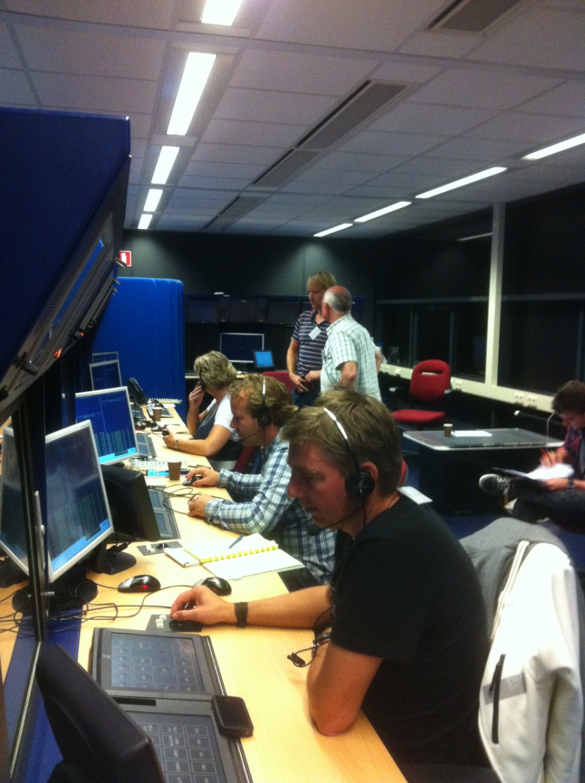
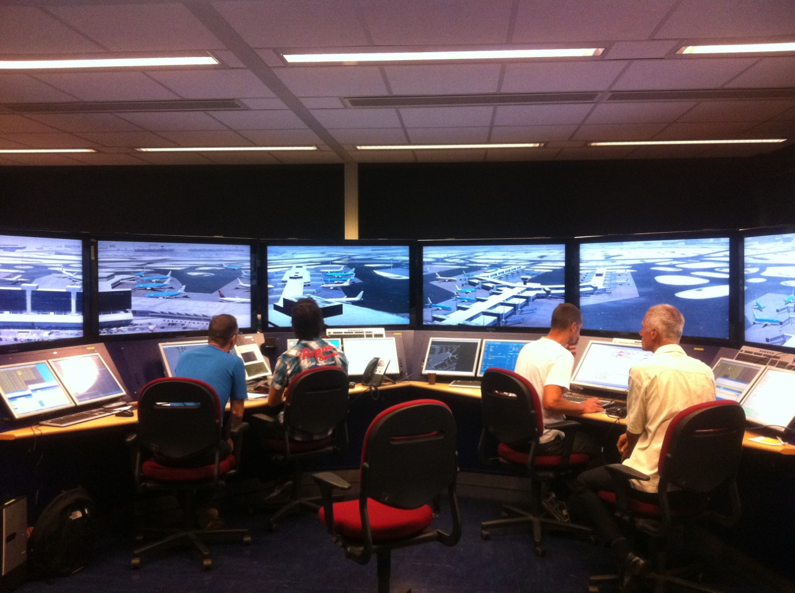
Notes:
The Air traffic control and the people of the ground control from our Airport used a simulation exercise to be prepared for snow situations in winter...

Slide 8
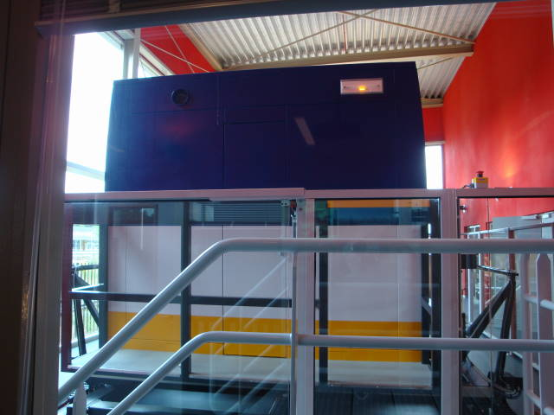
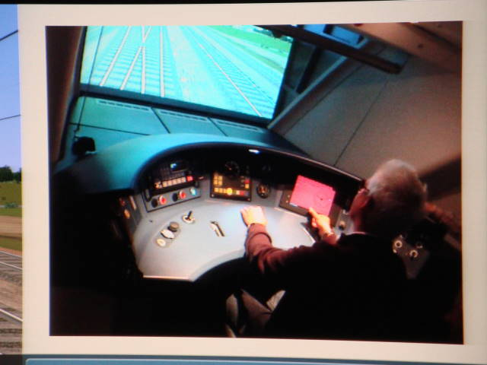
Notes:
Even our train drivers have their own simulator where they train twice a year!

Slide 9
Why don’t WE use simulators more often????
Notes:
So why do we not use simulator training more often in the Meteorology?? Has anyone got an idea?
scary?
too expensive?
?????

Slide 10
My idea
Excellent for:
Determining gaps
Training
Assessment
Notes:
My idea is that training your people (or at least mine) with a simulator is an excellent way of ……..
finding the gaps in the training programmes.......where does it go wrong in ...then can thing of meteorological background, following procedures or communicating with customers=
training your people for normal AND extreme situations....becasue in extreme situations people act differently from what you expect in normal situations...think of a little girl drowning in a poll...how many people are watching and not doing anything..That happens in your weather service too If your don’t train your people for extreme situations!
last but not least.....I do think training with a simulator is an excellent way to check out whether your people are competent to do their job

Slide 11
What NOW ?
Okay! We want to train our people with a SIMULATOR
Notes:
Okay, I have convinced you now to use a simulator in your training… What is next??

Slide 12
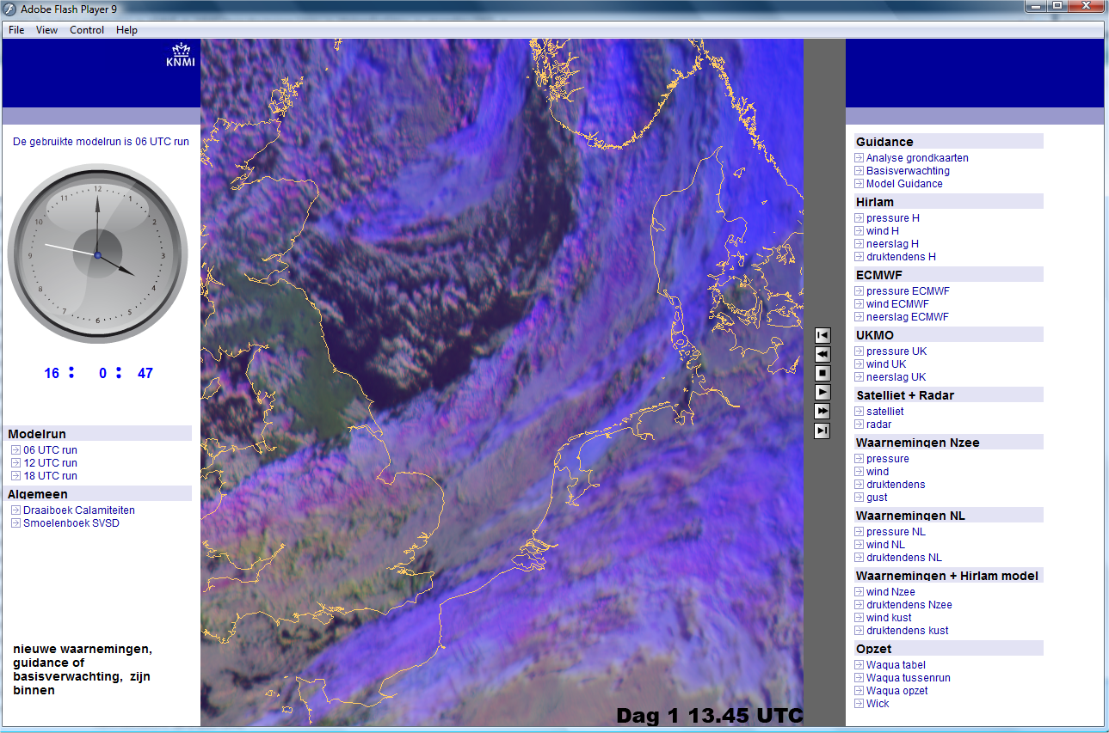
Okay..... let’s go and build a simulator!
Notes:
Then most of you are worrying about the technique........let’s go and build a simulator..or how can I adapt your simulator for my training....
But in my view that is the least thing to worry about!

Slide 13
Before you start!
Who do you want to train?
What do they need to be trained for? What are their trainings goals?
How do you realise this training goal?
How are you going to make this training a success?
How are you going to report?
A SIMULATOR training
Notes:
I think before you want to train people with a simulator you should you first think of things like:
who you want to train,
what do then need to be trained for? and the training goals
…and then think about how you are going to realise these training goals because maybe using a simulator is not the solution for this!
How you are going to do it???
And how are you going to report back?
Basically no other questions then when you develop a classroom training in my view.

Slide 14
Okay, let’s go through this together!
Notes:
Vesa is busy at the moment to develop a simulator exercise so I have asked him to help me with this part in stead of using a already tested concept...I hope that you will think along with Vesa and speak your thoughts out......next to that I hope that you will keep your mouth shut to the people who have to do this training...otherwise you make it less fun for both the vesa and the participants.

Slide 15
(1) Who do you want to train?
Notes:
Please pick a group of people you want to train and write that on a paper

Slide 16
General
New forecasters ?
Experienced forecasters ?
Calamity groups ?
Customers ?
???
Notes:
In general concept:
Do you want to train your new forecasters comming in who have no experience with forecasting or do you want ot training your experienced forecasters??
Or do you want to train calamity groups?? our forecasters work in these type of groups in extreme situations we (examples extreme weather, nuclear and chemical effents etc.). Those groups need to be trained for these cicumstances…
Vesa who are you going to train??

Slide 17
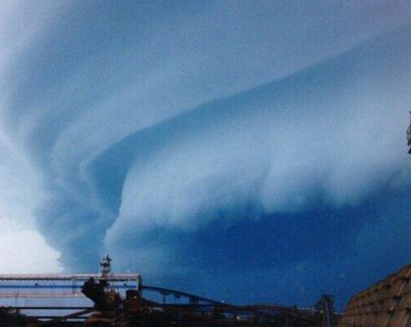
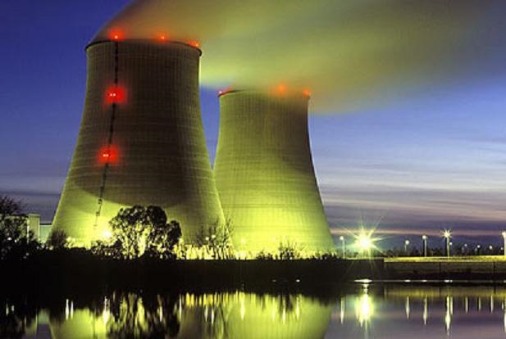
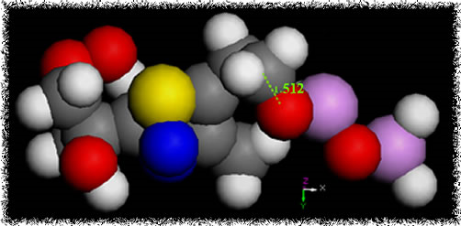
Example: Our Extreme Situations Forecasters
in this case:
but also in:
Severe weather
Chemical accidents
Nuclear accidents
Notes:
This is my example!

Slide 18
(2) What are the trainings goals?

Slide 19
General
train new people ?
check/secure procedures ?
train people for extreme situations ?
you might want to get insight whether the procedures are working when times get though ?
get people focused on a special situations
collaboration between team member and/or different teams?
???
Notes:
Here are some training goals…
Apart for the for you usual ones I found out that when you have new groups in which your forecaster has to act in case of extreme situations ....that it is very wise to find out whether the procedures work and if all the information is available they need to do it right before they start....
You never think of everything behind your desk designing such a type of calamity groups and the people have to get used to each others way of working and need to be able to understand each other......often in those case you have only one chance to do it right!
A new Water Management Centre in the Netherlands who act in case of extreme high or low water we regularly train with help of a simulator case and then we look to training goals like ...point 4, 5 and 6
So Vesa...what is your training goal??

Slide 20
Example: Our Extreme Situations Forecasters
Procedures
Communication
Not meteorological content!
Notes:
We want to train our Extreme Situations forecaster in:
Doing the procedures correct at the right time… Do they tackle the right decisions on the right moment and do they contact the right people at the right time?
How do they communicate both internally and to the customer….
It is important that the forecasters comes out of his convert zone AND is not hiding in meteorological content as they like to do.

Slide 21
(3) How do you realise this training goal?

Slide 22
General
Training the people alone or in/with groups?
Is the training internal or together with the customer
Do you need extra pressure or not?
Do you train a complete shift or only a single product?
Notes:
How are you going to train with your simulator to realise your training goals??? You can ask youself questions like this??

Slide 23
General
Think about how and what you want to do
Prepare a timeline of the things you expect to happen
Notes:
Basically you have to think about ......how and what you want to do with your simulator case ..
Vesa how are you going to do your training and why??
And did you already prepare a time line of when and how you want the things to happen?

Slide 24
Example: Our Extreme Situations Forecasters
forecasters are doing the simulation exercise on their own in 3 times normal speed.
found an extreme convective case
the warn criteria are taken down
they have to do an expert meeting
their texts products are checked and commented by a professional
their graphical products are checked
we have someone stalking them with questions from different corners during their work.

Slide 25
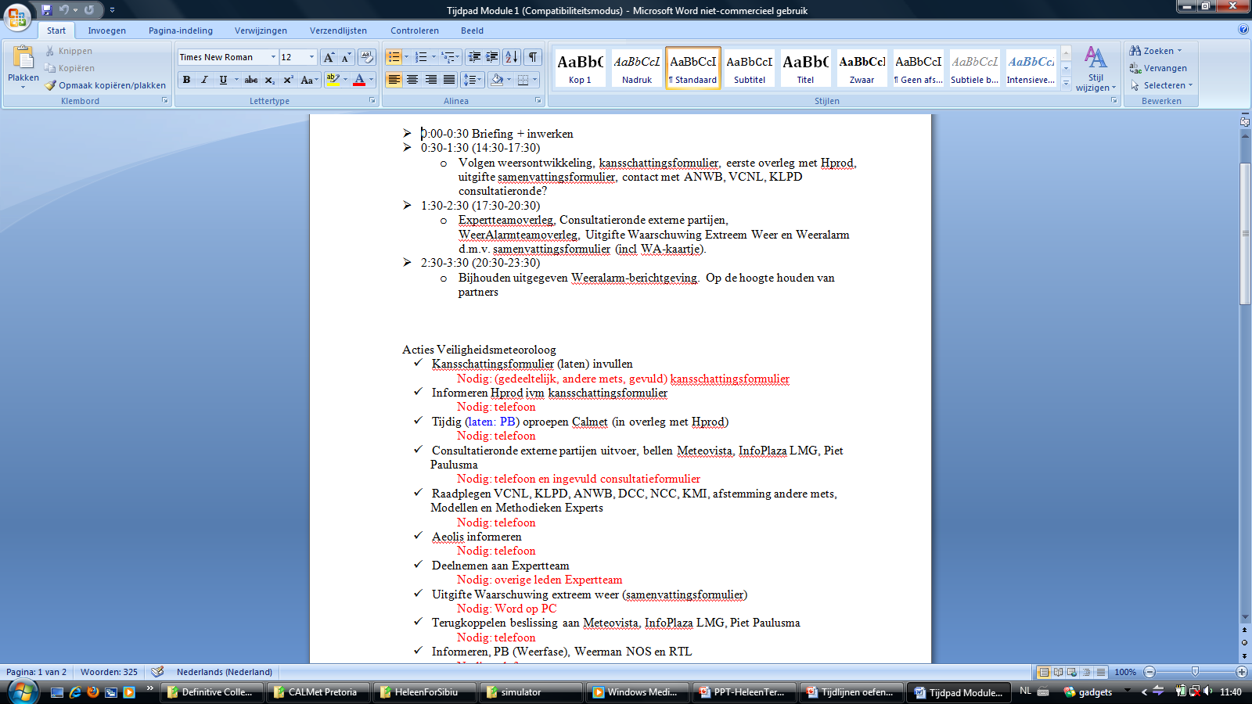
Example 1: Our Extreme Situations Forecasters
Notes:
The top part is the program….Sorry in Dutch…..what do we expect at different times during the excersise

Slide 26
(4) How are you going to make sure that you succeed??
Notes:
Okay, we have a idea and a timeline…how are you going to make sure that you succeed?

Slide 27
General
what do you need to make this training a success?
- rooms
- computers
- simulator & production tools
- data for simulator & production tools
- game facilitators
- telephones
- ????
Notes:
So what do you need to make this training a success??

Slide 28
Example 1: Our Extreme Situations Forecasters
Notes:
The bottom part is a list of actions which should be taken and what is needed to make it possible..think of telefoons, way to deliver your products, product sheets, .....

Slide 29
(5) How are you going to report??
Notes:
The I think the second important task....

Slide 30
Reports
Participants?
Boss?
How do you collect evidence?
Who will collects this evidence?
What do you need to do it right?
Instruction needed?
Notes:
What we often do after a simulation exercise is sit together (both participants and the game controllers) and debrief…what went well and what could be done better ...we do it both for the work the participants delivered and for the exercise...so you need to know what and when happens during the exercise.
Next to that often a positive fib going though the building...so a number of bosses wants to know what happend and what the results were.....and that is next to the usual evaluation!
How do you collect evidence? What evidence do you want to collect?
Who will collects this evidence? Special people walking around, people who help you to play the exercise?
What do you need to do it right? Special papers with the items you want to collect?
Instruction needed for people who are new to the process?
Believe me…these are the things you always forget and you will regret if you haven’t done it.
Vesa Have you already thought of this??

Slide 31
DO’s & DON’Ts
Notes:
So lets go to the do’s and don’ts

Slide 32
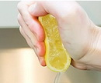
DON’Ts
Don’t overload the training programme
Don’t do something they are not prepared for
Don’t use unreal data
Notes:
The first time many people are scared for simulation exercises. They think they are confronted with the most horrible and extreme scenario’s…..
This doesn’t help your participants so build a simulator case with the things you want to train but don’t make it too extreme (unbelievable)…don’t drive them so far that the participants are total loss when they leave the training....people who are tired and frustrated won’t learn..you want them to leave with a positive fib.
Don’t do something they are not prepared for....I will come back on this one in the next slide
Don’t use unreal data....as soon as your participants discover this that are not in line with each other they will shut off and not act serious anymore...If you do use unreal data, tell them before that they know what to expect

Slide 33
DO
Introduction
Sometimes it is good to give the participants time to get adapted to this simulation work spot
Embed their usual accepted habits in the exercise…like a briefing to start with
Make sure that the participants need to go through the things you want them to do and that they have no escapes.
Debrief afterwards
Notes:
1) Before you start your simulation exercise give an introduction and tell the people what they are going to do;
what kind of excersise (snow, extreem weather),
the aim (get pepared for the winter season),
the focus of this excersise (your goals)
and what you what you expect of them (tell them that they have a shared responsibilities for making this exercise a success)
2)Tell them in advantage that the things are not 100% the same as at their own work spot…it is and will stay a simulator. If they haven’t used a simulator before get the time to get adapted to their “new” working spot
3) Embed their usual accepted habits in the exercise…forecasters always start their day with a briefing…so you should do that during a simulation exercise too….otherwise they are lost during the first period of time and the simulation won’t be as affective.
4) Make sure that the participants need to go through the things you want them to do and that they have no escapes. Lower your condictions when needed…In our cases at home extreme weather means extra work..and my experience is that some people like to stay away from that if possible
5) And Debrief Thing like
How dit it go?
We have learnt?
What can be done differently next time?
Helps to make a simulation exercise effective

Slide 34
Simulators & Assessment?
Notes:
Now we have the new ICAO rules coming up for aviation forecasters…….Can we use simulators for the assessment??

Slide 35
SO
Have you already thought of how are you going to do the assessment of your aviation forecasters and observers in the nearby future?

Slide 36
Disadvantages of a simulator assessment?
……
Notes:
You have to take people out of the working process and you need time of people to assess the forecasters….
Preparation of a good assessment exercise takes valuable time
We don’t have enough cases..
People are talking and that way know on forehand what we are going to assess…

Slide 37
Advantages of a simulator assessment?
…….
Notes:
You are 100% sure that the required competences are being assessed
This way of assessment is objective because you can prepare the things you want to assess/
The circumstances are the same for everyone the same
You have a clear record of what someone preformed or didn’t preform during his/her assessment.

Slide 38
Advantages/Disadvantages
What is more important in your eyes?
Notes:
At KNMI we see more advantages then disadvantages of using a simulator for the assessment of our forecasters. So we will use the simulator as part of our certification process.
BOM is also using the simulator as a assessment tool and I have brought an example from them which I used as a guideline to develop my simulator training….it will show how they work, what they expect and how they collect effidence of the participants…I will do this example in the Moodle system…please check it out, because it is very worthwhile

Slide 39
We don’t have a simulator and NOW?
Notes:
I already hear many people say...we don’t have a simulator in house and it is too expensive to buy one. This type of training is out of our reach.

Slide 40
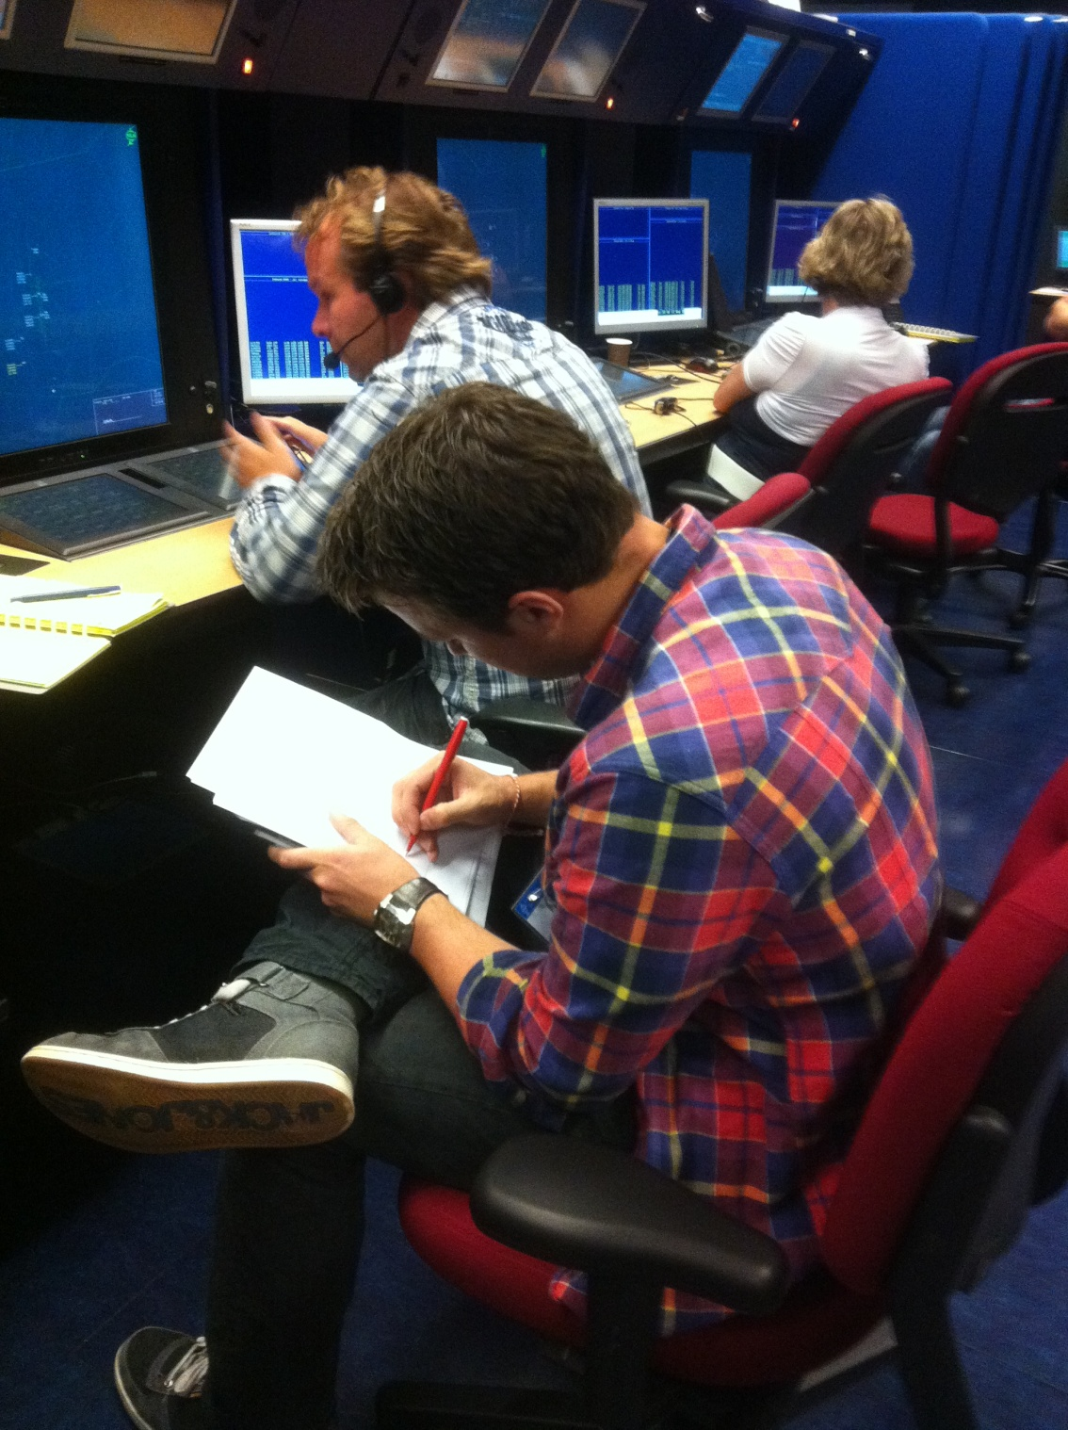
Notes:
Don’t get yourself demotivated by serious gaming environments like I saw last sommer
A large simulation excersise for Air trafic controllers……within the dutch airpace from the border until the planes line up to land at Schiphol airport.

Slide 41
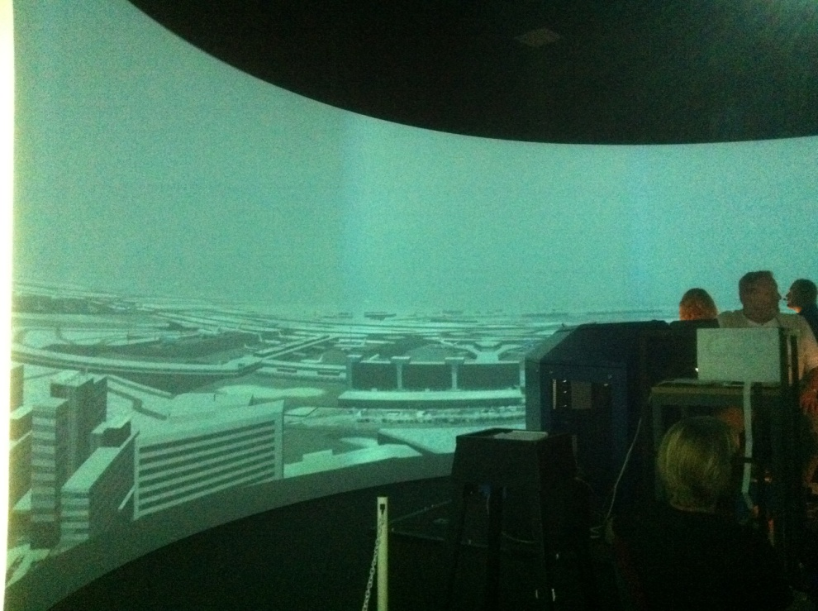
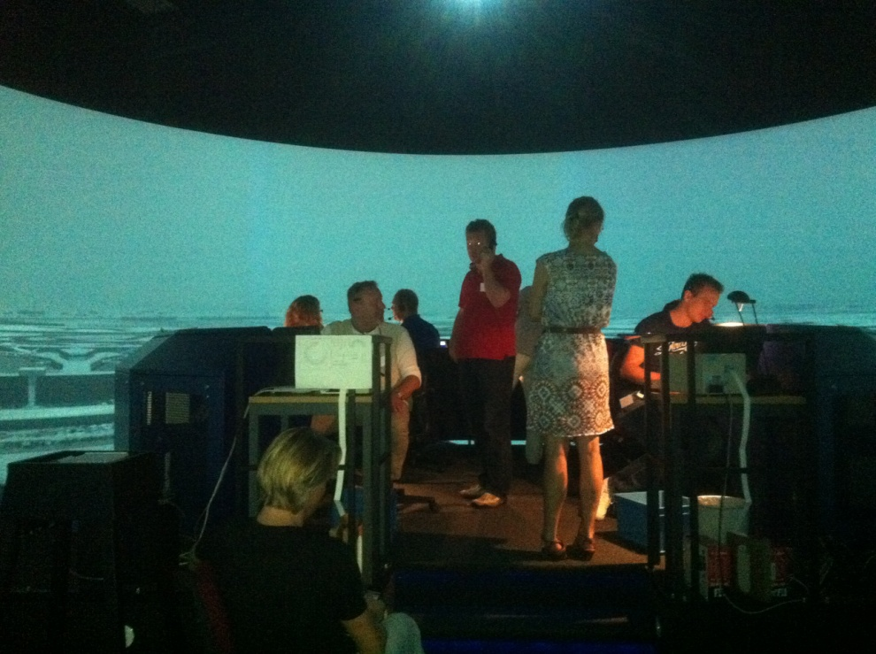
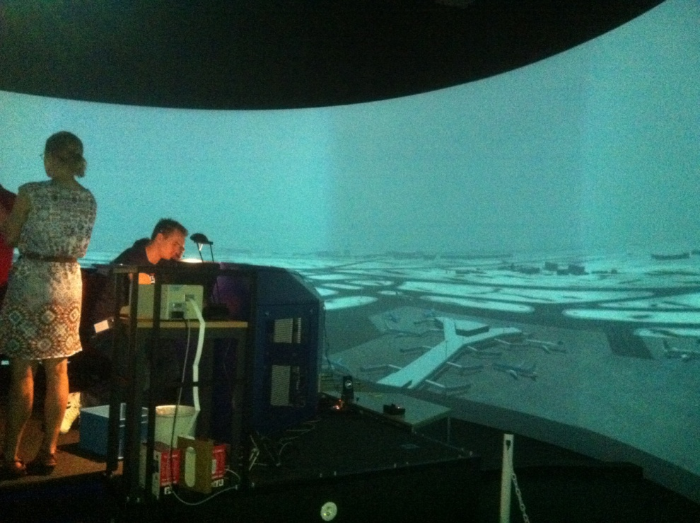
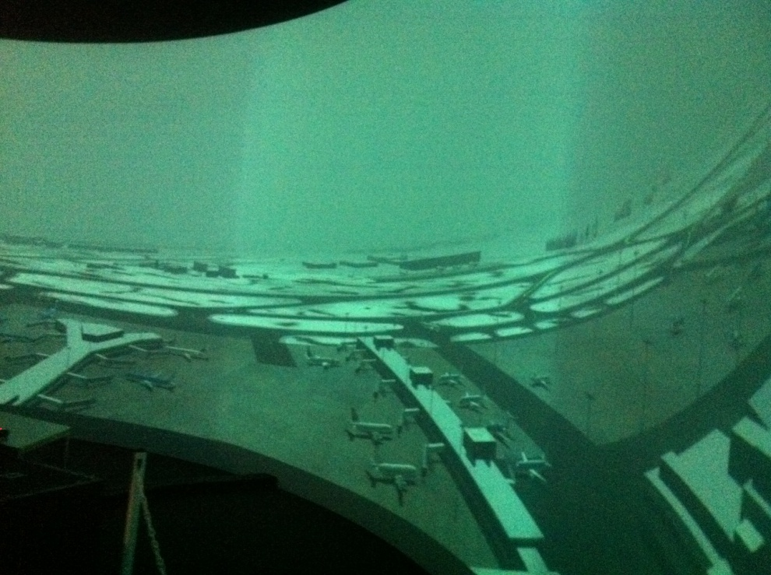
Notes:
Air traffic control in the tower for landing

Slide 42
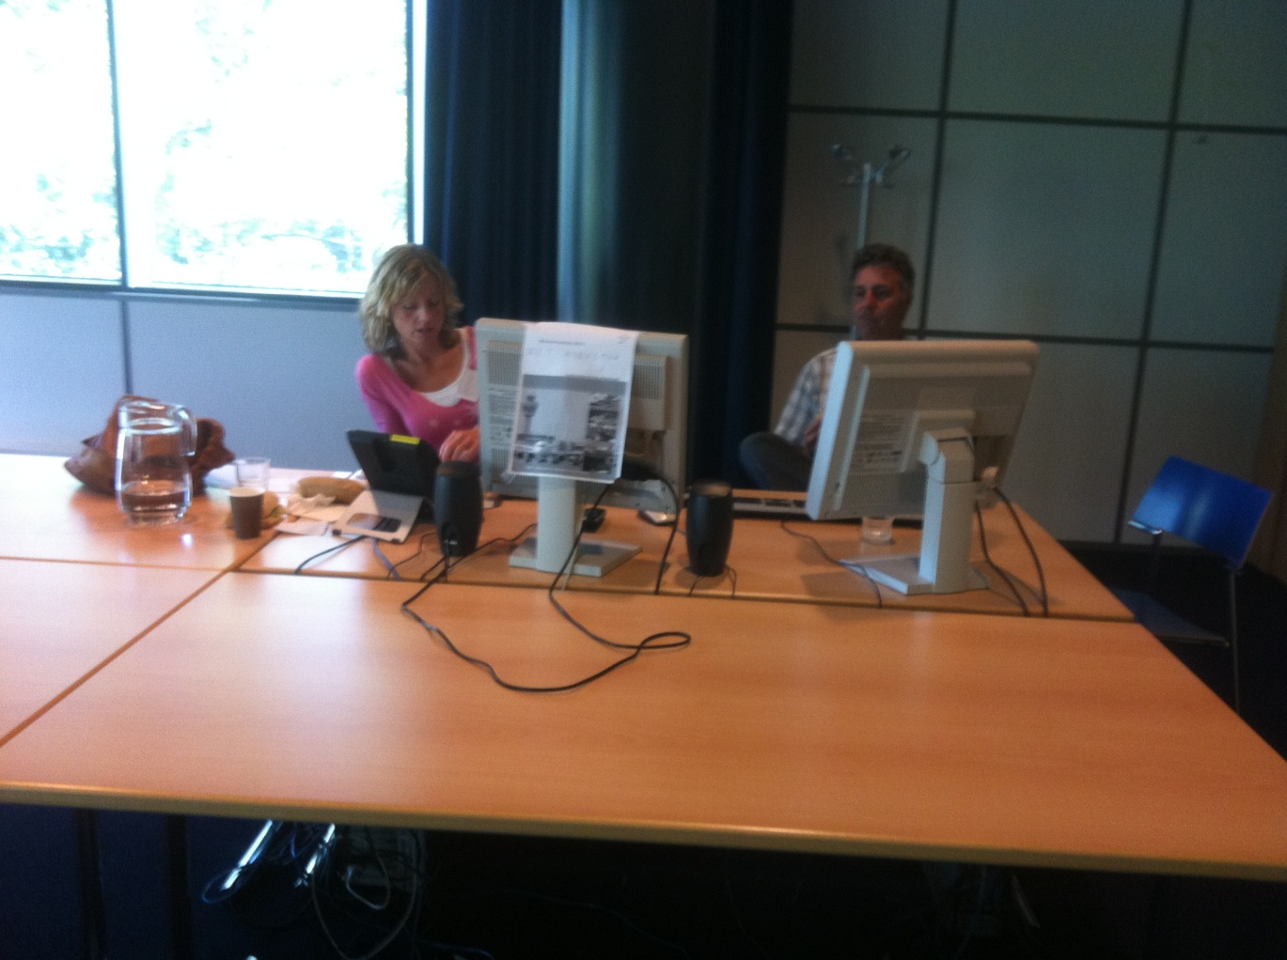
Notes:
And The ground traffic control for all vehicles on the ground.

Slide 43
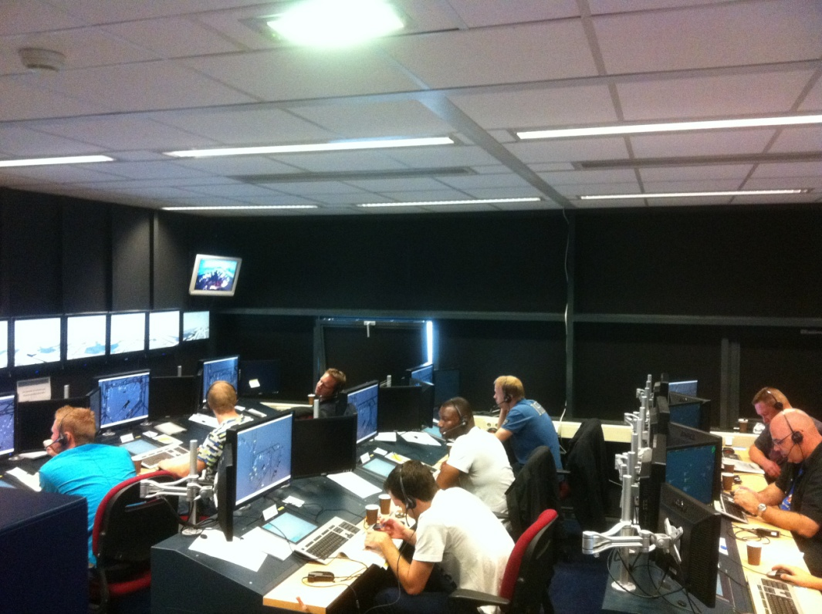
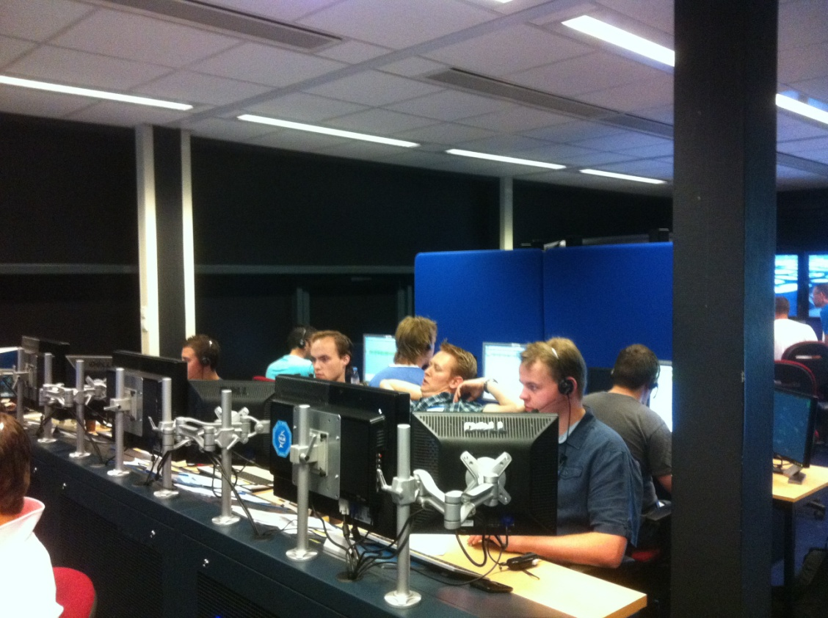
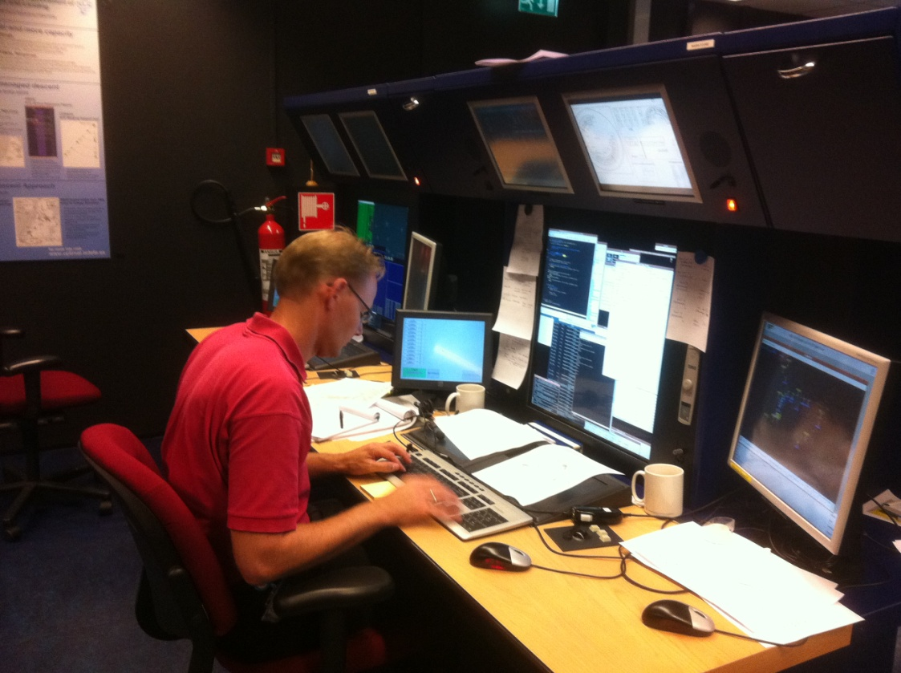
Notes:
More than 30 people who made this simulation happening.
Here you see 25 People who played planes and pilots and 5 who played the vehicles on the ground like the snow patrol
Next to that at least 2 people who were there for technical support and who kept the systems and the simulation running

Slide 44
The success of your simulator training has nothing to do with the used technique but with the ideas and the philosophy behind it.
Notes:
Nowadays there are many different serious gaming project...some are even better than others. But technique is also very vulnerable......
With a pile of weather maps, a clock or a stopwatch and game leaders well known to your process you built sometimes more effective simulator training with al lot more fun than with expensive technique like I have shown before.
For this training type you are not dependant on a very expensive tools.

Slide 45
This simulator
Adobe FLASH
and
ActionScript 3.0
Notes:
To show how I succeed....I went to a Adobe Flash course of 5-6 days and I programmed the simulator in Adobe Flash with the help of ActionScript 3.0

Slide 46
High Impact Weather Group
Notes:
Within the EumetCal High Impact Weather Group we have taken the initiative to translate the simulator programme into English.
We are happy to share this tool with you and the rest of the educational world. It will be available on the EumetCal site or with me.
When an experienced programmer follows a Flash and ActionScript course.... the programmer will able to adapt the simulator for your own situation.
I know that I have disapointed some people with this story, because they want to hear the technical story.....
My idea is that this story needed to be told too...so that is why, but I am happy to do a separated session with the people who are interested on the technical side....

Slide 47
Questions?

Slide 48
Thank you for your attention!
pelkwijk@knmi.nl

