Slide 1
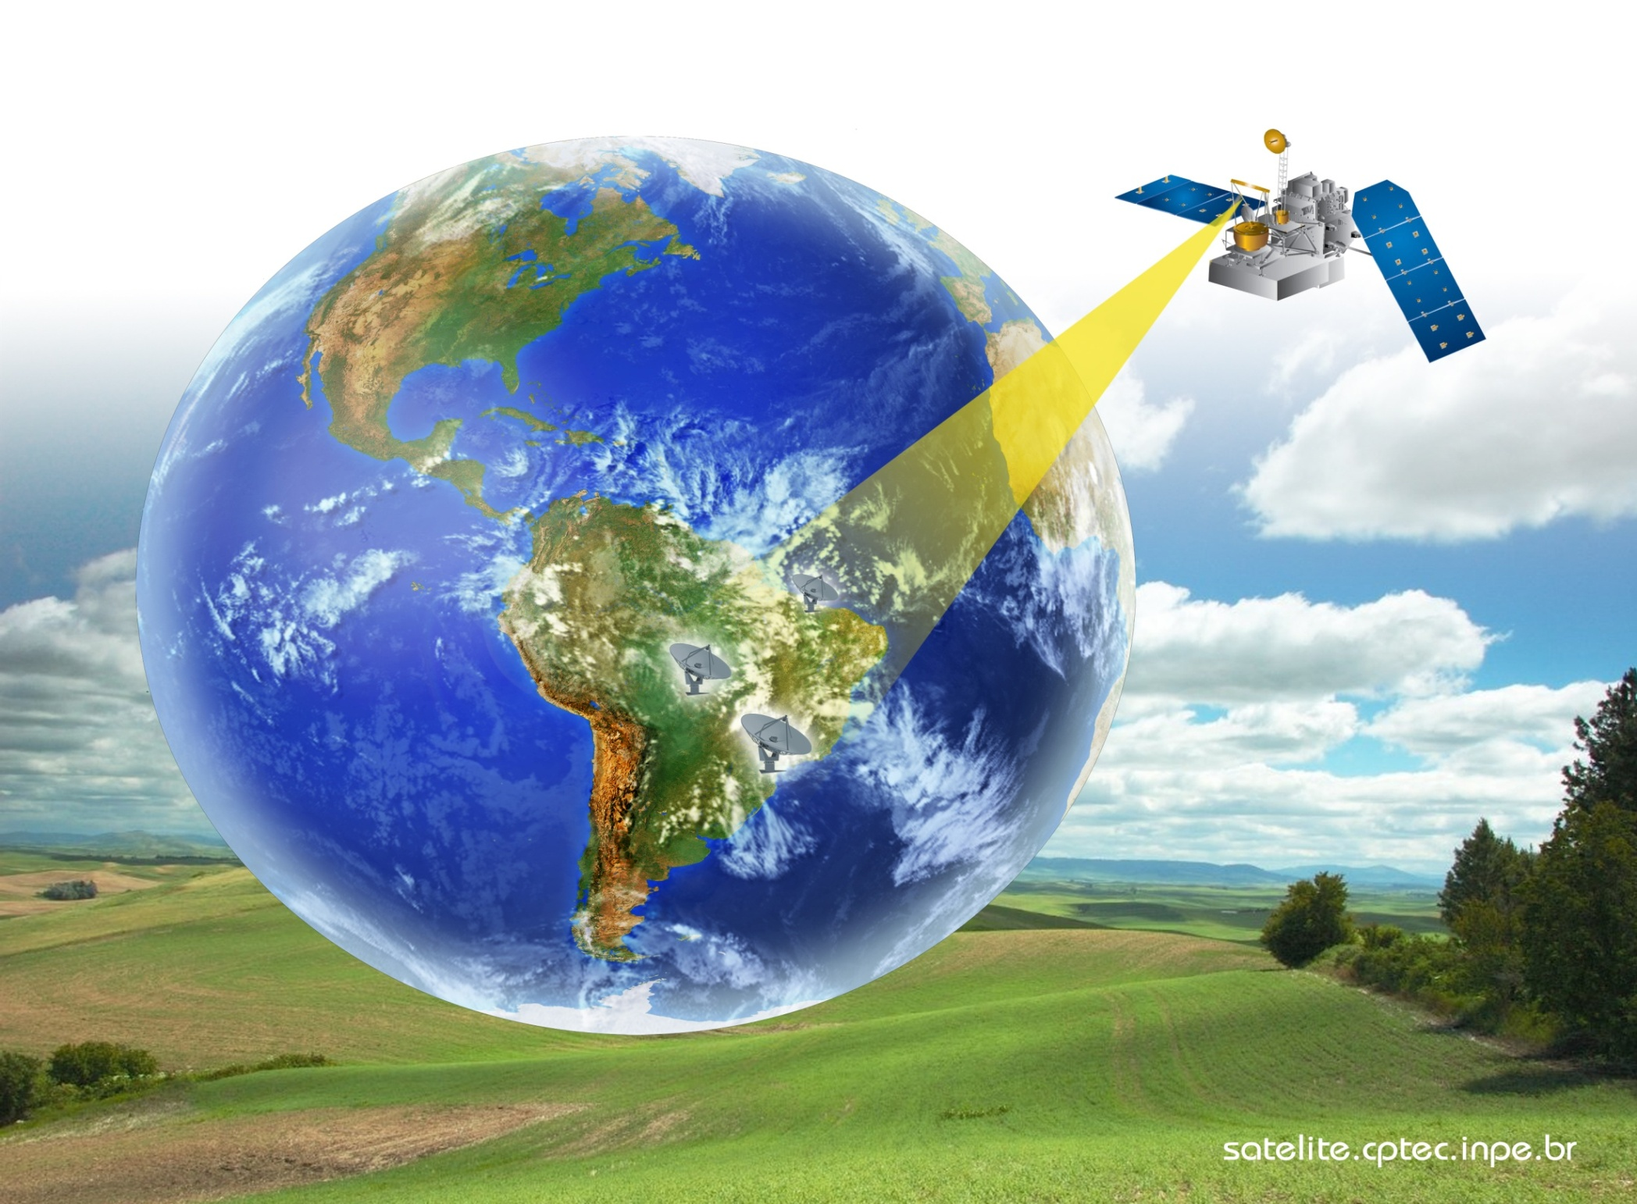
Activities do CoE Brazil
Center for Weather Forecast and Climatic Studies (CPTEC)
Brazilian National Institute for Space Research (INPE)
VLMG-6 MEETING
São José dos Campos, 8 – 11 October 2012

Slide 2
CoE in Cachoeira Paulista
Brazilian National Institute for Space Research (INPE)
Center for Weather Forecast and Climatic Studies (CPTEC)
Brazilian National Weather Service (INMET)
Mission
Provide education and training in satellite meteorology for the Portuguese-Speaking Countries
Notes:
2
The Center of Excellence in Cachoeira Paulista is a cooperation between the Brazilian National Institute for Space Research (INPE) through the Center for Weather Forecast and Climate Studies (CPTEC) and the Brazilian National Weather Service (INMET) and our mission is to provide education and training in satellite meteorology for the Portuguese-Speaking Countries.

Slide 3
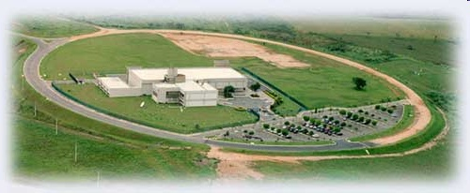
CoE in Cachoeira Paulista
CPTEC-INPE – Cachoeira Paulista, SP- Brazil
Notes:
Cachoeira Paulitsa is small city located at Sao Paulo State , between SP and RJ. (Less than 300 km)

Slide 4
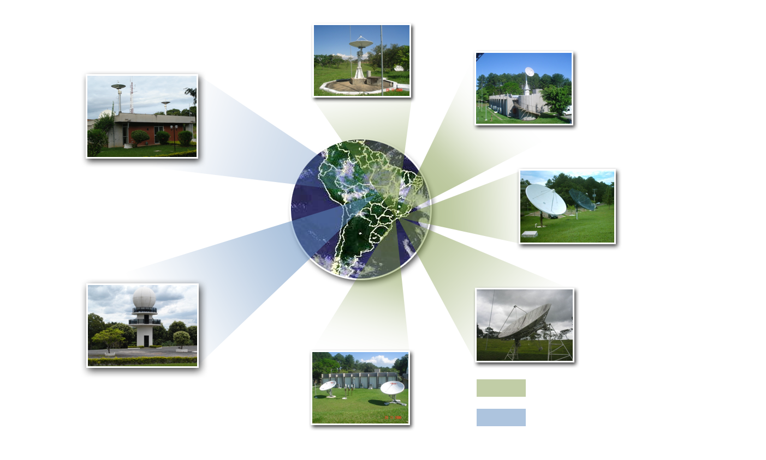
Facilities : Remote Sensing and Products
Two reception stations for Direct Readout from
GOES, MSG,NOAA, AQUA/TERRA satellites
NOAA/HRPT
NOAA/HRPT
NOAA/HRPT
MSG/SEVIRI
AQUA/MODIS/AIRS
AMSU/AMSR
TERRA/MODIS
GOES/VISSR
GEONETCast/ EUMETCast
Intelsat -9/ NSS-806
These facilities are presently managed by the Image Generation Division of INPE

Slide 5
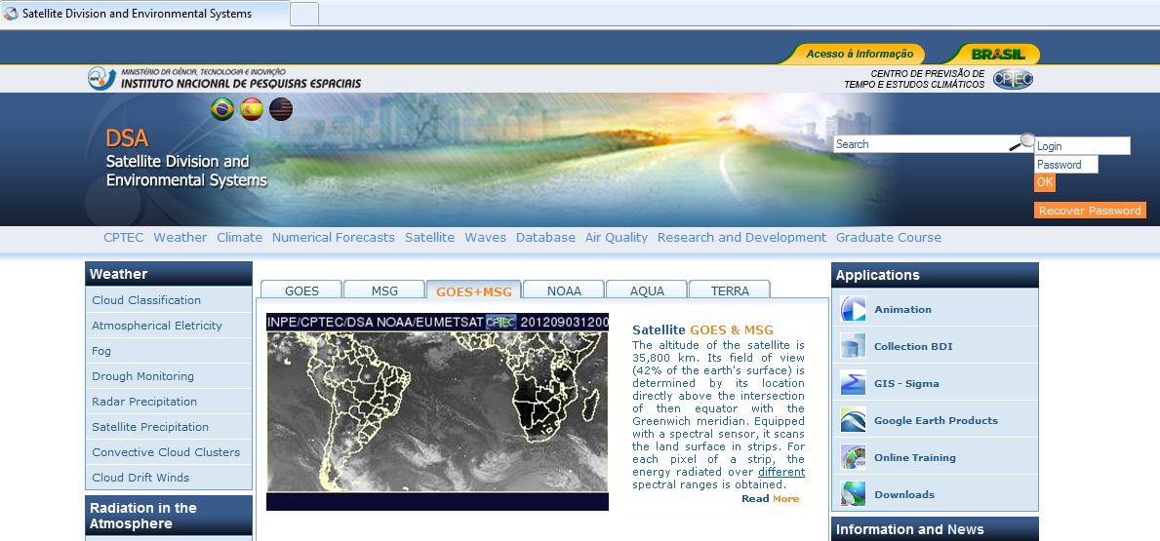
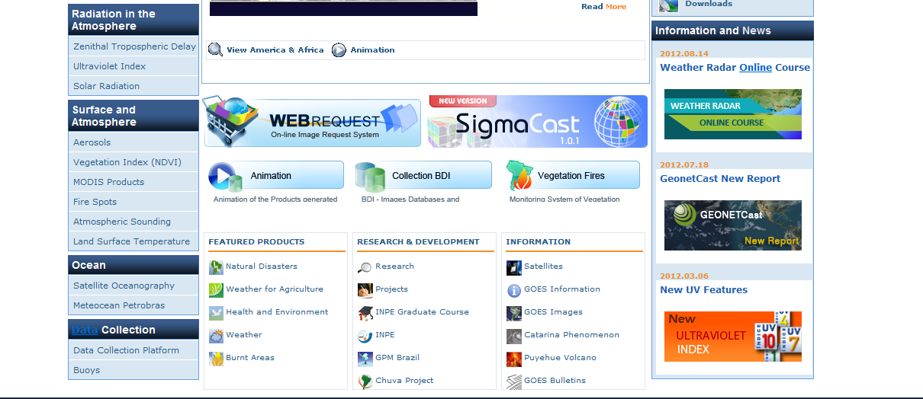
DSA/CPTEC HOMEPAGE
Facilities: Remote Sensing and Products

Slide 6
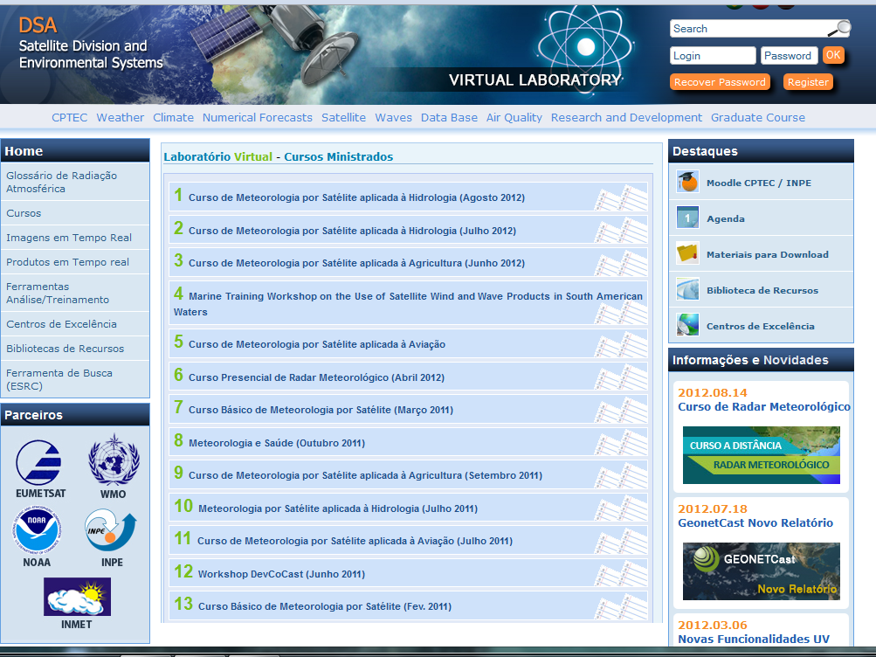

Slide 7
http://poapem.cptec.inpe.br

Slide 8
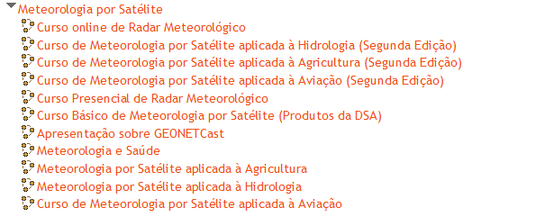
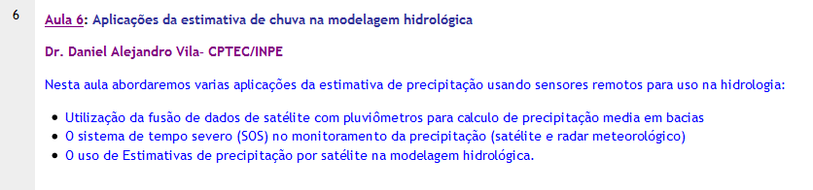
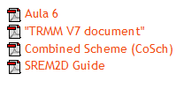
http://poapem.cptec.inpe.br
MOODLE FACTS
11 Courses in the last 2 years
650 + Registered Users
60+ training material developed and additional references

Slide 9
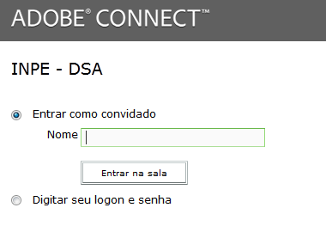
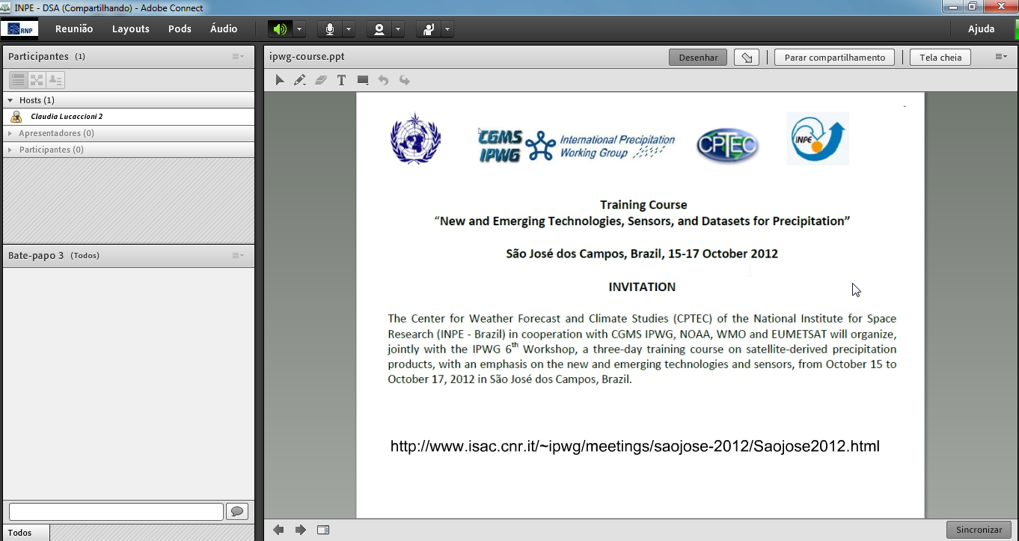
NATIONAL EDUCATION AND RESEARCH NETWORK TOOL
http://webconf2.rnp.br/dsa
http://poapem.cptec.inpe.br

Slide 10
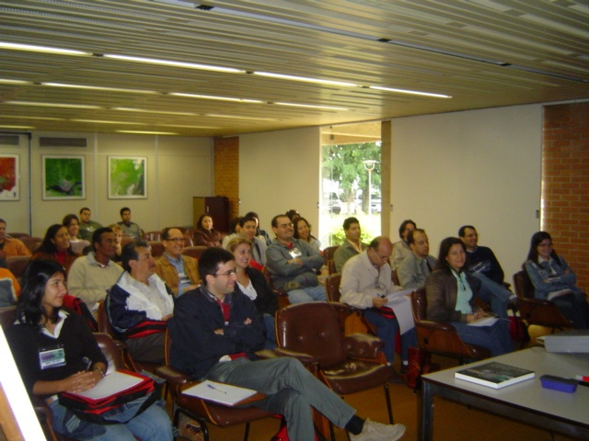
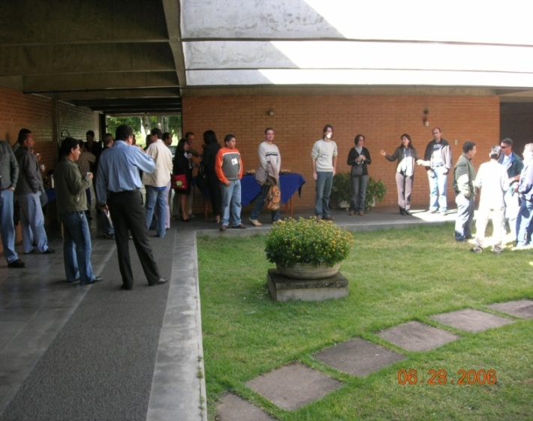
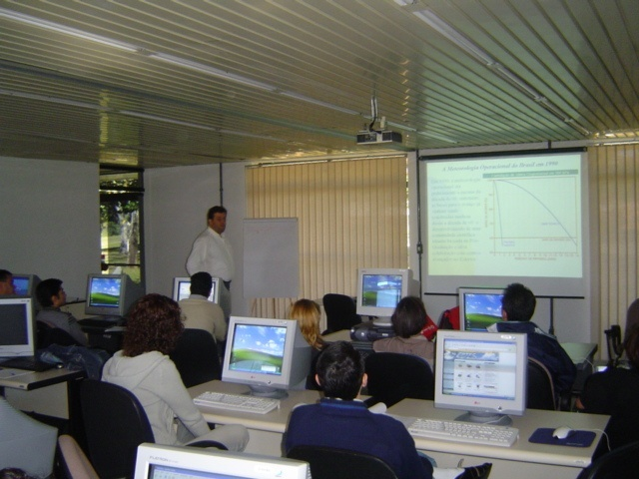
Facilities and Logistics
Classroom Area
Classroom with capacity for 60 people (area: 12m x 7m); Internet connection; Coffee break space (10m x10m)
Computer Laboratory Area
15 personal computers and 2 more computers as backup. Secretary Office, The computer laboratory have enough space (7.5m x 7.5m) for three attendees to sit in front of each computer; Projector; Wireless Internet connection;
Notes:
10

Slide 11
ABOUT OUR COURSES...
OBJECTIVE: Provide high quality training and updated resources on current and future weather satellites. Encourage the use of satellite data and products for Portuguese-speaking countries.
COURSES TYPE: 30% classroom courses – 70% on-line courses.
AVERAGE DURATION: 3 day (2 sessions per day) – Seminar type presentations.
ACADEMIC BODY: Satellite and Environmental Systems Division, Rio de Janeiro Federal University, Itajuba Federal University, National Center for Monitoring Natural Disasters Alerts, among others.

Slide 12
ABOUT OUR PARTICIPANTS...
PARTICIPANTS: 288 students (2011)
379 students (2012)
AVERAGE ATTENDANCE: 48 students/course
Brazil
Bolivia
Chile
Argentine
Ecuador
Peru
Venezuela
Uruguay
Colombia
Portugal
Green Cape
Angola
Mozambique
South Africa
PARTICIPANT COUNTRIES

Slide 13
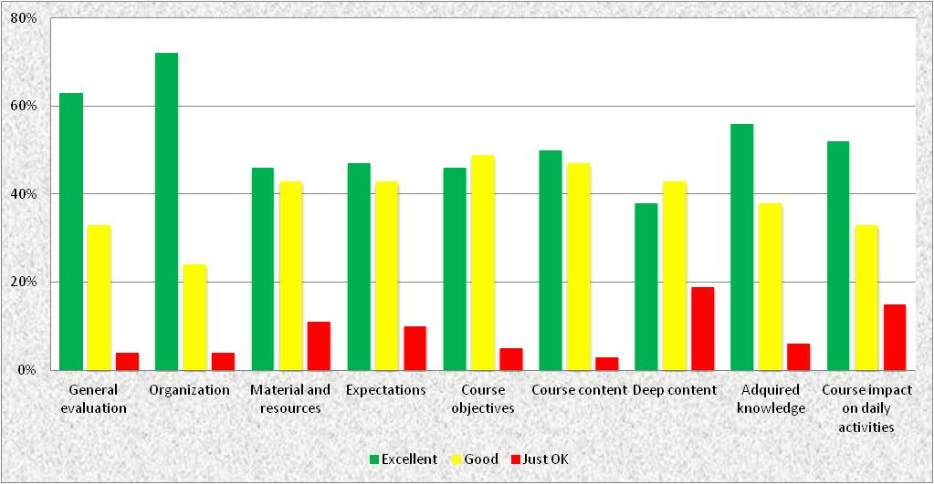
ACADEMIC ACTIVITIES ASSESSMENT

Slide 14
SWOT ANALYSIS: STRENGTHS, WEAKNESSES, OPPORTUNITIES, AND THREATS
 | STRENGTHS Commitment of management and instructors for VLab activities. Access to IT tools for e-learning. | WEAKNESS Competing activities: research vs. outreach activities. Lack of knowledge on IT tools for practical activities and evaluation.
OPPORTUNITIES High number of specialists on Atmospheric Remote Sensing. High demand on the user’s side. | Expand VLab activities. Creation of RFG on Portuguese-speaking countries (tropical meteorology?) Event week. | Develop advanced course on MOODLE and other e-learning software. Provide training to improve training skills on using tools for e-learning. Improve visibility of VLab activities.
THREATS Lack of genuine resources for maintaining the VLab (a fee is charged to the courses). | Interact with management for funding VLab Activities. Submit proposals for funding at external agencies: (FP7/UNESCO/COSPAR) | Less number of courses/activities to explore new tool functionalities.

Slide 15
COE BRAZIL BRIEF SUMMARY
Following our main objective:
PROVIDE EDUCATION AND TRAINING IN SATELLITE METEOROLOGY FOR THE PORTUGUESE-SPEAKING COUNTRIES.
ACHIEVEMENTS | DIFFICULTIES
More participants. More courses. Portuguese speaking countries and also Spanish speaking countries were attended. Stronger links with Universities and other Institutions. | Lack of a fixed budget. Instructors with competing activities. Need for improving our knowledge on IT tools.
WE CONSIDER THOSE ISSUES AS AN OPPORTUNITY TO FIND CREATIVE SOLUTIONS.

