Slide 1
Satellite data Sharing and Service in NSMC/ CMA
LIU Jian
National Satellite Meteorological Center, CMA

Slide 2
Satellite Data Sharing and Service
Satellite data sharing
Satellite data application tools
Support for training
National Satellite Meteorological Center ,CMA

Slide 3
Satellite Data Sharing and Service
Satellite data sharing
Satellite data application tools
Support for training
National Satellite Meteorological Center ,CMA

Slide 4
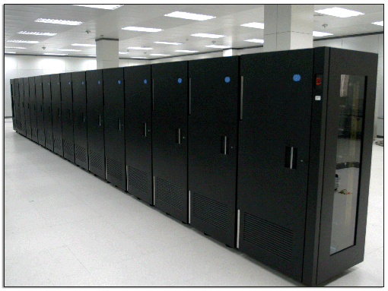
1 Satellite Data Resource in NSMC
Archived ability :
Tape Library with
28 tape drivers, 5000 tapes
Archived data : total 3.2PB
0.5GB/ day in 1987
6400
3200GB/ day in 2011
National Satellite Meteorological Center ,CMA

Slide 5
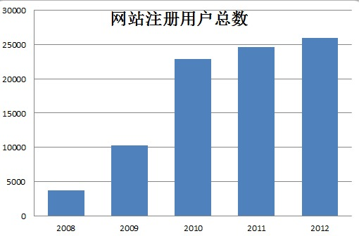
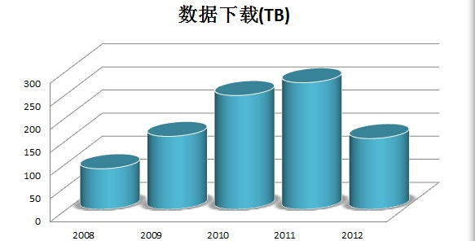
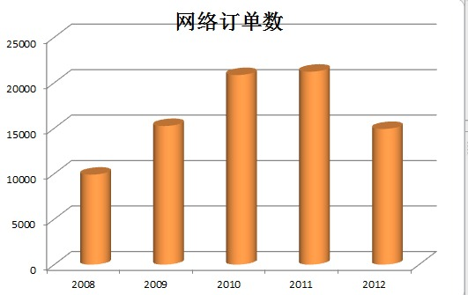
1 Satellite Data Service and Sharing in NSMC/CMA
National Satellite Meteorological Center ,CMA

Slide 6
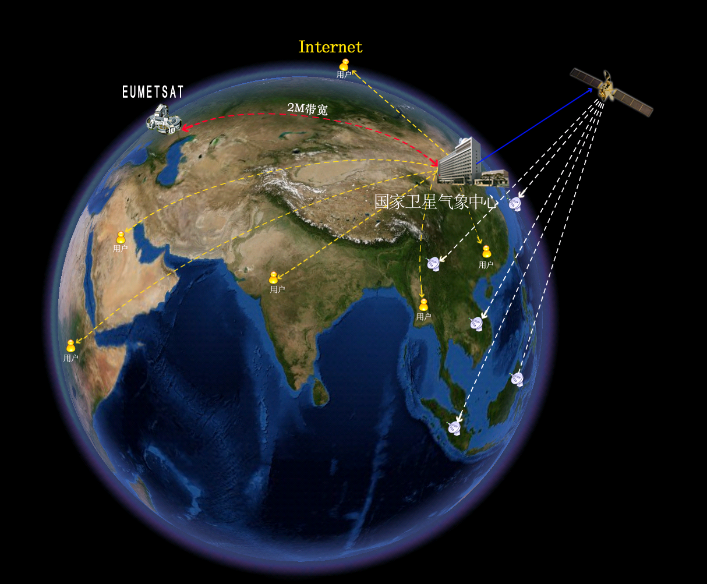
CMACast
全方位的数据共享服务

Slide 7
1 Satellite Data Service and Sharing in NSMC/CMA
Website-based Data Service
Web page：http://satellite.cma.gov.cn
users can browse, retrieve and download all available near real-time satellite data and products from NSMC archives.
25,000 users have registered the NSMC data service system, and download approximately 320TB data / year.
National Satellite Meteorological Center ,CMA

Slide 8
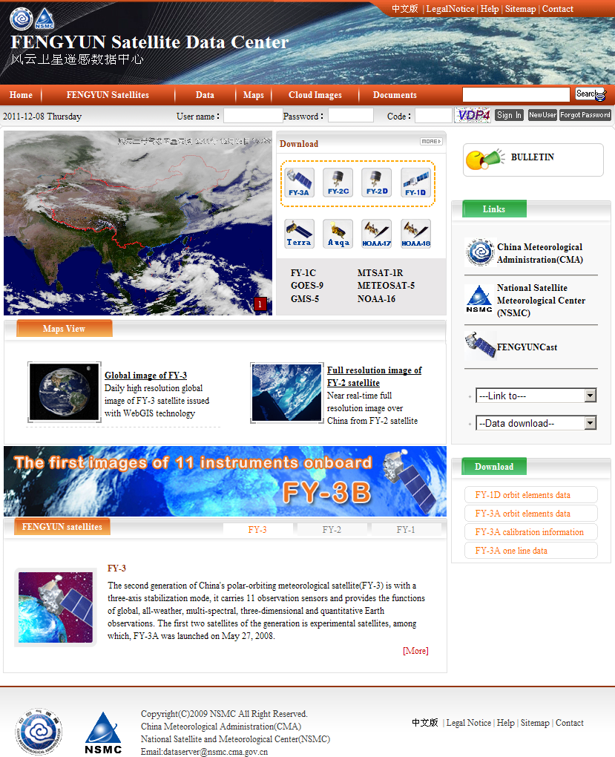
1 Satellite Data Service and Sharing in NSMC/CMA
--Satellite
----Instrument
-----Product type
-------Date and Time
---------Coverage
Most satellite data available on this website can be searched without login, except for a few data.
Prior to data subscription and download, it is required to register on the website as a legal user and go through the login verification.
All data subscriptions have to be made by submitting a subscription form. Various data can be listed in each subscription form.
http://satellite.cma.gov.cn
National Satellite Meteorological Center ,CMA

Slide 9
1 Satellite Data Service and Sharing in NSMC/CMA
CMACast is based on DVB-S2 technology with both file and multimedia transmission capability. It uses an entire 36MHz C-band transponder of AsiaSat-4 to distribute meteorological data and satellite sensing data to users in China and Asia-Pacific region at 70Mbps data rate.
Satellite Based Data Broadcast System
National Satellite Meteorological Center ,CMA

Slide 10
1 Satellite Data Service and Sharing in NSMC/CMA
CMA data provided to EUMETSAT – FY-2E, FY-3A/3B
 | Products
1 | FY-2E nominal data (hourly data)
2 | FY-2E atmospheric Motion Vectors (infrared,water vapour, 6 hourly data)
3 | FY-2E precipitation estimate (6 hourly, 24 hourly data)
4 | FY-2E black boday brightness temperature (hourly, daily, 5 days, 10 days, monthly data)
5 | FY-2E total cloud cover (hourly data)
6 | FY-2E precipitable water from a clear sky (3 hourly data)
7 | FY-2E surface incidence solar radiation (daily data)
8 | FY-2E cloud land moisture profile (3 hourly data)
9 | FY-2E could type(hourly data)
10 | FY-2E snow cover(daily data)
11 | FY-2E outgoing longwave radiation (3 hourly, daily, 5 days, 10 days, monthly data)
12 | FY-3A/3B MWTS 1b data
13 | FY-3A/3B MWHS 1b data
National Satellite Meteorological Center ,CMA

Slide 11
1 Satellite Data Service and Sharing in NSMC/CMA
EUMETSAT data received via RMDCN and Internet– METOP-A, METEOSAT-7/9, NOAA16/17/18/19 ,GOES-11/12/15
 | Products
1 | METEOSAT 7 (VIS, WV, IR) , hourly data
2 | METEOSAT 7 (VIS, WV, IR) , half-hourly data
3 | METEOSAT9 (VIS,HRV,WV,IR) HRIT, hourly data
4 | METEOSAT 9 MPEF (CLM, GII, AMV, CLA, CLAI, CTH, TH, TOZ, CRM)
5 | Foreign Satellite Data (GOES 11, 12,and 15) , hourly data
6 | METOP A (AMSU-A, GRAS, HIRS, IASI, MHS, ASCAT)
7 | NOAA 16, 17,18, 19 (AMSU-A, AMSU-B, HIRS, MHS), regional and global data
National Satellite Meteorological Center ,CMA

Slide 12
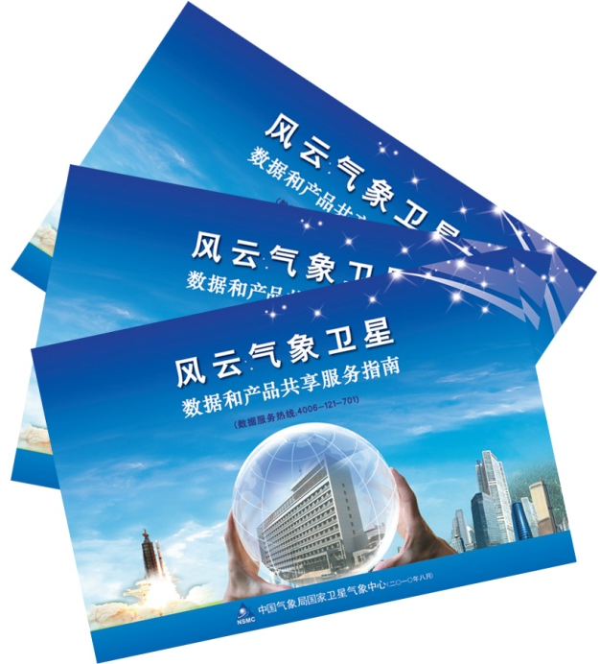
1 Satellite Data Service and Sharing in NSMC/CMA
User mannual for satellite data
FY satellite images per month
National Satellite Meteorological Center ,CMA

Slide 13
Satellite Data Sharing and Service
Satellite data sharing
Satellite data application tools
Support for training
National Satellite Meteorological Center ,CMA

Slide 14
Satellite Data Sharing and Service
Satellite data sharing
Satellite data application tools
FengYun Tool kit
FY-2Satellite Weather Application platform（SWAP)
FY-3 Satellite Monitoring Analysis & remote sensing Toolkit(SMART)
Support for training
National Satellite Meteorological Center ,CMA

Slide 15
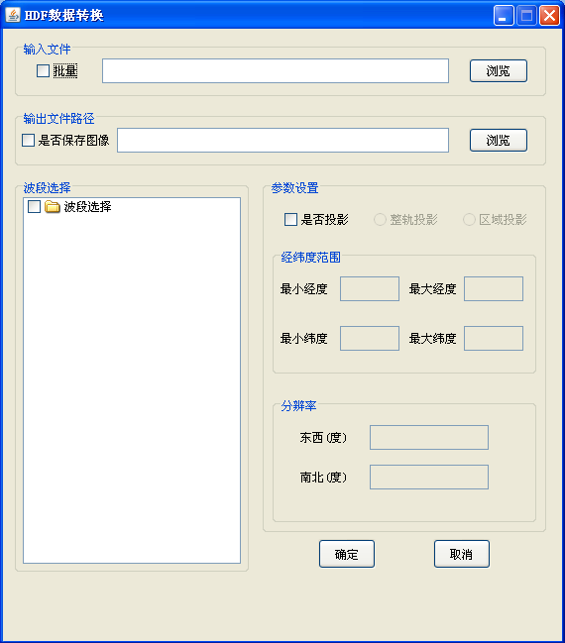
2 Satellite data application tools
National Satellite Meteorological Center ,CMA

Slide 16
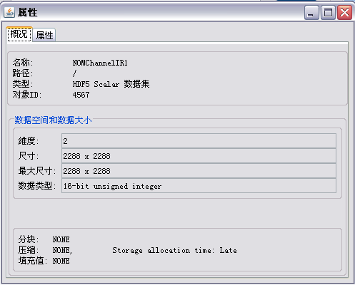
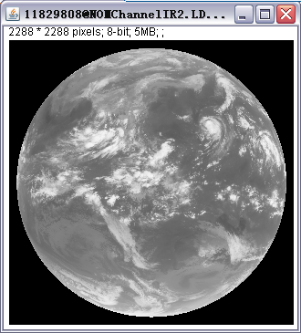
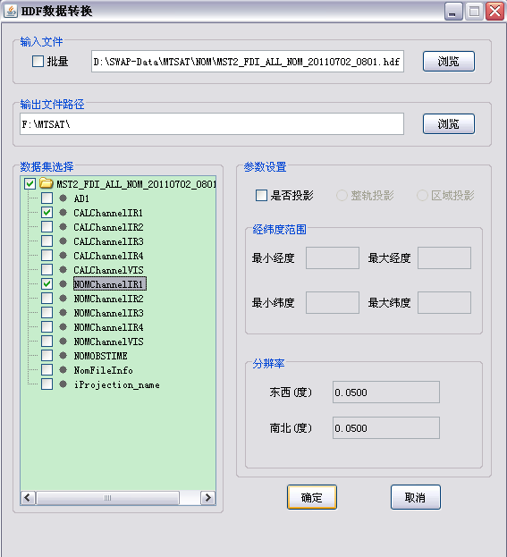
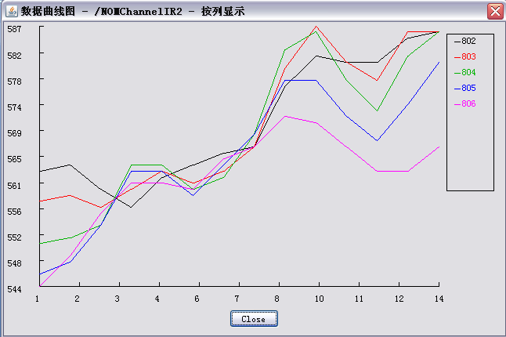
2 Satellite data application tools
FENGYUN Tool Kit
Function:
read data (HDF4, HDF 5)
transfer projection
save data as RAW format & JPEG image
simple statistic & calculation
review data properties

Slide 17
2 Satellite data application tools
FY-2Satellite Weather Application platform（SWAP)
1、flexible basic framework
Component development & modular deployment
Simply & open framework
2、enhanced data processing
Multi source spatial data uniform loading
Massive, multi-source and multi-format data processing and display
image enhancement, animation and correlation analysis for huge data
3、 Expansion of professional tools
Tropical cyclone analysis tool
Rain Storm tracking and extrapolation

Slide 18
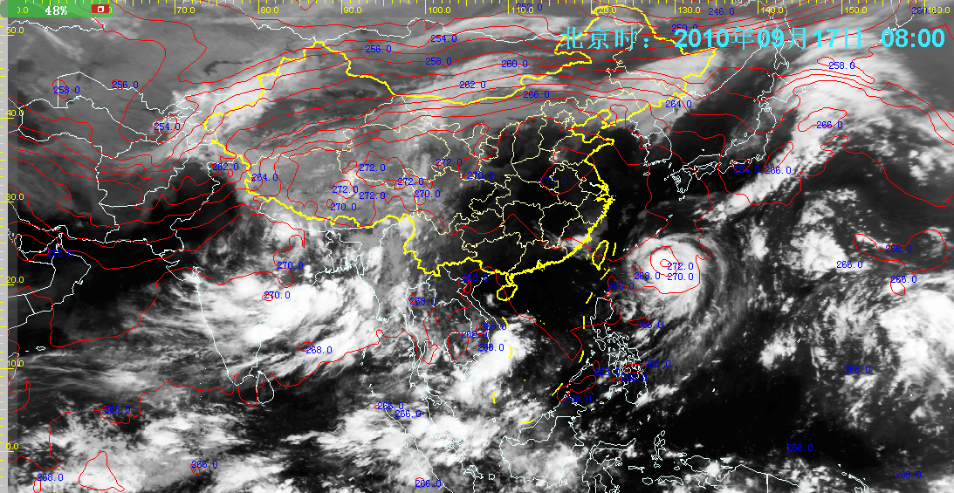
SWAP-Surface observation data overlay the satellite image
2 Satellite data application tools
中国区域叠加温度场动画
National Satellite Meteorological Center ,CMA

Slide 19
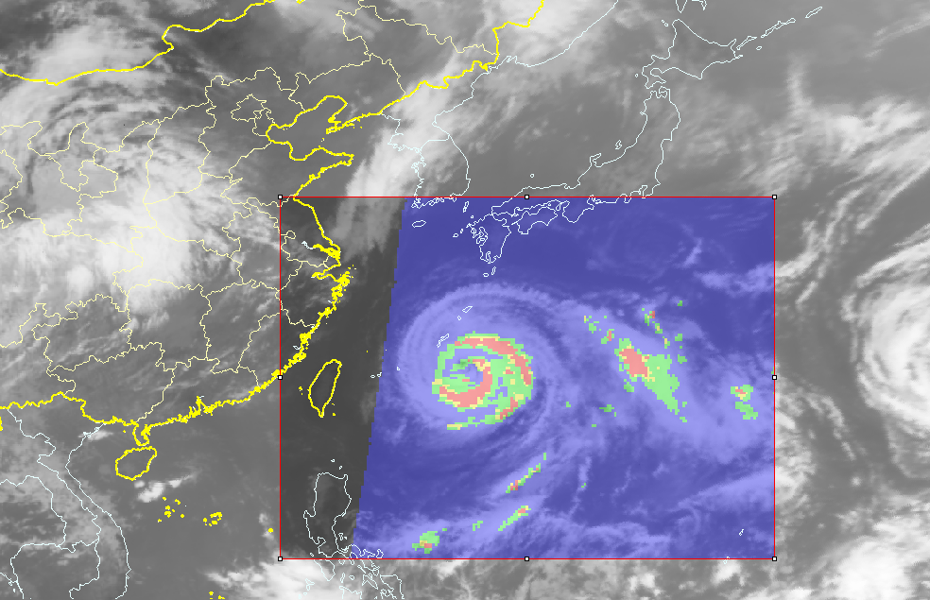
2 Satellite data application tools
SWAP-multisource data overlay display
National Satellite Meteorological Center ,CMA

Slide 20
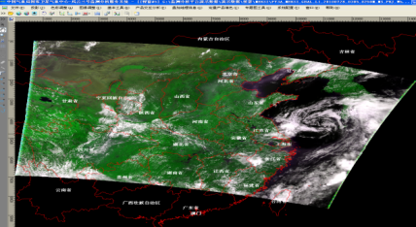
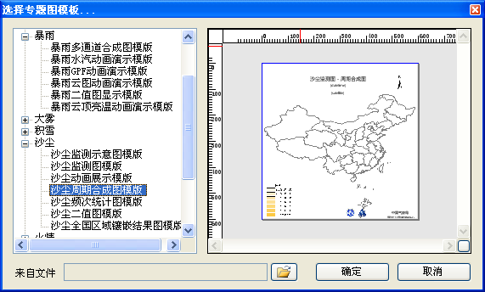
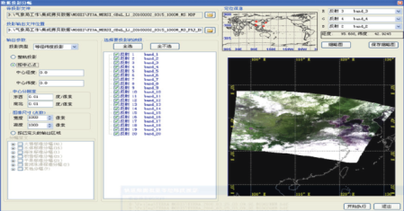
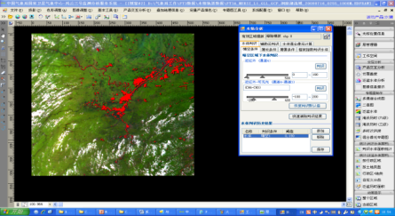
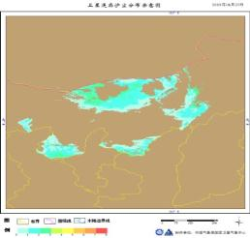
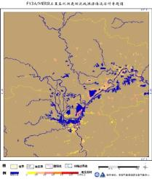
2 Satellite data application tools
FY-3 Satellite Monitoring Analysis & remote sensing Toolkit(SMART)
源图像
目标图像
匹配后图像
Read & display data
Remote sensing data processing
Remote sensing image processing
Monitoring analysis
product produced
Product service
National Satellite Meteorological Center ,CMA

Slide 21
Satellite Data Sharing and Service
Satellite data sharing
Satellite data application tools
Support for training
National Satellite Meteorological Center ,CMA

Slide 22
Satellite Data Sharing and Service
Satellite data sharing
Satellite data application tools
Support for training
Historical data re-processing and build long term data set
Training events
National Satellite Meteorological Center ,CMA

Slide 23
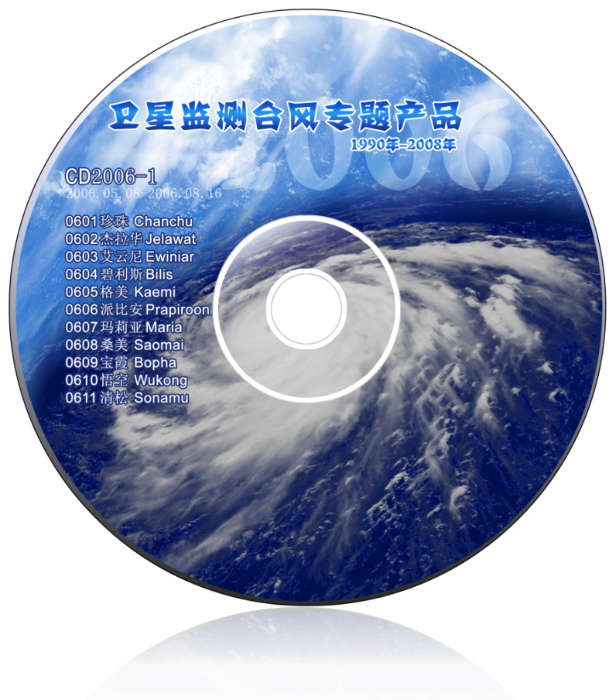
3 support for training
Typical cyclone images
台风个数 | CD-年、编号 | 台风个数 | CD-编号
22 | CD2008-1/-2 | 12 | CD1998-1
23 | CD2007-1/-2 | 24 | CD1997-1/-2
24 | CD2006-1/-2 | 24 | CD1996-1/-2
23 | CD2005-1/-2 | 22 | CD1995-1/-2
2 | CD2003-1 | 35 | CD1994-1
23 | CD2002-1 | 28 | CD1993-1
25 | CD2001-1 | 30 | CD1992-1
21 | CD2000-1 | 29 | CD1991-1
17 | CD1999-1 | 28 | CD1990-1
National Satellite Meteorological Center ,CMA

Slide 24
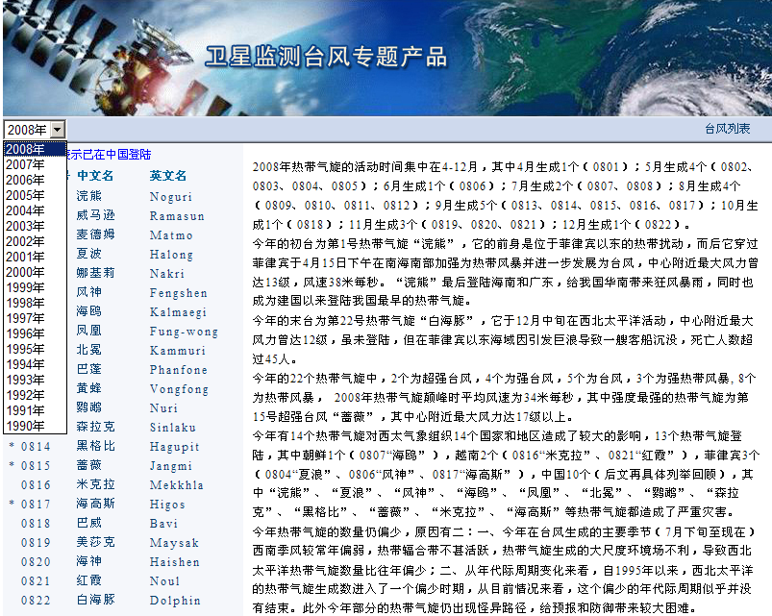
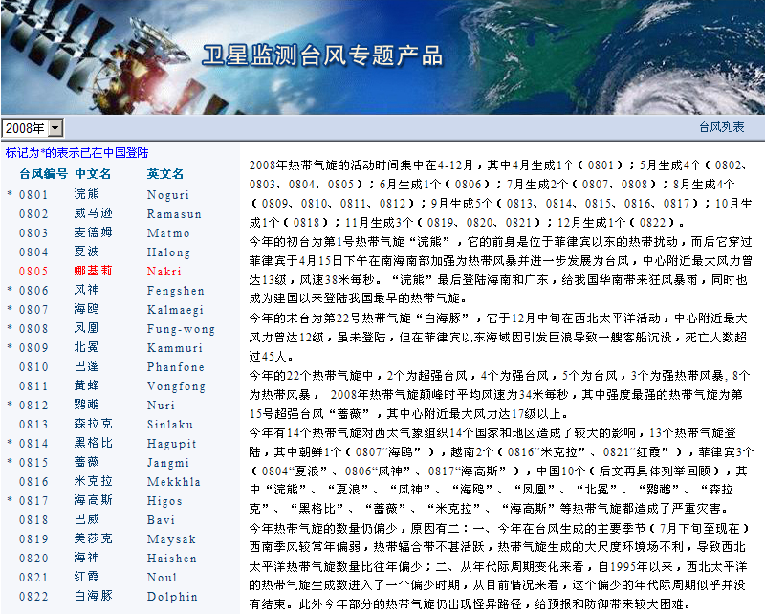
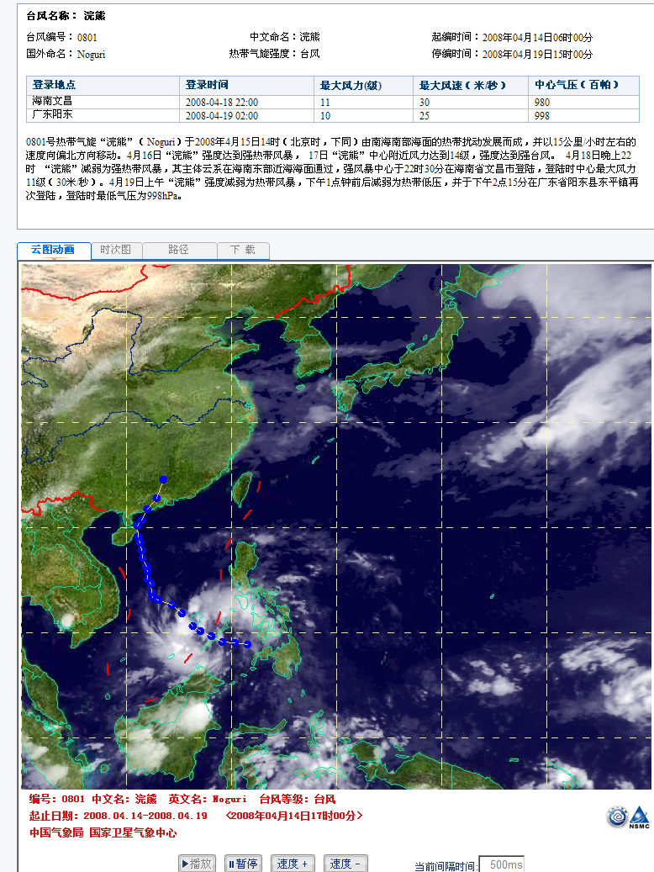

Slide 25
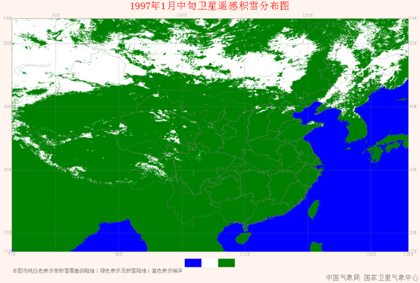
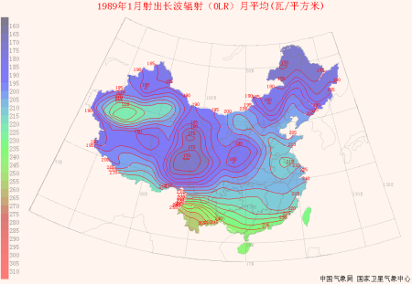
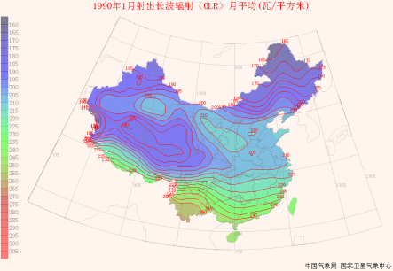
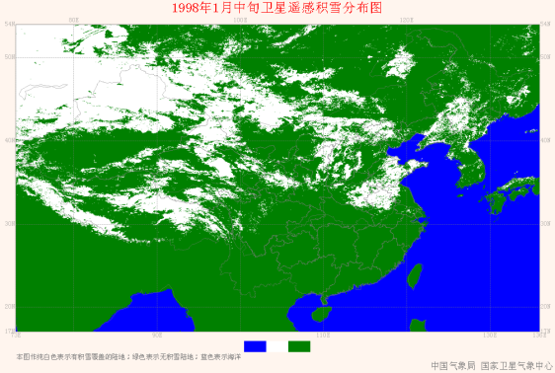
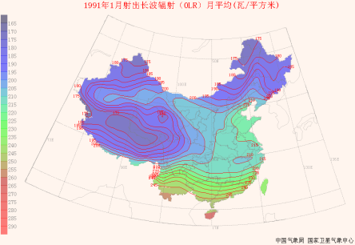
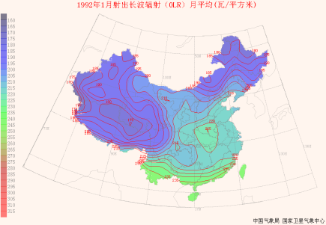
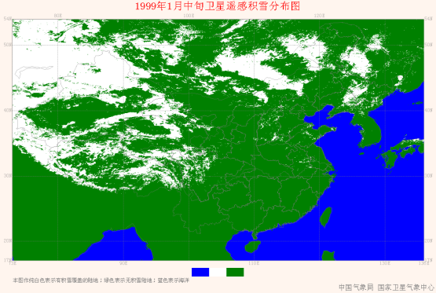
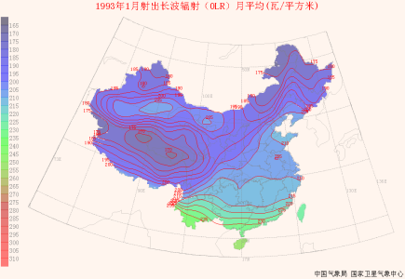
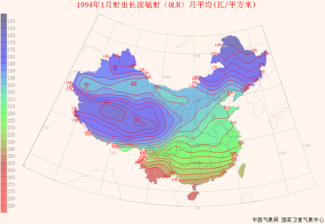
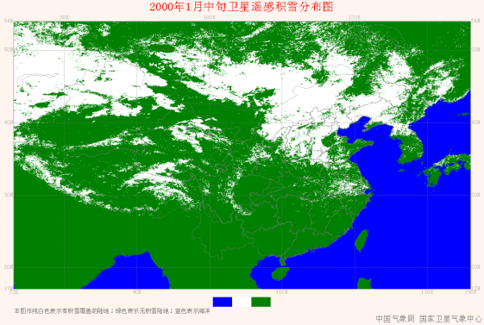
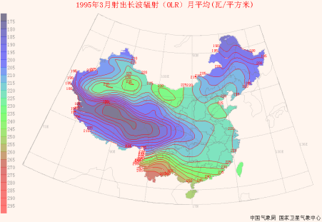
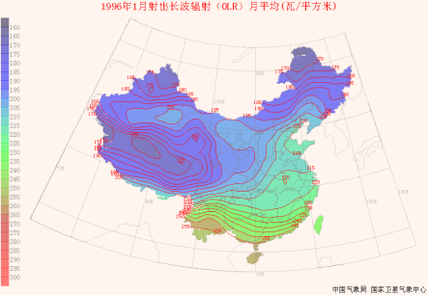
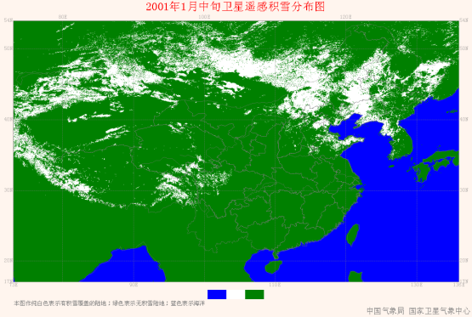
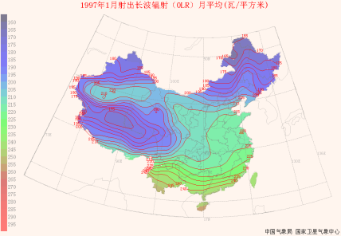
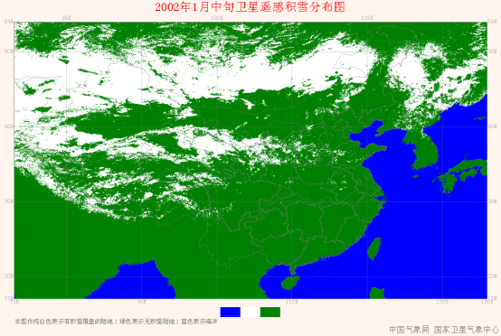
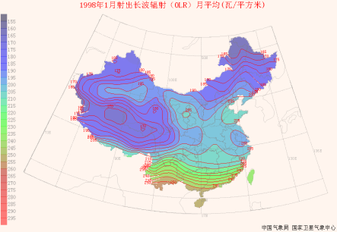
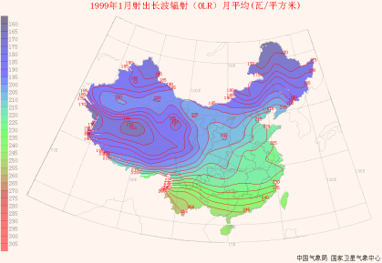
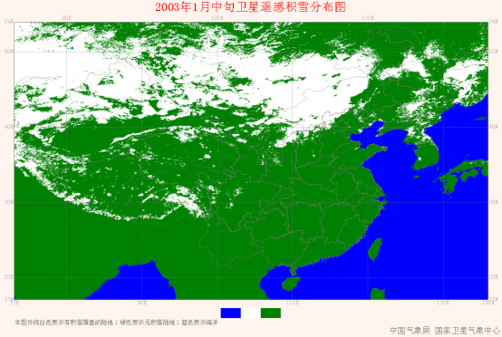
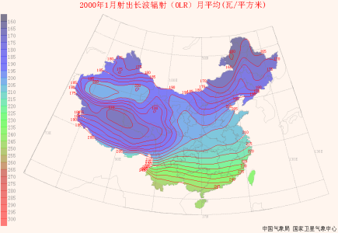
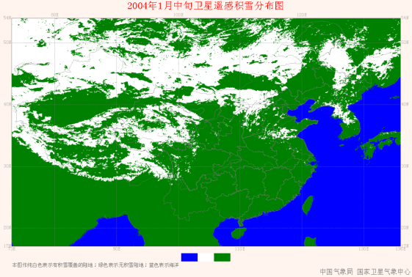
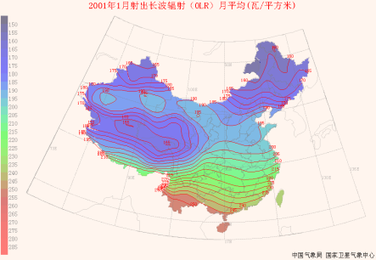
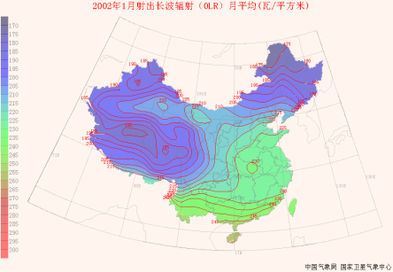
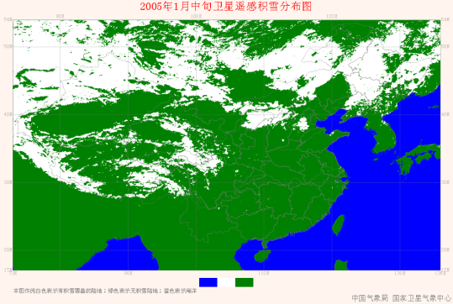
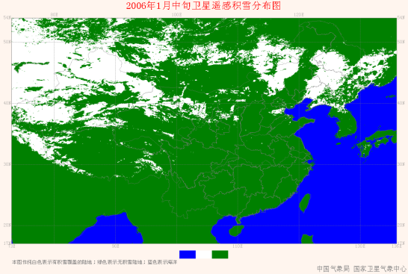
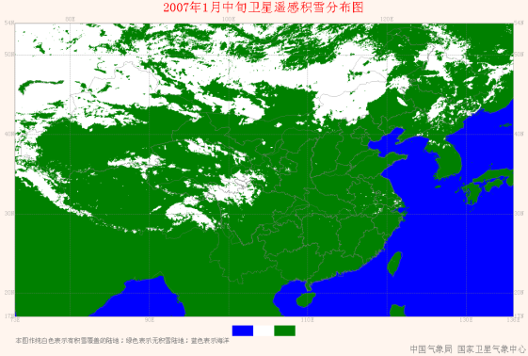
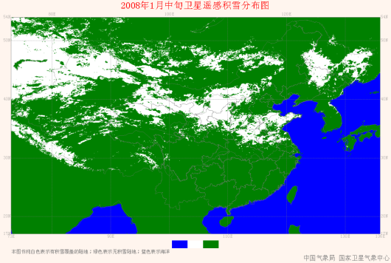
3 support for training
Long term data processed OLR (left),snow(right)

Slide 26
3 support for training
April 18-29 2011, Nanjing, International Satellite Application training.
International Training Course on “Application of Meteorological Satellites in Disaster Mitigation and Environmental Studies, in Beijing, China, from 22 October to 2 November 2012.
Satellite application in weather forecast: forecaster

Slide 27
Thanks for your Attention

