Slide 1
KMA’s Training Activities
Korea Meteorological Administration
National Meteorological Satellite Center

Slide 2
Domestic Training Program
Expert training program for forecasters
Satellite image analysis, remote sensing etc
Operation of cyber lecture course
Satellite meteorology for KMA staff
Specialized education on Satellite
General course on Satellite
Satellite image analysis for weather forecast
Publishing the teaching materials
Standardization text for the level of forecaster
Domestic user group workshop for COMS data utilization since 2006

Slide 3
International Training Program(I)
Objectives
Contribution to increase the use of COMS data for weather forecast
Contribution to reduction of meteorological disasters obtaining satellite related technique and application
Participants
Asian-Pacific region countries
Training courses
COMS image data and products
COMS data processing system and utilization
COMS data service and user stations
COMS system, COMS program progress

Slide 4
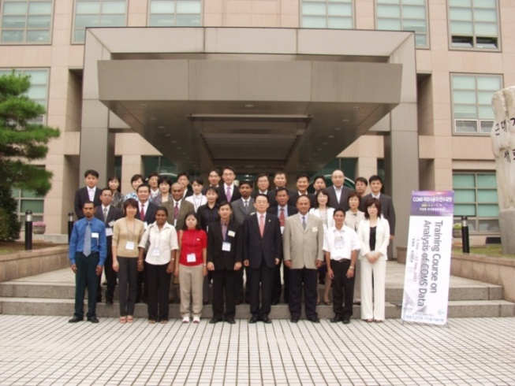
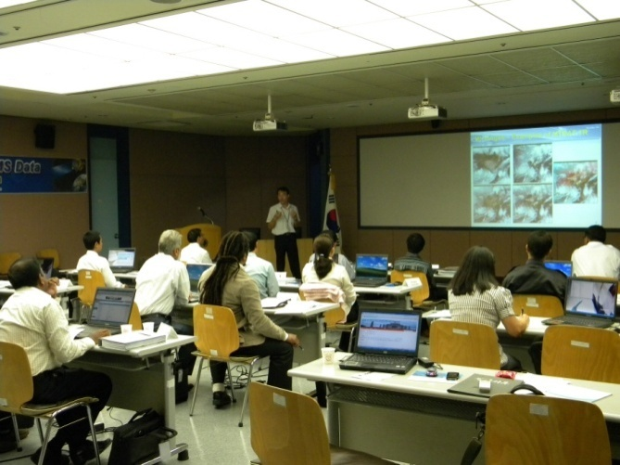
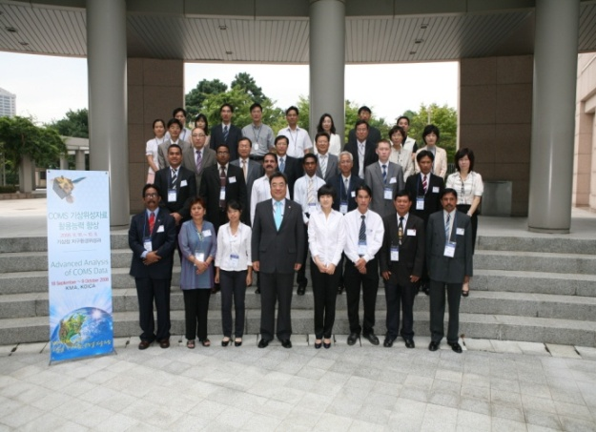
International Training Program(II)
1st : Sep. 2 - 17, 2007 (13 participants/Asia-Pacific 13 countries)
2nd : Sep. 18 - Oct. 9, 2008 (13 participants/12 countries)
3rd : Sep. 3 – 24, 2009 (14 participants/14 countries)
4th : Aug. 26 – Sep. 18, 2010 (19 participants/11 countries)
5th : Sep. 2 – Sep. 22, 2012 (19 participants/13 countries)
2009
2007
2008

Slide 5
Support and contribution
Support for COMS ground system and data processing system and training (2010-2012)
COMS data receiving and processing for L2 products
Modification of the algorithm and application via off-line and on-line
Off-line training of H/W system and S/W algorithm (1st: 2011.11.20-12.3, 2nd: 2012.6.10-23)
→ First country is Sri-Lanka, and expand to Asia-Pacific countries such as Fiji, Philippines, etc.
Contribution to WMO VLab (2012)
WMO VLab Technical Support Office as WMO Trust Fund

Slide 6
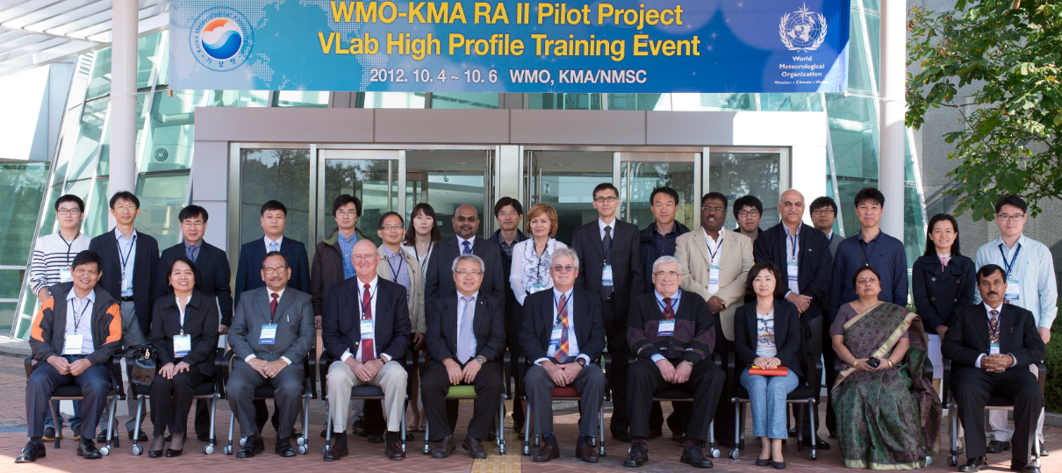
WMO-KMA RA II VLab High Profile Training Event
Date : 2012. 10. 4~6 (3 days) / NMSC, KMA
Contents : WMO SP/VLab, NPP & Exercise, Real Time Weather
Interpreting Satellite ImageryExercise/Analysis,
Satellite & their Orbit, COMS Data/Products(KMA),
COMS Applications(Nowcasting/Tropical Storm),
Rainfall(IPWG)*, Data(CMA/ROSHYDROMET/JMA/EUMETSAT)*
Lecturers : James Purdom, Paul Menzel
IPWG, CMA, ROSHYDROMET, JMA, EUMETSAT, KMA
* On-Line Lecture

Slide 7
Future Plan
Build up the dedicated web pages
Share the previous training materials(Korean to English)
Organize the discussion on the training activities with the COMS data
Establishing online learning system
Utilize the existing methodology
Utilizing/delivering the contents provided by other CoEs
Cooperation with
RAII Pilot Project, Asia/Oceania Satellite User Groups

