Slide 1
Virtual Laboratory Management Group Sixth Meeting - VLMG-6 São José dos Campos, Brazil – 8 to 11 October 2012
NOAA/USA contributions
Presented by: Bernie Connell (CIRA)
For the period: September 2011 to August 2012
Includes contributions from:
US National Weather Service (NWS) Training Division
Cooperative Institute for Research in the Atmosphere (CIRA)
NWS Hydrometeorological Prediction Center (HPC) / International Desks
University Corporation for Atmospheric Research (UCAR) COMET
UCAR at NWS International Activities (IA) Office

Slide 2
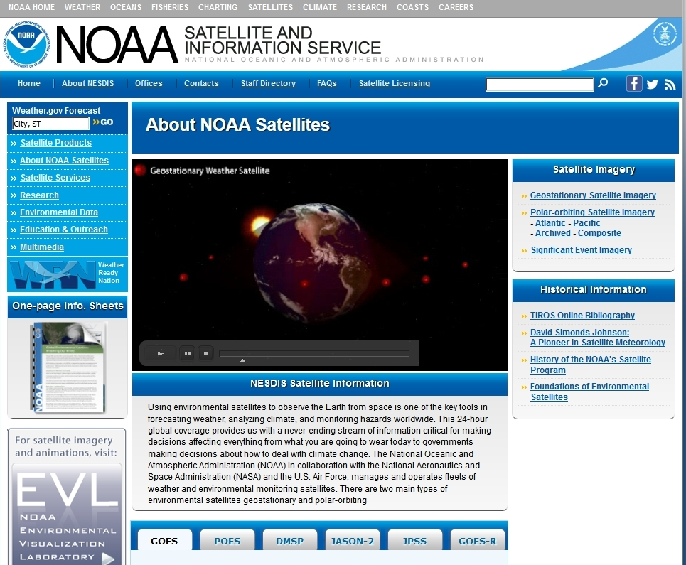
Select
satellite
http://www.nesdis.noaa.gov/SatInformation.html
Notes:
Basic information that I am presenting is readily available – and I am pointing you to this link to get updated information should you need it.

Slide 3
http://www.nesdis.noaa.gov/FlyoutSchedules.html
Notes:
Operational - geostationary
We are in 2012, the next satellite won’t be launched until late 2015 or early 2016.

Slide 4
http://www.nesdis.noaa.gov/FlyoutSchedules.html
Notes:
Operational Polar

Slide 5
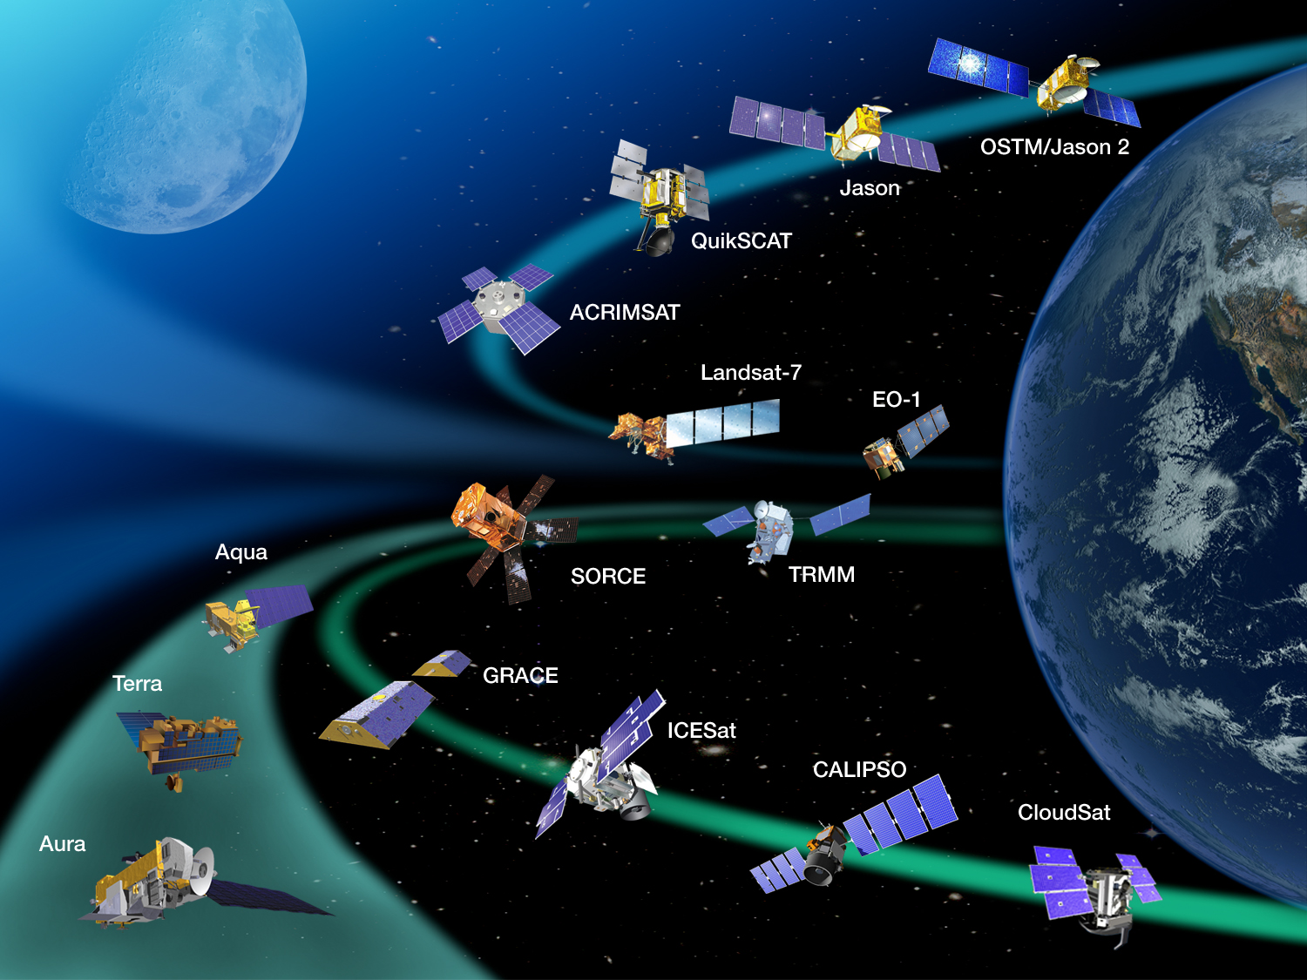
Current NASA Missions
http://www.nasa.gov/missions/current/index.html
5
Notes:
5
Non-operational missions

Slide 6
VLab Activities
Americas and Caribbean Monthly Focus Group (12 sessions) + CIMH (Barbados) led sessions
Contributions to Workshops and Training Events
US Training links
Environmental Science Resource Center (ESRC)
VLab TSO Support: funding and oversight for position via CIRA

Slide 7
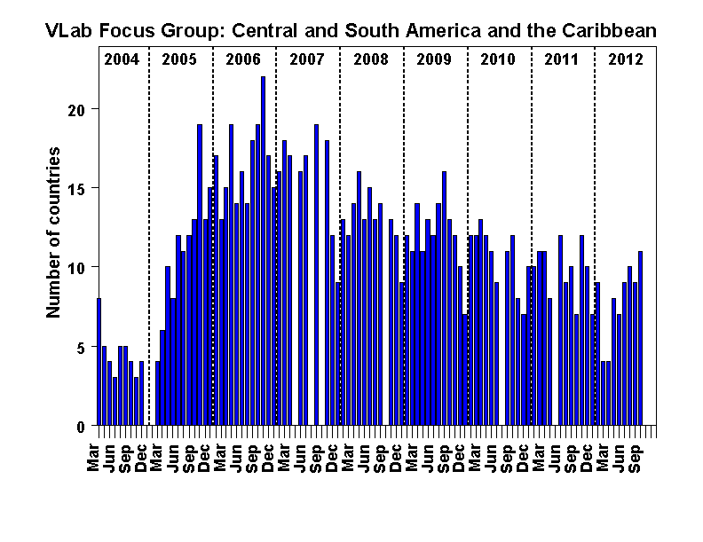
Americas and Caribbean Monthly Focus Group CIRA-WMO VLab http://rammb.cira.colostate.edu/vlab
Notes:
Organizanizing: CIRA
Images for session: CIRA
Lead – Mike Davison; Active organizer participant: Kathy-Ann Cesar and Vilma Castro
Recordings: CIRA

Slide 8
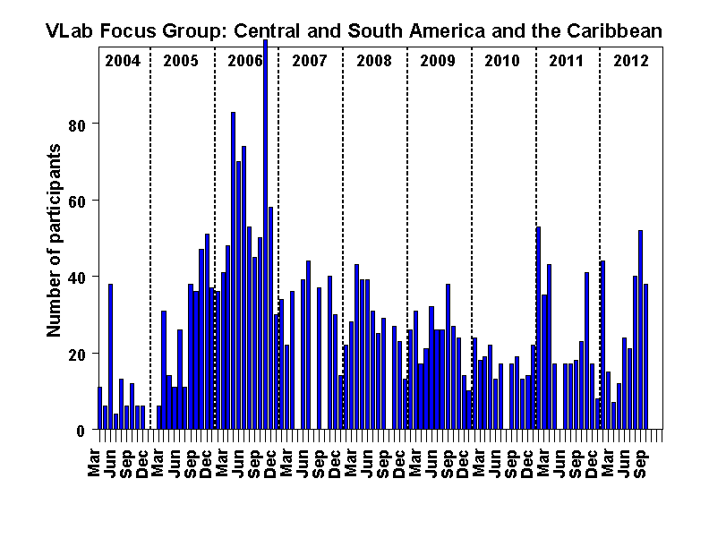
Americas and Caribbean Monthly Focus Group CIRA-WMO VLab http://rammb.cira.colostate.edu/vlab

Slide 9
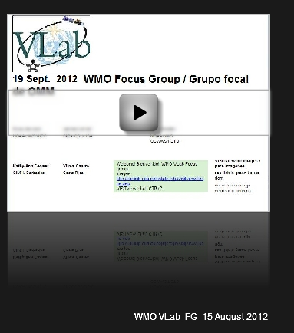
Focus Group Recordings
2012: June - September
http://rammb.cira.colostate.edu/training/rmtc/fg_recording.asp
3 segments from each session were sent through GEONETCast Americas following the Aug. and Sept. sessions.

Slide 10
Lecture and RFG support to training activities
WMO Regional Training Seminar for National Instructors of RA III and RA IV (Aug. 2012)
Workshop on Numerical Weather Prediction and Forecasting (June 2012)
Caribbean Aviation Week (May 2012)
Training on EMWIN and GEONETCast systems (April 2012)
Dust and Ash Week (Oct. 2011)
Aeronautical Continuing Professional Developing Course (Sept. 2011 – May 2012 and Sept. 2012 - May 2013
Training on the Central America Flash Flood Guidance System (Sept. 2011

Slide 11
WMO Regional Training Seminar for National Instructors of RA III and RA IV Lima, Peru, 6 – 17 August 2012
Mike Davison, NOAA/HPC/NCEP, presented lecture/session on:
Capabilities and Limitations of Online Training
VISITview demonstration
Coordinated RFG Americas and Caribbean Session on 15 August

Slide 12
Workshop on Numerical Weather Prediction and Forecasting Mexico City, Mexico 4-8 June 2012
Co-ordinated with Servicio Meteorologico Nacional de Mexico (SNM)
Sponsored by US NWS, WMO, and SMN
9 lectures and 7 exercises covering: Isentropic Surfaces, Upper Level Jets, Satellite Imagery Applications and development of quantitative precipitation forecasting techniques.
US contributors: Mike Davison and Jose Galvex (both HPC International Desks), Rosario Alfaro (UCAR at NWS IA)

Slide 13
Caribbean Aviation Week: 30 April – 3 May 2012
Organizer: Kathy-Ann from CIMH Barbados
Mike Davison, NOAA/HPC/NCEP, presented 2 lectures:
Fronts and Shear Lines
Easterly Waves or TUTT induced Pertubations?

Slide 14
Training on EMWIN and GEONETCast systems April 2012
Hosted by MARN, El Salvador
Sponsored by NOAA/NWS
Presenters: Kelly Sponberg and Rosario Alfaro (both UCAR at NWS IA)
Audience: Forecasters and technicians of MARN

Slide 15
Dust and Ash Week: 24-28 October 2011
EUMETSat organized the week
Tom Lee, Naval Research Lab presented
Dust detection – VIS/IR techniques
Bernie Connell, CIRA presented
Volcanic eruptions: introduction to remote sensing techniques for ash and SO₂ detection

Slide 16
Aeronautical Continuing Professional Developing Course Sept 2011 – May 2012 and Sept 2012 - May 2013
Organizer: Kathy-Ann from CIMH Barbados
Recorded US modules/presentations:
Basic Satellite Interpretation in the Tropics
HPTE Lecture D: Convection
Introduction to GOES-R
In 2012-2013, Moodle is being used through the COMET program.

Slide 17
Training on the Central America Flash Flood Guidance System September 2011
Hosted by Ministerio del Ambiente y Recursos Naturales (MARN), El Salvador
Sponsors: Hydrological Research Center of San Diego and NOAA
US Presenters: Kosta Georgakakos, Theresa Carpenter, and Rochelle Graham (all HRC), and Rosario Alfaro (UCAR at NWS IA)
Audience: meteorologists and hydrologists.

Slide 18
New COMET MetEd Modules directly applicable to the International audience
Writing Effective TAFs in the Caribbean
Tsunami Strike! Caribbean Edition
ASMET: 2009 Drought in East Africa
ASMET: Flooding in West Africa
Monitoring the Climate System with Satellites
ASMET: Satellite Precipitation Products for Hydrological Management in Southern Africa
ESRC (in English, Spanish, French, Russian)
http://www.meted.ucar.edu/esrc/index.php

Slide 19
New Spanish translations of COMET MetEd Modules
Ciclo de vida de las olas II: propagación y dispersión
Fundamentos de radar meteorológico
Tipos de olas y sus características - Actualización de 2012
Suomi NPP: Una nueva generación de satélites de observación ambiental
Impactos del clima espacial en la aviación
Introducción al clima espacial, 2a edición
¡Tsunami a la vista! Edición del Caribe
Sistemas de gestión de la calidad: implementación en servicios meteorológicos
Cenizas volcánicas: impactos en la aviación, el clima, las operaciones marítimas y la sociedad
Cenizas volcánicas: Introducción
GOES-R: beneficios de la observación ambiental de próxima generación
Meteorología satelital: Selección de canales del GOES, vers. 2

Slide 20
New Spanish translations of COMET MetEd Modules
Tsunami: preparación de la comunidad, 2a edición
Cenizas volcánicas: Herramientas de observación y modelos de dispersión
Cenizas volcánicas: Vulcanismo
Introducción a la meteorología tropical, versión 2, Capítulo 4: Variabilidad tropical
Introducción a la meteorología tropical, versión 2, Capítulo 1: Introducción
Introducción a la meteorología tropical, versión 2, Capítulo 2: Aplicaciones de percepción remota en los trópicos
Introducción a la meteorología tropical, versión 2, Capítulo 5: Distribución de la humedad y precipitación
Introducción a la meteorología tropical, versión 2, Capítulo 8: Ciclones tropicales
Introducción a la meteorología tropical, versión 2, Capítulo 9: Observaciones, análisis, predicción
Definición de mesoescala

Slide 21
Training Links
GOES-R Proving Ground
http://www.goes-r.gov/users/proving-ground.html
NWS Training Portal
http://www.nws.noaa.gov/training/
VISIT - Virtual Institute for Satellite Integrated Training http://rammb.cira.colostate.edu/visit/
SHyMet – Satellite Hydrology and Meteorology http://rammb.cira.colostate.edu/training/shymet/
COMET MetEd http://www.meted.ucar.edu
SPoRT – Short-term Prediction Research and Transition Center http://weather.msfc.nasa.gov/sport/training/

Slide 22
Expected Challenges over the next three years
Preparations for GOES-R
Data reception & Display software
Adapting existing GOES-R training on new channels and products for the International community.
Delivering GOES-R training to the International community.
Adding International Component to Satellite Proving Ground

Slide 23
VLab TSO
GRRRRRREAT idea! Wonderful support!
What it took to get it going…
Brazil, NOAA with CIRA, EUMETSAT and WMO Space Programme working together (to setup position using CIRA)!
What is necessary to keep it going…

