Slide 1
Partnership VLAB + GEO + CEOS
Hilcéa Ferreira
Earth Observation Directorate – OBT-INPE
hilcea@dpi.inpe.br

Slide 2
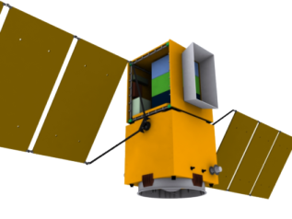
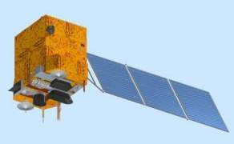
INPE’s space technology agenda
“Global EO” – Brazil as global player in earth observation
Bilateral agreements
(China, Argentina, UK)
Multilateral Agreements
(CEOS, GEO)

Slide 3
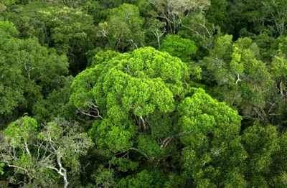
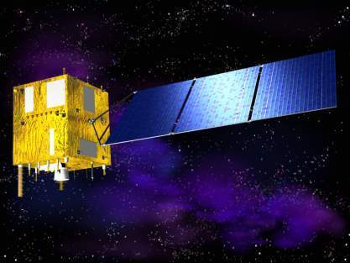
A vision for the future
A constellation of satellites will provide free global land imaging for all countries on Earth (CEOS)
CBERS is a key member of the land imaging constellation

Slide 4
Earth Observation at INPE
Remote Sensing Ground Station
CBERS Chinese Brazilian Satellite
Remote Sensing Data Centre
Remote Sensing Research and Applications
GIS Technology Research and Applications
Capacity Building: graduate courses, short courses in GIS and Remote Sensing, face to face and distance learning
Environmental Modelling

Slide 5
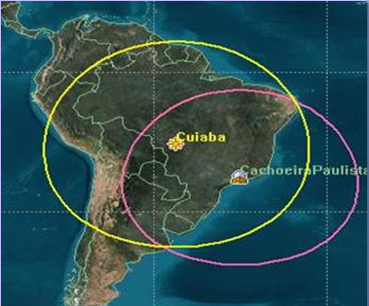
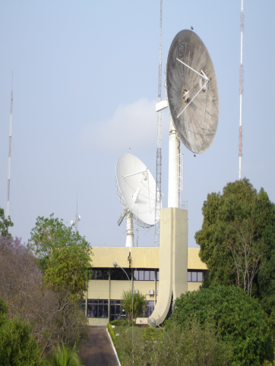
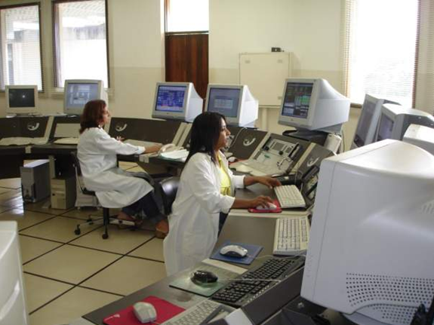
Systems on the Ground
Satellite Data Reception Station – Cuiabá
Centre for satellite control

Slide 6
Policy for CBERS International Data Downlink
Access fee is charged on a LANDSAT-like basis
One flat annual fee for complete access to all data in the antenna’s footprint
Distribution in areas within the antenna’s footprint is the responsibility of the ground station operator
There is no additional charge for image distribution
Ground station operators are encouraged to distribute CBERS data free of charge on the Web

Slide 7
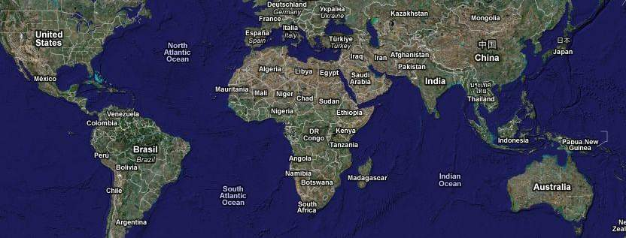
CBERS: a global satellite
Urumchi
Miyun
Maspalomas
Aswan
Ghuangzhou
Chetumal
Bangcoc
Boa Vista
Gabon(?)
Nairobi(?)
Darwin(?)
Cuiabá
Alice Springs (?)
Jo´burg
Current CBERS reception stations (solid lines) and planned stations (dashed lines) cover all tropical areas worldwide

Slide 8
Remote Sensing Data Centre
MSS-LANDSAT: 1973 - 1983
Available for free on the web
http://www.dgi.inpe.br/CatalogoMSS/
TM/ETM-LANDSAT: 1984 - 2000
Being placed on-line (free access) until the end of 2005
CBERS-2B
Available for free on the web (http://www.dgi.inpe.br/CDSR/)
MODIS
Being placed on-line (free access) until the end of 2005
ResourceSat-1
Available since 2009: 25.892 scenes (5.133 AWIFS and 20.759 LISS-3)

Slide 9
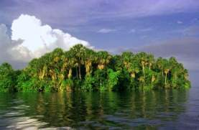
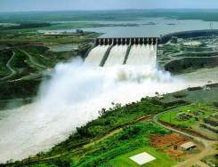
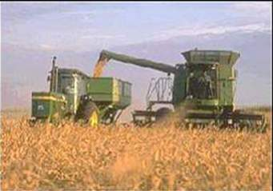
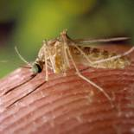
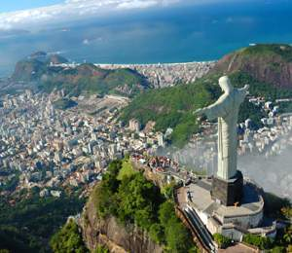
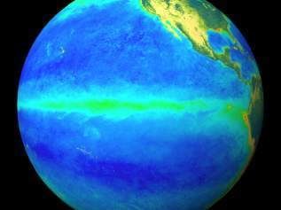
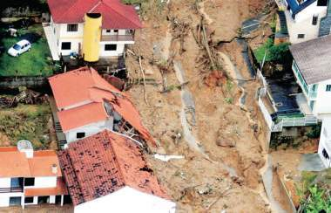
Contribution to different fields
Energy
Ecosystems
Agriculture
Health
Weather
Civil Defense
Urban Management

Slide 10
Earth Observation in Brazil
Amazonian Rain Forest
Human actions are modifying environmental conditions
Semi-Arid North-East
Period droughts affect 25% of Brazilian Population
SouthEast and Central Regions
Crop forecasting and yield estimation are crucial information needs
Large Urban Settlements
Increasing intra-urban social exclusion and environmental vulnerability
Remote Sensing and GIS Technologies are essential from management of Brazilian territory

Slide 11
GIS Technology R&D
SPRING: GIS (http://www.dpi.inpe.br/spring)
Open geospatial technologies and open standards
TerraLib((http://www.terralib.org/index.php): a functions library developed in C++ that allows a collaborative environment and its use for the development of multiple GIS tools.
TerraView
TerraMA2: Open Plataform for Monitoring, Analysis and Alert Systems
TerraHidro: tool built on TerraLib´s library, designed to develop distributed hydrological models, using elevation and hydrological data
TerraAmazon – open source software for large-scale land change monitoring

Slide 12
Remote Sensing Education at INPE
Graduate Program in Remote Sensing (MsC and PhD)
400+ graduate students
Short Courses in GIS and Remote Sensing (40 h)
www.dpi.inpe.br/cursos
Establishment, in 2004, of a distance learning program in GIS and Remote Sensing
500+ trained people
On-line material (books, overheads)

Slide 13
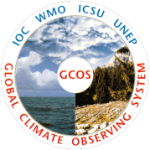
What is CEOS?
28 space agencies
20 participating organizations

Slide 14
INPE: CEOS and GEO
CEOS – Chair in 2010
Secretariat Member
Calibration and
Validation
WGCV
Capacity Building
and Data Democracy
WGCapD
Information Systems
and Services
WGISS
Constellations
Land Surface Imaging
Ocean Color Radiometry
GEO – Task Lead
GEO – Implementation Boards
CBERS
Ground Stations
Data Democracy
Forest Carbon Task
(FCT)
Institutions and
Development
Executive Committee

Slide 15
VLAB and GEO
GEO 2012-2015 Workplan: Developing Institutional and Individual Capacity
Priority Action
Coordinate capacity building components across Societal Benefit Areas:
Organize summer schools or training workshops within and/or across Societal Benefit Areas (and related areas), e.g. Disasters, Health, Energy, Climate, Agriculture, Forest Monitoring.
Build upon ongoing regional activities such as the CLIVAR program for Latin America, and global activities such as the WMO/CGMS Virtual Laboratory on Education in Satellite Meteorology (VLab).

Slide 16
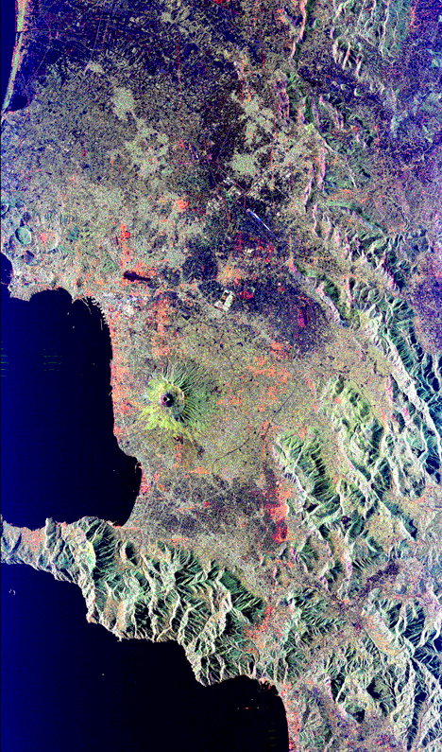
CEOS: The Birth of Data Democracy
Initiated within CEOS in 2008 by CSIR
First Steps Towards DD
CBERS free data policy in Brazil - 2004
CBERS Data for Africa – 2007
Landsat for Free – 2008
Reconstitution of CEOS WGCapD to focus on DD: 2011
WGCapD is focused on building capacity for the effective use of EO data as well as providing wider and easier access to those data

Slide 17
Data democracy explored
Data
Democracy
Data Access
Data Dissemination
Capacity Development
Software Tools
Illustrated through the exploration of the WGCapD activities

Slide 18
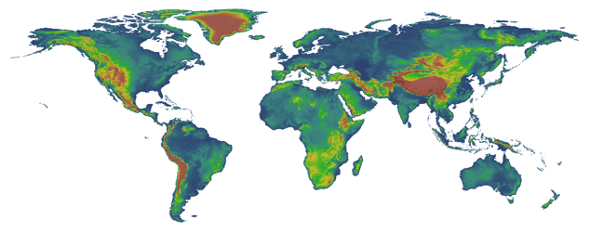
Data Access: DEM Development Project
Digital Elevation Models (DEMs) Development Project
Work within the United States agencies to make previously unavailable Level 2, 1 arc second (30m) elevation data gathered on the Space Shuttle Radar Topography Mission (SRTM) available to certain countries
Deliver to underserved communities in developing regions of the world

Slide 19
VLAB and CEOS: Possible partnership with Capacity development: DEM workshops and E-Learning Courses
Regional workshops across the world utilizing the SRTM 2 data
Train participants on how to utilize the data in capacity building workshops
Focus of workshops will be on flash flood forecasting and settlement planning
First workshop planned in Nairobi, Kenya
Maximize the skillsets and contributions of a range of partners: RCMRD, INPE, SANSA, NOAA, NASA/SERVIR, USGS, Secure World Foundation
E-Learning Course
180 hour courses that target university professors in the sciences to teach them the benefits of incorporating EO into their classes
Use of data sets that are normally restricted
Taught by consortium of CEOS agencies and partners
Supported by INPE in Brazil

Slide 20
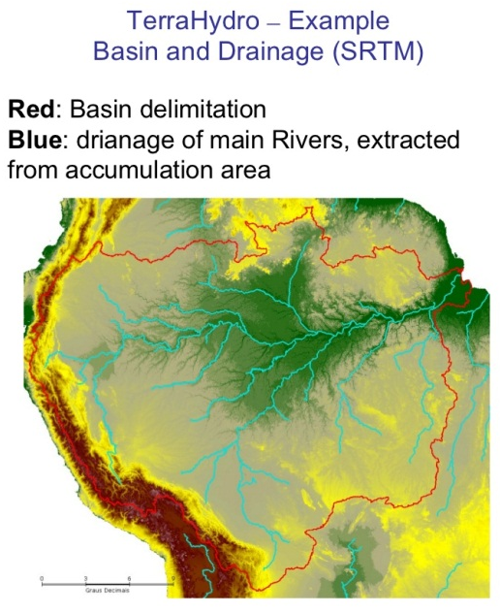
Software Tools: Open Source software
Regional DEM Development Workshops
Train on open source software tools that all users can (TerraHidro, TerraMA2, SPRING)
E-Learning Course
SPRING
SOPI
ORFEU Tool box

Slide 21
Data dissemination: GEONETCast
GEONETCast is a low cost satellite-based data and product dissemination system
WGCapD support of GNC
GEONETCast Americas Forum
GEO Plenary side event
Focus on the end users
Synergies, issues, improvements
DEM Development Project
Work with regional GEONETCast provider to ensure that appropriate agencies have ability to receive and transmit data as necessary

Slide 22
Discussions
Networking
Learn from VLAB experience – Best Practices!

