Slide 1
Virtual Laboratory Management Group Sixth Meeting - VLMG-6 São José dos Campos, Brazil – 8 to 11 October 2012
RFG DISCUSSION
Includes contributions from:
Focus Group Americas and the Caribbean
Supporters: CIRA, HPC/NCEP Int. Desks, US NWS Training Division
Barbados CoE, Costa Rica CoE

Slide 2
Tools Used
FG Americas and Caribbean
Email list (252 members)
VISITview + voice from GoToWebinar
Both are “freely” available to us.
Using both helps with bandwidth issues.
GoToWebinar does not have adequate point and draw tools for the audience.

Slide 3
Positive Outcomes
FG Americas and Caribbean
Builds community.
An easy way to communicate across boundaries: physical, institutional, and social.
We are still conducting sessions!
Sharing information about satellite anomalies and switches.
When the lead is unavailable, the community fills in.

Slide 4
Difficulties
FG Americas and Caribbean
Increased workload = reduced time for session
Earthquake
Problems with software or internet
Accident
Uncomfortable pauses when starting out.

Slide 5
Suggestions for others
Good sound/voice and imagery viewing
Collaborate – share the workload
Use “local” advocates to increase participation
Schedule sessions with face to face training events
Welcoming environment

Slide 6
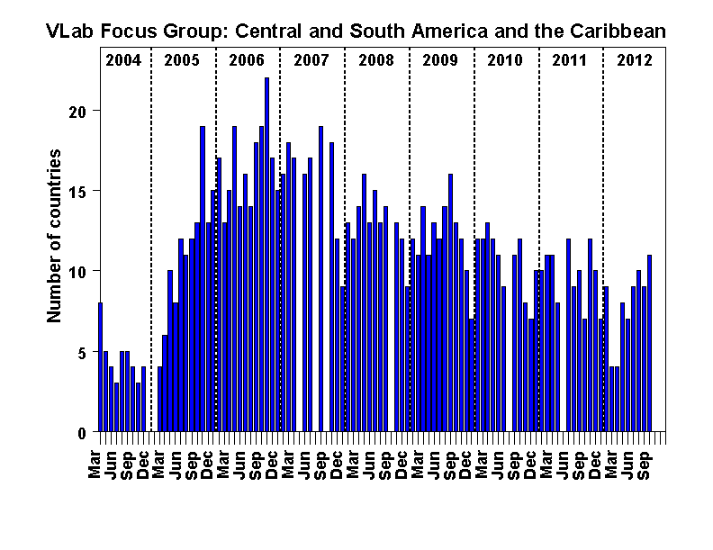
Americas and Caribbean Monthly Focus Group CIRA-WMO VLab http://rammb.cira.colostate.edu/vlab

Slide 7
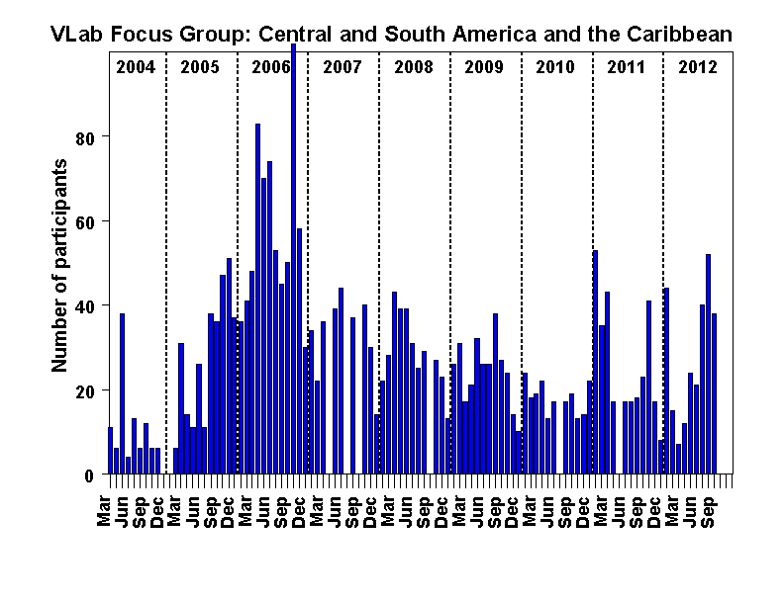
Americas and Caribbean Monthly Focus Group CIRA-WMO VLab http://rammb.cira.colostate.edu/vlab

Slide 8
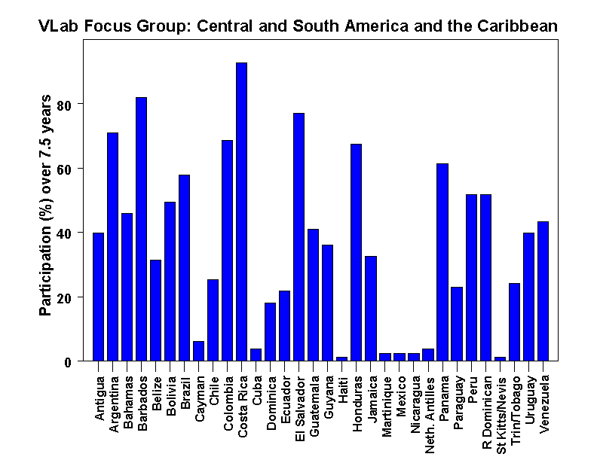
Americas and Caribbean Monthly Focus Group CIRA-WMO VLab http://rammb.cira.colostate.edu/vlab

Slide 9
Virtual Laboratory Management Group Sixth Meeting - VLMG-6 São José dos Campos, Brazil – 8 to 11 October 2012
RFG DISCUSSION
Includes contributions from:
Focus Group South Africa
Supporters: EUMETSAT
South Africa CoE, Meteorological Training Institute, University of Pretoria

Slide 10
Tools Used
South African and SADC (and beyond)
Email list (121 members and growing)
Centra (license holder EUMETSAT) and Internet
EUMETSAT let us use the tool.
Power point (convert to JPG) and irfan view
Satrep online, SUMO and local NWP products

Slide 11
Positive Outcomes
FG South Africa, SADC and beyond
Building a database of interested parties.
An easy way to communicate
Participation from Australia, Swaziland, South Africa (Regional stations), Kenya.
These are audiences that we would not always be able to reach.
The sharing of information has been very beneficial.
A few South African participants have also made presentations of case studies, which is the direction we need to take the project.

Slide 12
Difficulties
FG South Africa, SADC and beyond
When the leader of the session is not available there is a problem
Consideration – only 20 spaces available for sessions
Network permissions from SAWS are a big problem. the firewall does not allow for uploads via internet. Lee-ann have been granted special permission, but other SAWS participants struggle to join the group. The constant upgrades of the SAWS firewall and Java applications changes the setup.
The network connection can be slow, and images load very slowly or not at all. The voice/audio is sometimes not clear either, and participants struggle to follow what is happening.
Getting people to attend the session is difficult. There are a core group which always attend, but the numbers are not increasing or expanding to all countries.
Inviting attendees through centra is tedious. Lee-ann doesnt find it easy, quick or straight forward. She prefers to forward an email to a group than to search for peoples addresses through Centra.

Slide 13
Suggestions for others
Need Good sound/voice and imagery viewing
Practice within your department/organization first, to get confident with the system
Make sure all your systems are working a few hours before the session is due. Check projectors if you are presenting in front of an audience, try uploading your agenda early, to make sure it all works. Make sure to check your audio systems. Make sure you have an audience of attendees who will be online.
Send out reminders about the sessions. Make sure of the meeting settings, check them before the session to ensure that the settings allow the participation of your intended audience.

Slide 14
Virtual Laboratory Management Group Sixth Meeting - VLMG-6 São José dos Campos, Brazil – 8 to 11 October 2012
RFG DISCUSSION
Includes contributions from:
Focus Group : Caribbean Weather Discussion
Supporters: CIRA
Barbados CoE, Regional Meteorological Services

Slide 15
Tools Used
Caribbean Weather Discussion
Email list (60 members)
VISITview + voice from Blackboard (formerly Elluminate)
VISITView is “freely” available but Blackboard has a annual fee;
Using both helps with bandwidth issues.
Blackboard has interactive services and allows drawing.

Slide 16
Positive Outcomes
Caribbean Weather Discussion
Builds community and confidence in young forecasters.
Very good at introducing operational forecasters to weather situations unique to regimes other than their on;
Good tool to introduce new technologies to operational forecasters
Sharing information about satellite anomalies and switches;
After a period of poor attendance there has be a local following of late!
In the onset of a tropical disturbance or storm in the area CWD has a been a means of briefing Disaster Managers as well.

Slide 17
Difficulties
Caribbean Weather Discussion
Increased workload = reduced time for session
If the lead in unavailable the session does not come off
Problems with Software and Bandwidth
Still have a problem of encouraging new person to participate
Some territories still have internet issues

Slide 18
Suggestions for others
Not a one person show
Good sound/voice and imagery viewing
Collaborate – share the workload
Use “local” advocates to increase participation
Schedule sessions with face to face training events
Never give up.

