Slide 1
Performance Gaps Is Training the Answer?
Tools for Trainers
Ian Bell
3 November 2012
iandbell@fastmail.fm

Slide 2
The Learning/ Training Cycle
A performance gap is not always a training issue
Prepare or select training resources & activities
Plan
Learning experiences
Competencies
Performance criteria
Required Performance
Needs
Assess
Practice performance
Current Performance
Evaluate
all aspects
Notes:
Prototype
Simulate performance in as realistic conditions as possible
Consolidation

Slide 3
A performance gap is not always a training issue
Authenticity gap
Competencies
Performance criteria
Specified performance is not what is done
Required Performance
Communication gap
Not sure what is expected or why
Abilities gap
Current Performance
Don’t have enough knowledge and skills
Motivation gap
Don’t really want to do it
Systems gap
Inadequate hardware, software, procedures
Management gap
Inadequate leadership, organisation, support, resources
Notes:
“Every performance failure is a learning opportunity”
Abilities – they don’t have the skills and knowledge to perform the task. Conduct competency based training.
Systems – if the systems or the interfaces are inadequate redesign them or provide performance support systems (help, checklists, etc). Training is not a solution for poor design
Management – Training may lead to only limited improvements if there is no support or roadblocks from above.
Motivation – the person is capable of performing the work effectively but lacks motivation. Determine and address the cause of the problem. Further training won’t help otherwise.

Slide 4
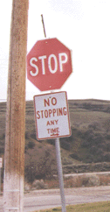
Authenticity gap
Specified performance is not what is done
Solution
Re-specify competencies or performance criteria
or
Training is not required

Slide 5
Communication gap
Not sure what is expected or why
Solution
Explanation or directive
Training in user needs

Slide 6
Abilities gap
Don’t have enough knowledge and skills
Solution
Make information available
Performance support systems
Conduct competency based training

Slide 7
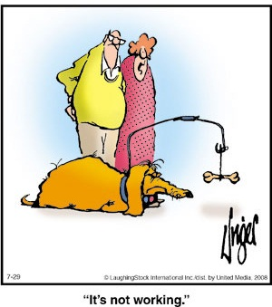
Motivation gap
Don’t really want to do it
Solution
This may or may not be a training issue!
Identify cause and respond to it

Slide 8
Systems gap
Inadequate hardware, software, procedures
Solution
Procure hardware
Redesign procedures or provide performance support
Redesign software or user interface
These are not training solutions!
Notes:
Training is not an answer for poor design!

Slide 9
Management gap
Inadequate leadership, organisation, management, resources
Solution
This is beyond your control
These are not training solutions!

Slide 10
A performance gap is not always a training issue
Authenticity gap
Specified performance is not what is done
Communication gap
Not sure what is expected or why
Abilities gap
Don’t have enough knowledge and skills
Motivation gap
Don’t really want to do it
Systems gap
Inadequate hardware, software, procedures
Management gap
Inadequate leadership, organisation, support, resources
Competencies
Performance criteria
Required Performance
Current Performance

Slide 11
When a performance gap is a training issue
HAVE TO DO
KNOW WHAT TO DO
PRACTICE DOING
ABLE TO DO
WANT TO DO
KNOW HOW TO DO
TOOLS TO DO
SUPPORT TO DO

