Slide 1
?
Are my
competencies
competent
Ian Bell
iandbell@fastmail.fm
5 November 2012

Slide 2
Competencies Checklist
Competency | Authentic | High level | Clear, concise | Assessable | Proficiency | Overall

Slide 3
Attributes of a good competency
Select a topic or use < > or mouse click
☑
1. Authentic
☑
2. High level
☑
3. Clear and concise
☑
4. Assessable
☑
5. Proficiency
☑
6. Complete

Slide 4
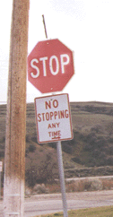
Attributes of a good competency
Select a topic or use < > or mouse click
The competency must reflect what people are actually required to do on the job
☒ List conditions for convective initiation
☑ Forecast convective initiation
☒ Describe the main cloud types
☑ Identify clouds
☒ Understand how to brief a pilot
☑ Conduct a pilot briefing
☒ State the benefits of different
assessment techniques
☑ Select an assessment type and
prepare an assessment
☑
1. Authentic
☑
2. High level
☑
3. Clear and concise
☑
4. Assessable
☑
5. Proficiency
☑
6. Complete
Notes:
Re my trainees actually required to do this on the job? (cf, describe, list, …)

Slide 5
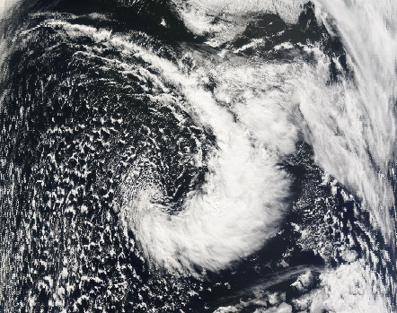
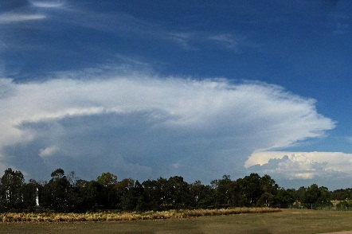
Attributes of a good competency
Select a topic or use < > or mouse click
Choose competencies that involve the highest cognitive functions (as in Bloom’s taxonomy)
☑ Identify cold air convection
How to display and interpret satellite images
Which channel to use
Characteristics of cold air convection
Conceptual model
☑ Forecast thunderstorm weather
Tools to display observations, including radar
Knowledge of formation conditions
Conceptual models
☑
1. Authentic
☑
2. High level
☑
3. Clear and concise
☑
4. Assessable
☑
5. Proficiency
☑
6. Complete
Image: Ian Bell

Slide 6
Attributes of a good competency
Select a topic or use < > or mouse click
Simplify, but don’t oversimplify. Remove extraneous words and redundancies. Include an active verb.
☒ Perform the task to the required standard
☑ Perform the task
☒ Locate a cold front using available data
☑ Locate a cold front
☒ Perform the task correctly in a timely manner
Perform the task
It may help to include some of these in a preamble.
☑
1. Authentic
☑
2. High level
☑
3. Clear and concise
☑
4. Assessable
☑
5. Proficiency
☑
6. Complete

Slide 7
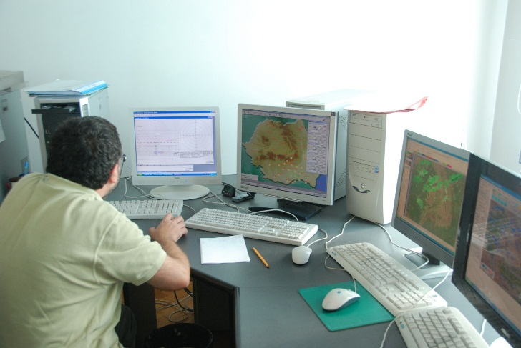
Attributes of a good competency
Select a topic or use < > or mouse click
Each competency should be demonstrable and assessable.
Assessment should simulate the on-the-job performance and associated conditions as closely as possible.
☑
1. Authentic
☑
2. High level
☑
3. Clear and concise
☑
4. Assessable
☑
5. Proficiency
☑
☑
6. Complete
Image: Ian Bell

Slide 8
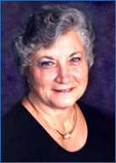
Attributes of a good competency
Select a topic or use < > or mouse click
How well do we want them to be able to perform the task?
☑
1. Authentic
☑
2. High level
Expert*
☑
3. Clear and concise
Unconscious competence
☑
4. Assessable
Proficiency
☑
5. Proficiency
Proficiency
Conscious action
☑
6. Complete
Conscious effort
Comprehension
Familiarisation
Gloria Gery, 1991
* Not in Gery’s classification
Notes:
Gery, Gloria (1991) Electronic performance support systems: How and why to remake the workplace through the application of technology. Boston: Weingarten Publications, Inc. ISBN 978-0-9617968-1-5

Slide 9
Attributes of a good competency
Select a topic or use < > or mouse click
If someone perform all of the tasks associated with these competencies, will they be fully functioning in their job?
Are there other things they will need to do?
☑
1. Authentic
☑
2. High level
☑
3. Clear and concise
☑
☑
4. Assessable
☑
5. Proficiency
☑
6. Complete

