Slide 1
EUMETSAT Active Fire Monitoring product (FIR)
Sauli Joro
2nd SALGEE Training Workshop
“MSG Land Surface Applications: Drought & Fires”
Antalya, Turkey, 4–7 Apr 2011

Slide 2
Operational Active Fire Monitoring product (FIR)
Uses SEVIRI channels VIS0.6 µm (Refl VIS0.6 < 30),IR3.9 µm and IR 10.8 µm, no cloud mask required
Fire detection allowed under thin clouds (Refl VIS0.6 > 30, EBBT NIR3.9 > 310)
Dynamic thresholds using forecast data (ECMWF), RTTOV, and surface emissivity information (MODIS)
Std10.8 test used only to detect possible fires
Threshold interpolation between night and day using the sun zenith angle
 | Fire |  | Possible Fire
 | Day | Night | Day | Night
IR 3.9 | > TH5 | > TH5 | > TH1 | > TH1
IR 3.9 – IR 10.8 | > TH7 | > TH7 | > TH3 | > TH3
StdDev IR 10.8 | - | - | < 4 | < 4
StdDev IR 3.9 – StdDev 10.8 | > TH6 | > TH6 | > TH2 | > TH2

Slide 3
Hardware change HP - SUN
~15 UTC
~15 UTC

Slide 4
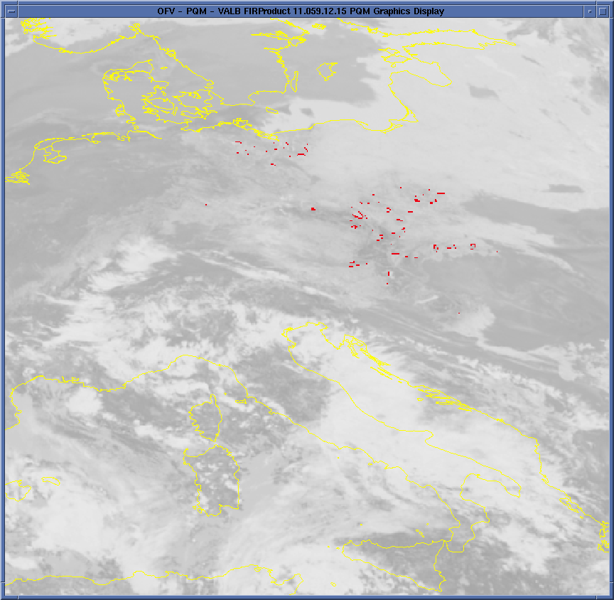
Increased false alarm frequency
http://www.eumetsat.int/Home/Main/News/ProductServiceNews/804953?l=en
March 24, 2011: Re-validation of MSG Active Fire Monitoring Product
EUMETSAT has changed the status of the Active Fire Monitoring (CAP and GRIB) products to 'Demonstration'.
An increasing trend of false alarms (poss. fires) was detected early Feb forwards
Increasing solar radiation with cold surfaces along cloud edges -> StdDev IR3.9 – StdDev IR10.8 test triggered -> false alarms
Decrease VIS0.6 threshold to 20%
28 Feb 12:15 UTC

Slide 5
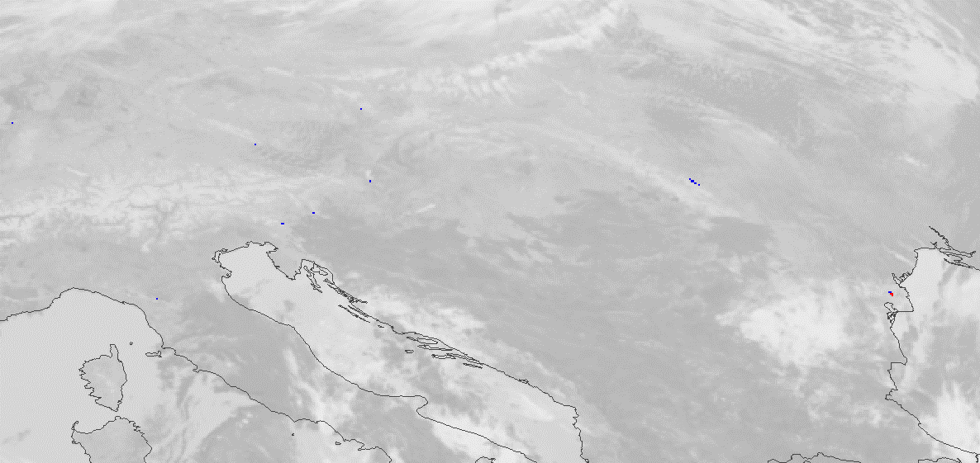
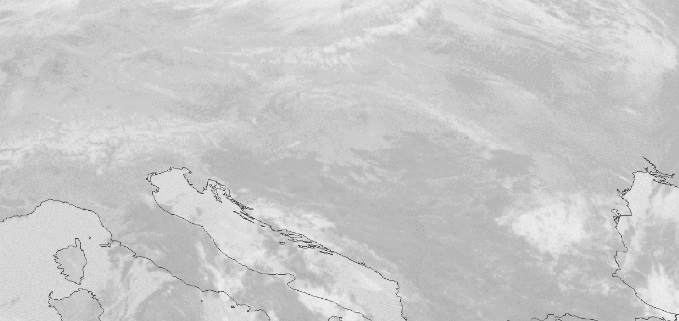
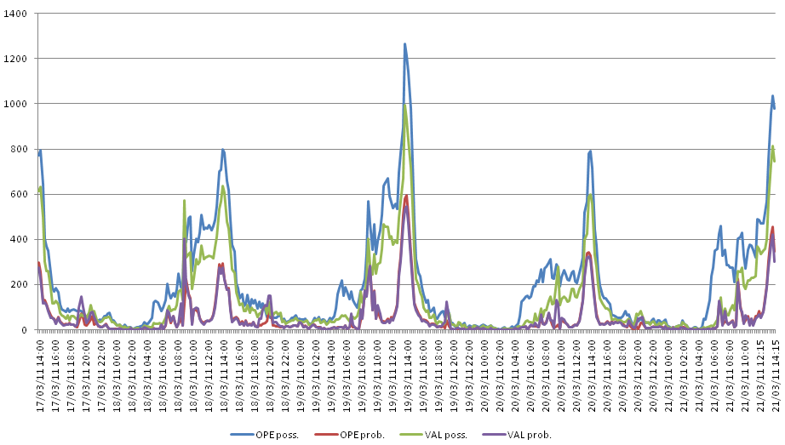
FIR product monitoring (VIS0.6 < 20%)
Decreased false alarm rate with possible fires

Slide 6
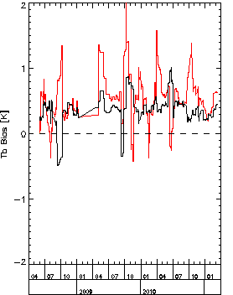
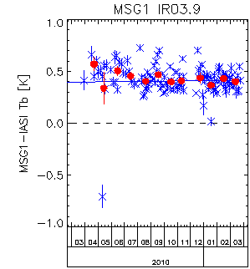
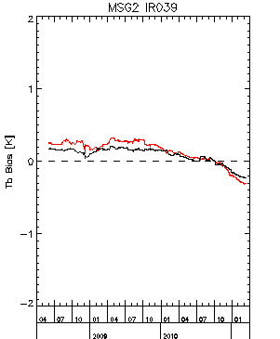
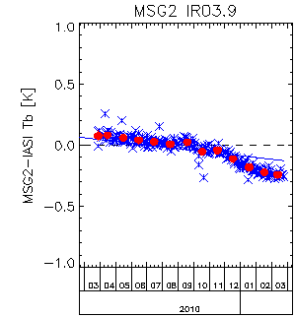
GSICS Bias monitoring: IR3.9 Met-8 vs. Met-9
FIR product development done with Met-9
Algorithm configuration at the moment is not spacecraft dependent
GSICS bias monitoring shows an increasing difference in Met 8 and 9 IR3.9 BT -> algorithm configuration will be made separately for both spacecraft in the near future (~May 2011)
standard scene
310K
standard scene
IASI collocations
standard scene
IASI collocations
standard scene
310K

Slide 7
Active Fire Monitoring: CAP format
http://www.eumetsat.int/Home/Main/News/ProductServiceNews/803809?l=en
FIR CAP product replaced the FIR ASCII product in the operations on 24 Mar 2011
EUMETSAT’s Volcanic Ash product also in CAP
Standard recommended/required by WMO
Common Alerting Format (CAP):
  Arose from a need to define a standard method for the creation and distribution of all kinds of alerts and warnings with local, regional and international scope
  Based on Extensive Mark-up Language
  CAP ensures the maximum usability of alert information — messages will be interpreted by different systems in different situations in the same way

Slide 8
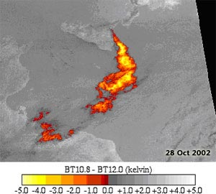
CAP breakdown
Style sheet reference
Graphics
CAP message
Text
CAP message contains:
standard information (text)
and may additionally contain:
- a style sheet reference
- hyperlinks to associated information (images, news)

Slide 9
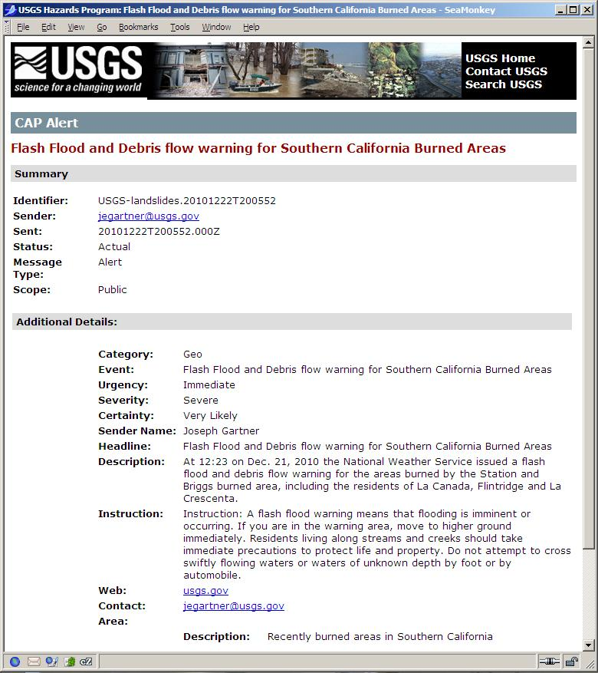
Example of USGS Cap Alert
<?xml version="1.0"?>
<?xml-stylesheet type="text/xsl" href="http://www.usgs.gov/hazard_alert/alerts/cap_alert.xsl"?>
<cap:alert xmlns:cap="http://www.incident.com/cap/1.0">
<identifier>USGS-landslides.20101222T200552</identifier>
<sender>jegartner@usgs.gov</sender>
<sent>20101222T200552.000Z</sent>
<status>Actual</status>
<msgType>Alert</msgType>
<scope>Public</scope>
<info>
<language>en-US</language>
<category>Geo</category>
<event>Flash Flood and Debris flow warning for Southern California Burned Areas</event>
<urgency>Immediate</urgency>
<severity>Severe</severity>
<certainty>Very Likely</certainty>
<senderName>Joseph Gartner</senderName>
<headline>Flash Flood and Debris flow warning for Southern California Burned Areas</headline>
<description>At 12:23 on Dec. 21, 2010 the National Weather Service issued a flash flood and debris flow warning for the areas burned by the Station and Briggs burned area, including the residents of La Canada, Flintridge and La Crescenta. </description>
<instruction>Instruction: A flash flood warning means that flooding is imminent or occurring. If you are in the warning area, move to higher ground immediately. Residents living along streams and creeks should take immediate precautions to protect life and property. Do not attempt to cross swiftly flowing waters or waters of unknown depth by foot or by automobile.
</instruction>
<web>usgs.gov</web>
<contact>jegartner@usgs.gov</contact>
<area>
<areaDesc>Recently burned areas in Southern California</areaDesc>
</area>
</info>
</cap:alert>

