Slide 1
Meteorological parametars for Drought and Fires of period 1999 - 2008 in Republic of Macedonia
DushankaTanushevska, meteorological engineer,
National Hydrometeorological Service of Macedonia
dusankat@yahoo.com

Slide 2



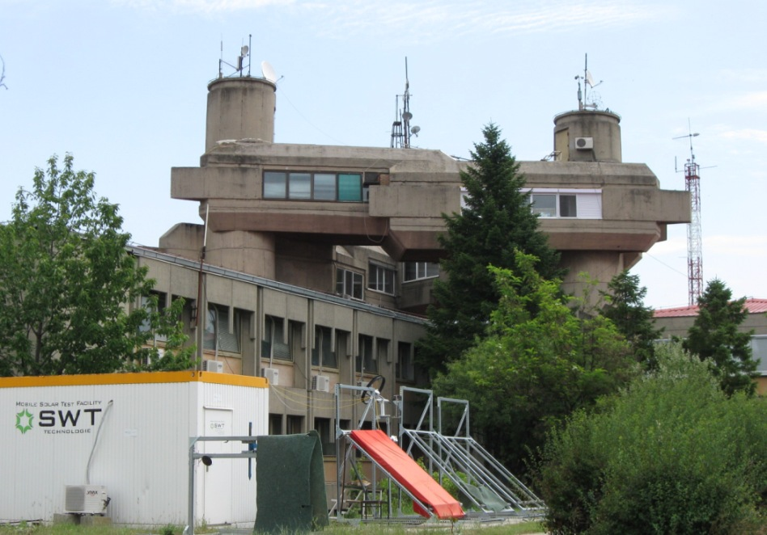
REPUBLIC OF MACEDONIA
MINISTRY OF AGRICULTURE,
FORESTRY AND WATER MANAGEMENT
NATIONAL HYDROMETEOROLOGICAL SERVICE

Slide 3
BRIEF HISTORY
  1891 -1899: The first meteorological measurements and observations in Macedonia were carried out in Skopje;
  1923: First meteorological station network was organized;
  1947: The Hydrometeorological Service in Republic of Macedonia was officially established 1964: surface water quality monitoring has begun;
  1974: air quality monitoring has begun;
  1978: it becomes Republic Hydrometeorological Institute - a governmental organization of special importance for carrying out work in meteorology and hydrology;
  1992: The Law on Hydrometeorological Matters was delivered;
  1993: as independent country Republic of Macedonia became a permanent member of the WMO;
  2008: The new Law on Hydrometeorological Matters is delivered;
  15 november 2010 was made instalation of DAWBEE station;
  10 February 2011 A co-operation agreement between the European Centre for Medium-Range Weather Forecasts (ECMWF) and the former Yugoslav Republic of Macedonia came into force on Wednesday, 9 February 2011.

Slide 4
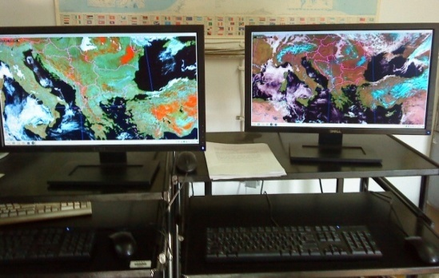
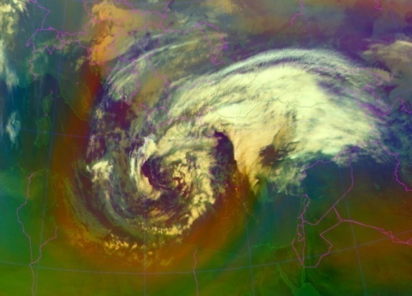
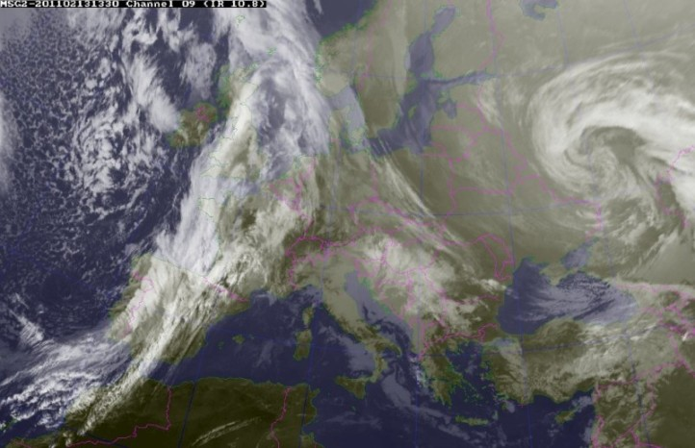
DAWBEE satellite receiving station
As part of the project for integration and increasing the meteorological data availability for the countries from Western Balkans and Eastern Europe, from EUMETSAT and under the auspices of WMO, at the end of 2010 our Department for weather forecast, warnings and informatics obtained a donation in means of a satellite receiving station for reception of satellite images.
The station is composed of two independent computers on which satellite images from European meteorological satellites MSG1 and MSG2 are being processed every 15 min.
The imagery received consists of basic channel images, RGB composites, High Resolution images, MPEF products, as well as Rapid scan images which are updated every 5 min.

Slide 5
NATIONAL HYDROMETEOROLOGICAL SERVICE
DIVISION FOR INTERNAL REVISION
DIRECTOR
STATE ADVISORS
DIVISION FOR HUMAN RESOURCES MAGAGMENT
METEOROLOGY DEPARTMENT
WEATHER
FORECAST,
WARNINGS
AND IT
DEPARTMENT
LEGISLATION AND INTERNATIONAL COOPЕRATION
DEPARTMENT
HYDROLOGY AND
ENVIROMENTAL
MONITORING
DEPARTMENT
FINANCE
DEPARTMENT
Division for
meteorological
measurements
and observations
Division for
hydrological
investigation on
surface and,
Groundwater
Division for weather
analysis
and forecast
Division for law
and
common works
Division for budget
coordination
Division for radar
monitoring,
warnings and
weather
modification
Division for
hydrological
information, balance,
studies
and water forecast
Division for budget
control
Division for
meteorological
data base
Division for inter
national
cooperation and
public relation
Division for
climatology and
аgriculture
Division for air, water
and
soil quality monitoring
and laboratory
Accounting Division
IT Division
Notes:
www.meteo.gov.mk

Slide 6
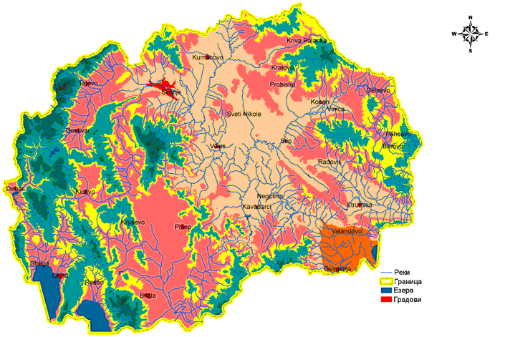
Climate Tyres in Macedonia
Climate Types
continental submediteranean
mountain continental
submediteranean
subalpine
warm continental
alpine
cold continental
alpine

Slide 7
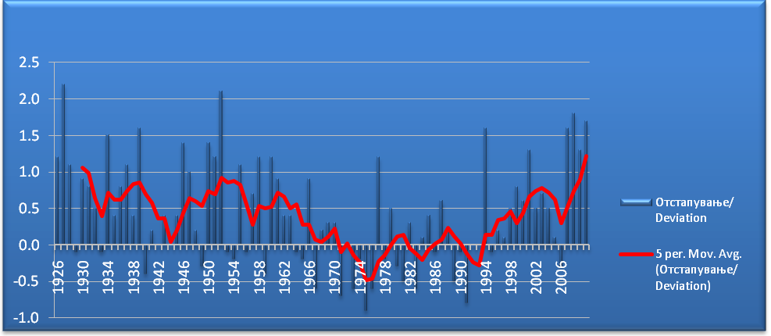
Climatic fluctuations in Macedonia
One of the most current topics in recent years climate change. Recent results obtained by scientific research on climate change indicate that globally, the twentieth century, the last decade of the twentieth century was the warmest in the last millennium.
According to data registered within the global climate monitoring system and national network of meteorological stations, a similar trend of increase of air temperature recorded is in hemisfercal scale, and prevail in the regional and local scales.
Such a trend of air temperature in the second half of the 20th century is registered in the Republic of Macedonia. As one indicator of climate change in this country are significantly higher mean annual air temperature in relation to average for the period 1961-1990 for all meteorological stations in Macedonia in the last twenty years that has changed is recorded in 2000, 2007 and 2008, but 2010 does not deviate much from the trend of growth temperatures.
Deviation of temperature from the average 1961-1990 for meteorological station Bitola

Slide 8
m.s. Bitola
Precipetat
ion
(mm)
year
amount of precipitation per year on average in 1961 – 1990 linear sum

Slide 9
may – september
deviat
ion
day
Detailed analysis of heat waves is made climatological-statistical processing of the frequency and duration of occurrence of heat waves for the meteorological station Skopje-Petrovec are processed with the number of days with maximum deviation of daily air temperature by 5 degrees more than the daily average (1961-1990) for the period from May to September.

Slide 10
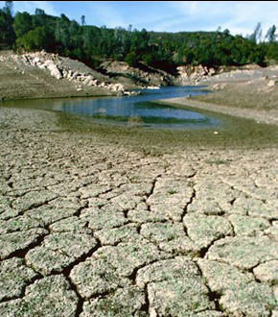



Drought
In recent decades drought has had a major impact on the economy of all countries in the South- Eastern European (SEE) region, as on the environment and society in general. According to the latest IPCC report for SEE the projection shows decrease of summer precipitation causing high water stress.
The main aim of DMCSEE project is to im-prove drought preparedness. The project will achieve this aim through several specific objectives: preparation of regional drought monitoring, assessment of regional vulnerability (mainly in agriculture), and analysis of the information for establishing early warning system.
Chart 2: Deviation of average monthly maximum temperatures from 1961 to 1990 average of m. s. Stip

Slide 11
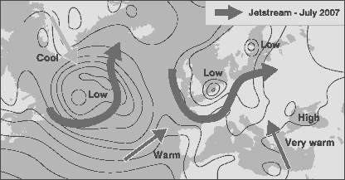
THE SYNOPTC ANALISES ABOVE EVROPA
Source: UK Met Office
Source: Met office
On 24 July 2007 the jet stream was flowing further south ,,allowing low pressure systems to sweep over Western / Atlantic Europe.
Warmer air was pulled from Africa, which was sweeping over South -Eastern Europe from which Macedonia was affected, and lasted for several days.
From Bulgaria in the North down to Greece in the South of the Balkans all countries have suffered an unprecedented severe fire season.

Slide 12
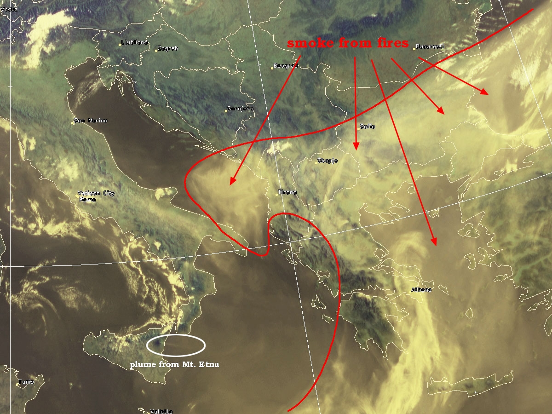
26.07.2007
Source: EUMET SAT

Slide 13
Number of forest fires, burnt area (ha), burnt timber mass (m ³) and economic losses (euros) in Macedonia in the period 1999 -2006.
Year | Number of Fires | Burnt Area (ha) | Burnt Timber/(m3) | Extinguishing Costs/(Euro) | Total Damages / Costs (Euro)
1999 | 69 | 2 415 | 1 950 | 32 512 | 372 921
2000 | 476 | 46 236 | 711 782 | 976 142 | 15 642 775
2001 | 161 | 6 263 | 88 260 | 66 811 | 9 851 849
2002 | 65 | 1 186 | 24 661 | 15 193 | 298 902
2003 | 144 | 1 069 | 10 987 | 44 608 | 251 527
2004 | 94 | 892 | 4 322. | 23 215 | 1 469 090
2005 | 182 | 1 368 | 1 063 | 42 018 | 411 181
2006 | 138 | 2 086 | 12 978 | 45 311 | 2 437 915
Total (1999-2006) | 1 329 | 61 515 | 856 004 | 1 245 810 | 30 736 160
Average (1999-2006) | 166 | 7 689 | 107 000 | 155 726 | 3 842 020
2007 | 569 | 33000 | 592 005 |  | 21 000 000
2008 | 140 | 2600
Source: P.E. “Macedonian Forests“

Slide 14
Crisis Management Structure at Local and National level in case of Fires
NATIONAL HYDROMETEOROLOGICAL SERVICE
Government
Non
Crisis
NATIONAL COORDINATION
Steering
Committee
Crisis M.
Centre
Crisis
Only
Directorate
Prot/Rescue
CMC
LOCAL COORDINATION
Crisis
Only
Municipality
Directorate
Prot/Rescue
Macedonian
Forests
Forestry
Police
LOCAL OPERATIONS MANAGEMENT
Macedonian
Forests FF
Civil Protection (DPR)
Civilians
Munici pality
FF
Forestry
Police
Armed
Forces
TTFU (DPR)
Source: P.E. “Macedonian Forests“

Slide 15
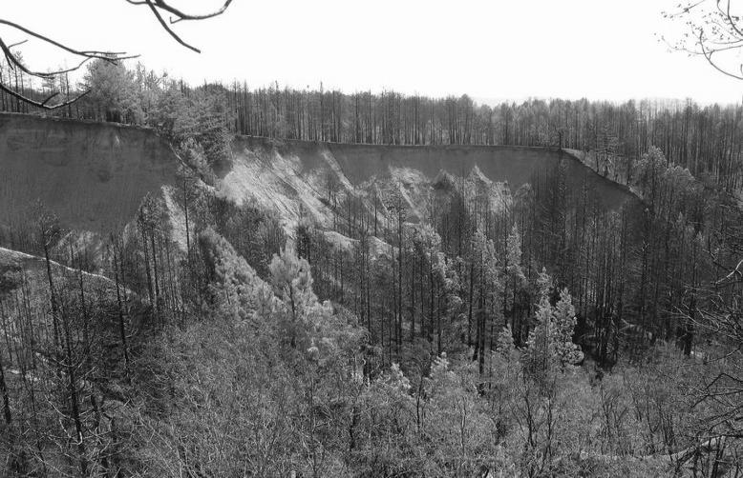
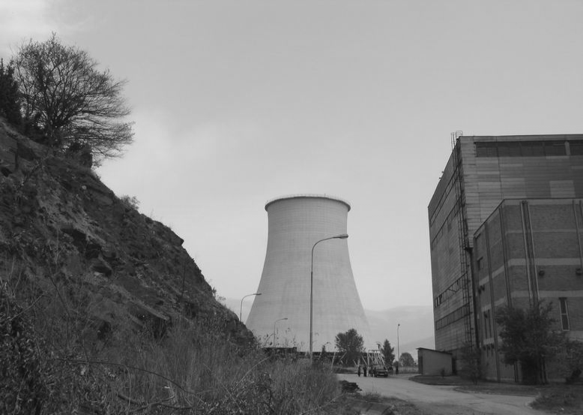
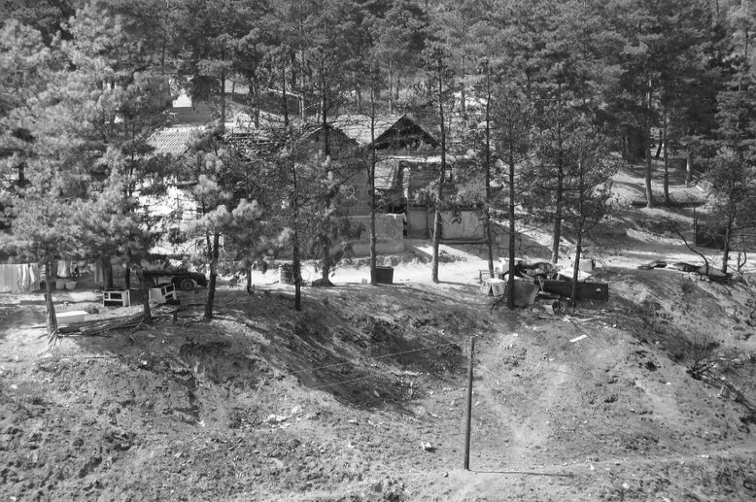
THE CONSEQENCES OF FIRES
Source:The photographs taken by Jelena Beronja (UNDP) are provided to illustrate main fire.
The electric power plant Oslomej near Kicevo was at threat to be affected by wildfires burning at the edge of the facility (left in the photograph) by burning embers (spot fires) falling out on very the structures of the power plant.
Fire -affected informal settlement of Roma at the outskirts of Bitola

Slide 16




Fire location map provided by UNOSAT for the period 1 -31 July 2 007

Slide 17
Conclusion
Experience shows that most forest fires or fires that are not caused by humans occur in the summer months of the year. However in the last ten years the most devastating fires have happened in 2007th. The analysis ​​shows that most fires occurred in 2007 all Balkan countries have suffered an unprecedented severe fire season.
In R. Macedonia the same year, damage from forest fires was estimated around 21 million euros.
Nature can create nice things, but it is often also the creator of dangerous phenomena that harm us greatly.
To be able to obstruct or reduce them and prevent their spread, they need to studied. For this purpose, in every country it is necessary to invest in science and technology, which are our essential tools to protect ourselves against natural disasters.
The question is whether there is more cost expenditure for procurement of equipment and investment in technical staff on the one side, or damages natural disasters do.
Notes:
"Second $Al.,titiF":T raining Workshop: "MSG Land
Surface Applications: Drought& Fires“ n Antalya/Turkey, from 4
- 7 April 2011

