Slide 1
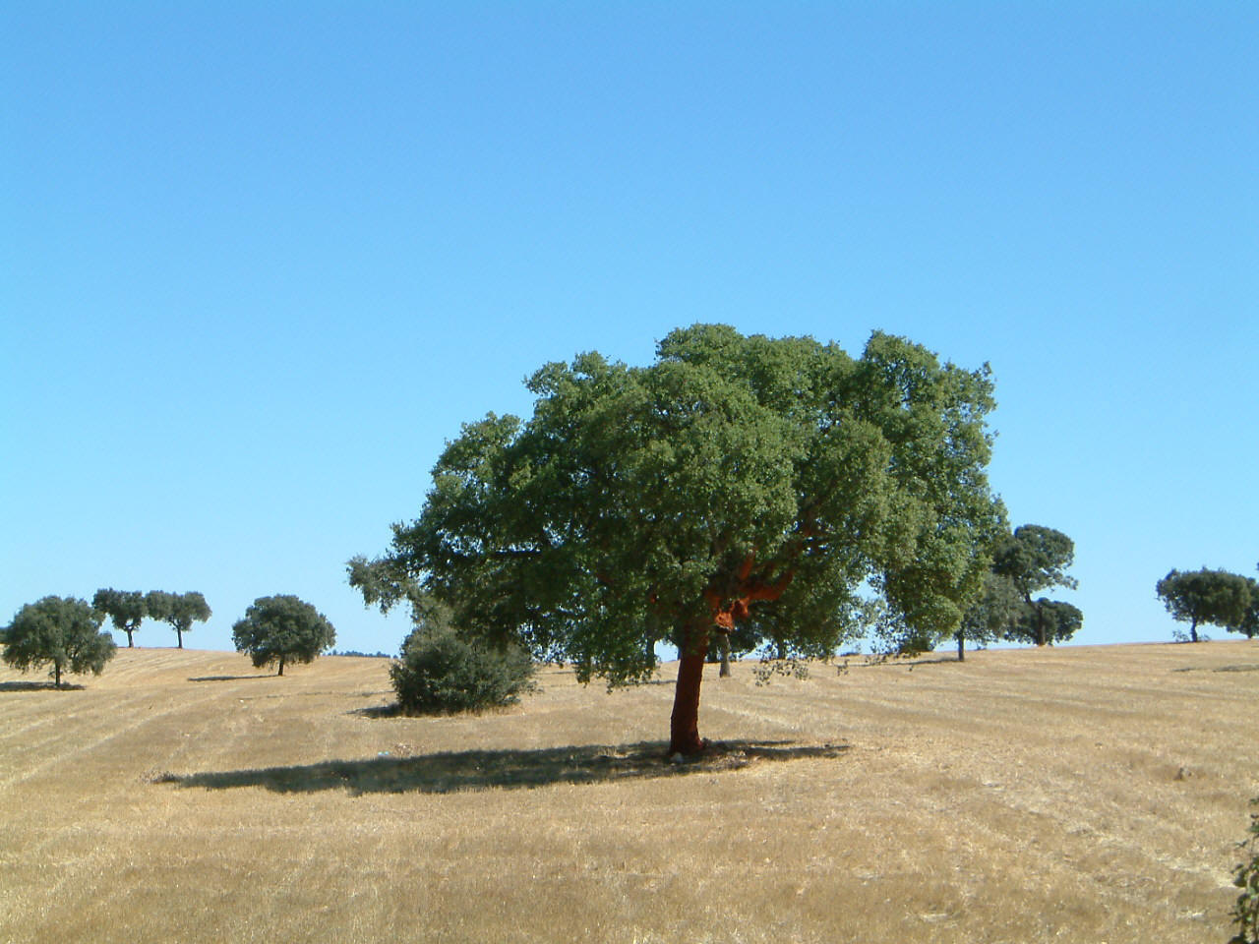
Modeling the angular dependence of satellite retrieved Land Surface Temperature (LST)
Sofia L. Ermida⁽¹⁾, Isabel F. Trigo^{(1,2)}, Carlos C. DaCamara⁽¹⁾
⁽¹⁾Instituto Dom Luiz, Universidade de Lisboa, Lisboa, Portugal
⁽²⁾Instituto Português do Mar e da Atmosfera, Lisboa, Portugal
8th APMG Meteorological and Geophysical Symposium
14th Luso-Spanish Meteorological Meeting
3rd SALGEE Workshop 2013

Slide 2
Basic Assumptions
Land covered by 3 main components:
Sunlit background
Shaded background
Canopy
Composite radiance of a MSG pixel:
L_{tree}
f_{tree}
L_{sunlit}
L_{shadow}
f_{sunlit}
f_{shadow}

Slide 3
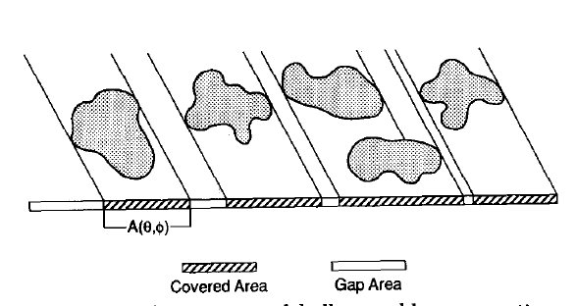
The Geometric Model
Based on the Boolean Scene Model that allows estimating the gap probability between objects within a layer is
proportion of illuminated background
proportion of
viewed background
Strahler, Alan H., Jupp, David L.B. Modeling bidirectional reflectance of forests and woodlands using boolean models and geometric optics, Remote Sensing of Environment, Volume 34, Issue 3, December 1990, Pages 153-166

Slide 4
The Geometric Model

Slide 5
The Geometric Model
Fraction of sunlit backgorund
Fraction of shaded backgorund
Fraction of overlap

Slide 6
Insitu Measurements
Brightness temperature for grass, tree and sky
Évora, Portugal
Source: GoogleMaps

Slide 7
Insitu Measurements
Starting and ending instants of shadow contamination to the radiometer. Blue dots indicate possible locations for the radiometer on that day.
25/11/2011 13:00
25/11/2011 15:40
11/02/2012 13:40
11/02/2012 16:20

Slide 8
Insitu Measurements

Slide 9
Insitu Measurements
Shaded background temperature?
Armson, D., Stringer, P., Ennos, A.R., The effect of tree shade and grass on surface and globe temperatures in an urban area, Urban Forestry & Urban Greening, Volume 11, Issue 3, 2012, Pages 245-255
Assumptions: - at night
-

Slide 10
Insitu Measurements
Planck’s law
Radiances
L_{sunlit}, L_{tree} , L_{shadow}
Centered at 10.8 µm
Correction of downward flux contribution:

Slide 11
Results

Slide 12
Change in viewing zenith angle

Slide 13
Modeling the angular dependence of satellite retrieved Land Surface Temperature (LST)
Sofia L. Ermida⁽¹⁾, Isabel F. Trigo^{(1,2)}, Carlos C. DaCamara⁽¹⁾
⁽¹⁾ Instituto Dom Luiz, Universidade de Lisboa, ⁽²⁾Instituto Português do Mar e da Atmosfera
snermida@fc.ul.pt, isabel.trigo@meteo.pt, cdcamara@fc.ul.pt
http:// landsaf.meteo.pt
Acknowledgements: This study was performed within the framework of the LSA SAF project, cofunded by EUMETSAT. Research also was partly supported by the Portuguese Science Foundation (FCT) through project FLAIR (PTDC/AAC-AMB/104702/2008) and by the EU 7th Framework Program through project FUME. (contract number 243888).

