Slide 1
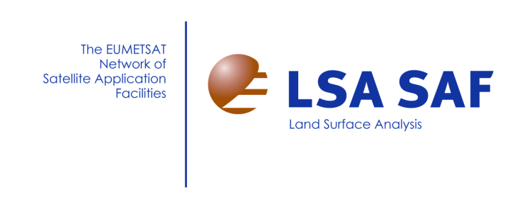
Assigning dates to maps of burn scars in Portugal
Renata Libonati¹ , Carlos C. DaCamara¹, Jessica Panisset²,
Guilherme Gaspar¹ , Teresa Calado¹ , Ana Barros³
¹Instituto Dom Luiz, University of Lisbon, Portugal
²Department of Meteorology, UFRJ, Rio de Janeiro, Brazil
³DEF/ISA, Technical University of Lisbon, Portugal
l

Slide 2
Introduction
Portugal presents the highest number of fire occurrences in Europe;
It also has the largest area affected by wildfires;
Wildfires present a large annual inter-variability, related to changes in the frequency of occurrence of atmospheric conditions
that favour the onset and
spreading of fires.

Slide 3
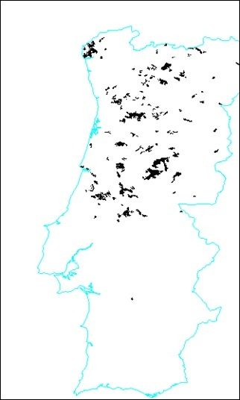
Objectives
The main goal is to develop an automated method to date scars detected by end of fire season Landsat 30 m images, using MIR and NIR bands from 1-km MODIS imagery.
Burned areas greater than 500 ha, from August 2005, as detected by Landsat (ICNF) .

Slide 4
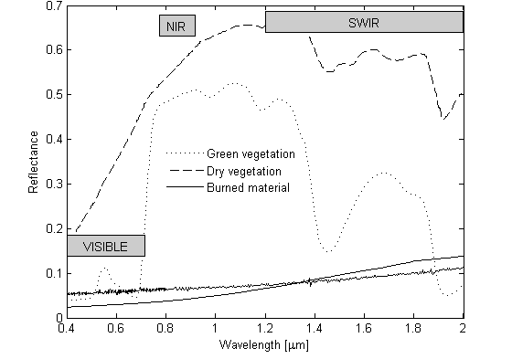
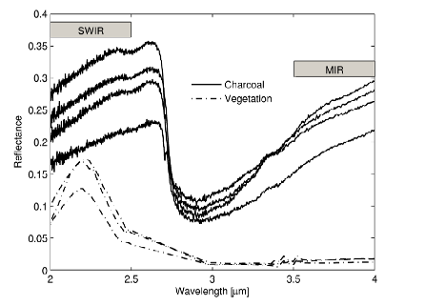
Why MIR and NIR bands?
In VIS (as well as in SWIR), charcoal is mixed up with dense dark vegetation, water, dark soils, wetlands, clouds and terrain shadows;
The MIR/NIR is the best bi-spectral region to discriminate between burned areas and other types of surfaces.

Slide 5
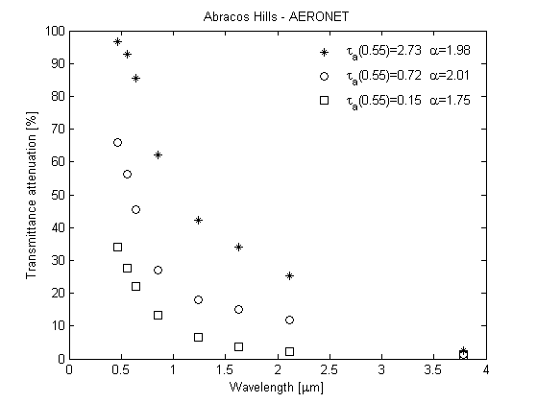
Why MIR and NIR bands?
MIR signal is practically not affected by smoke, which is especially relevant during the dry season, when the atmosphere is very contaminated by smoke (left panel);

Slide 6
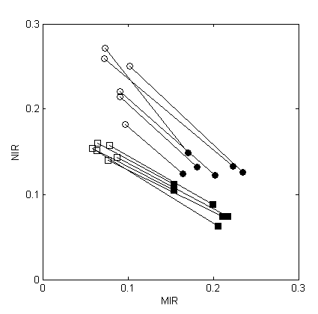
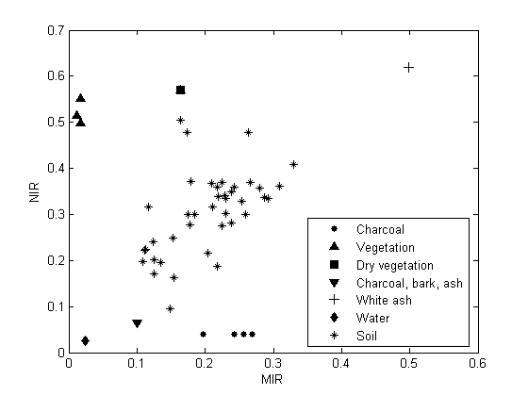
Why MIR and NIR bands?
Different materials/surfaces tend to form clusters on the MIR/NIR space (right panel).
There is an overall displacement along the diagonal of the graph, from vegetation, down to burned materials across the soil surfaces.

Slide 7
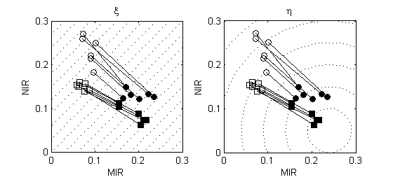
Towards an optimal index

Slide 8
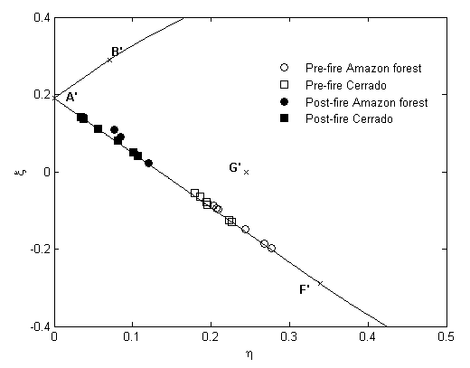
Towards an optimal index

Slide 9
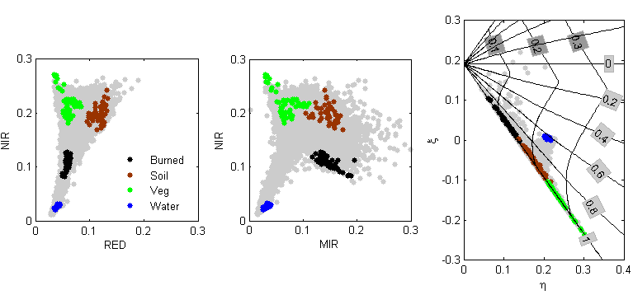
Towards an optimal index
V
W

Slide 10
Data
Input Data
MODIS Level 1B radiances 1km
(TERRA and AQUA)
Band 2 (NIR)
Band 20 (MIR)
Band 30 (TIR)
Solar Zenith
From July to September 2005
Validation Data
MODIS Level 3 data active fire products (hotspots)
Burning dates of Landsat scars based on MODIS Rapid
Scan & AFN Database

Slide 11
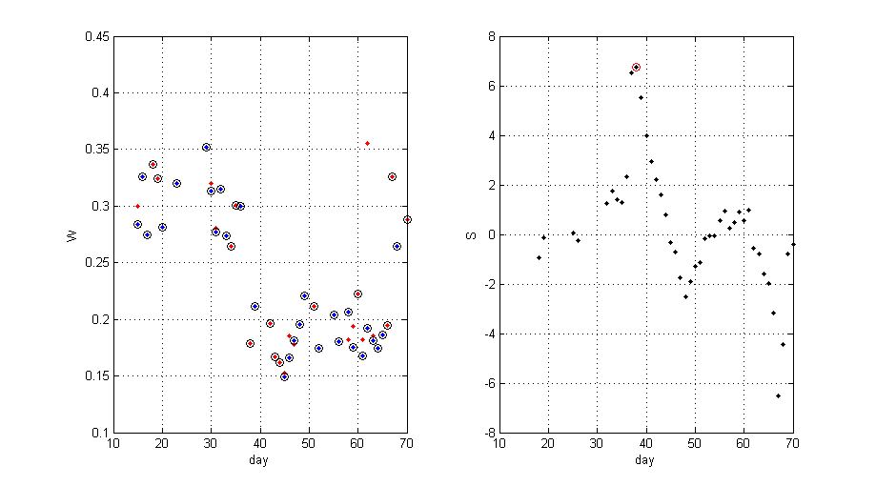
Daily Time Series
TERRA
AQUA

Slide 12
Detection Algorithm
Cloud mask, solar/view angle masks
Daily Reflectances (MIR/NIR)
Daily (V-W) indices
Temporal Composites
Day of S maximum
(Giglio et al., 2009)
Spatial Filter
Day of Burn Map

Slide 13
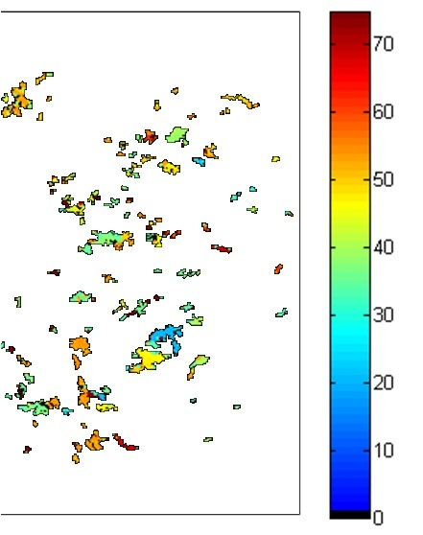
Map of Burning Day
or
and spatial consistency

Slide 14
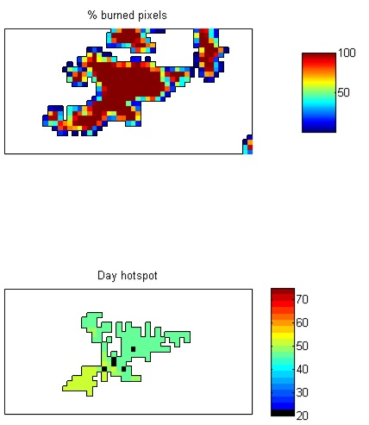
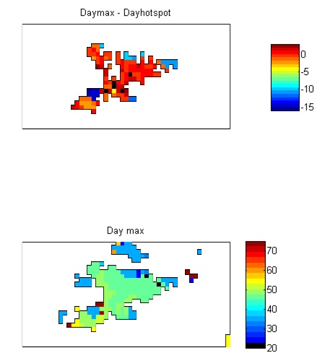
Validation – MODIS Hotspots

Slide 15
Accuracy assessment
78 scars were analysed;
70% of scars were correctly dated by the algorithm;
Allowing differences of up to 3 days, the matching score increases to 83%.

Slide 16
Accuracy assessment
Total amount of burned area – 230,433.132 ha

Slide 17
Conclusions
An automated procedure was presented that allows using time series of MODIS imagery to assign dates of burning to scars larger than 500 ha in the Landsat based fire atlas.
The procedure relies on the so-called (V,W) burned index that uses daily reflectance obtained from the 1km MODIS Level 1B calibrated radiance from bands 2 (NIR) and 20 (MIR).

Slide 18
Conclusions
The algorithm detects persistent changes in the (V,W) burned index time series, within each Landsat burned scar.
An assessment of the temporal accuracy of the algorithm was conducted for the year 2005. For this year, Landsat based fire scars larger than 500ha have an associated detection date, based on field information provided by the AFN.
Results are quite promising and are currently being extended to the period 1980-2011.

