Slide 1


Potential effects of regional climate change on rural fires in Europe
T. Calheiros(1), M.G. Pereira(2,1),
J.G. Pinto(3), Carlos C. DaCamara(1)
(1) Instituto Dom Luiz, IDL, Universidade de Lisboa, Lisboa, Portugal, tomascalheiros@hotmail.com
(2) Centro de Investigação e de Tecnologias Agro-Ambientais e Biológicas (CITAB), Universidade de Trás-os-Montes e Alto Douro, Vila Real, Portugal, gpereira@utad.pt
(3)Departamento de Física, Universidade de Trás-os-Montes e Alto Douro, Vila Real, Portugal,
SALGEE, Ericeira, March 2013

Slide 2
Introduction/Objectives
The aim of the study is to assess the potential impact of regional climate change on wildfires in Portugal using an appropriate Burnt Area Model (BAM) together with simulated data for future scenarios by a regional circulation model (RCM).
Data
The data used in the work includes:
monthly values of burnt area in Portugal as derived from the Portuguese Rural Fire Database (Pereira et al., 2011) and from the European Forest Fire Information System (EFFIS);
observed values of temperature and precipitation from the European Climate Assessment (ECA), for the period 1950-2010;
and simulated values of temperature, precipitation, wind and relative humidity from the MIROC (GCM) and COSMO-CLM model.

Slide 3
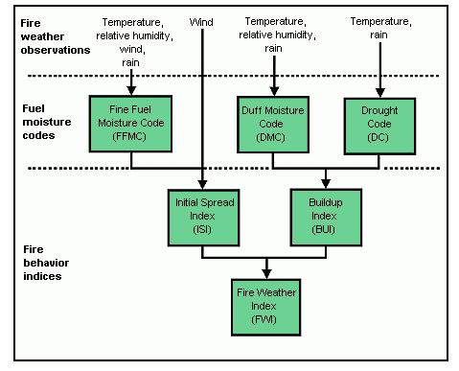
Canadian Forest Fires Danger Rating System
FWI and DSR

Slide 4
Rural fires in Portugal
High variability
Similar values
• 73% of total burnt area
Inter-annual variability of burnt area in mainland Portugal for yearly (thin line with grey diamonds) and July plus August (thick line with white circles) amounts, for the period 1980 – 2007. A plus (+) inside the white circle represents a severe summer season, defined as one where the monthly burnt areas of July and August are both greater than the upper tercile of the respective month while a minus sign (-) inside the white circle represents a mild summer season, defined as one where both the monthly burnt areas of July and August are lower than the respective lower terciles.

Slide 5
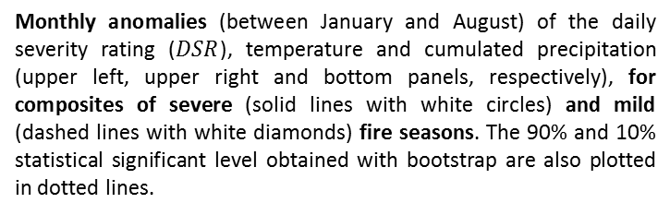
Rural fires in Portugal
Monthly anomalies (between January and August) of the daily severity rating ($DSR$), temperature and cumulated precipitation (upper left, upper right and bottom panels, respectively), for composites of severe (solid lines with white circles) and mild (dashed lines with white diamonds) fire seasons. The 90% and 10% statistical significant level obtained with bootstrap are also plotted in dotted lines.
Severe years:
More precipitation in March and April
Higher temperature in May and June
Mild years:
Less precipitation in March and April
Lower temperature in May and June

Slide 6
Rural fires in Portugal
Log-log scatter plot of July vs. August burnt area values in the period 1980 – 2007. Two-digit labels identify individual years. Vertical (horizontal) lines represent the lower and the upper terciles of July (August).

Slide 7
Rural fires in Portugal
As in previous, but respecting to the scatter plot of July vs. August DSR values.

Slide 8


Burnt Area Model
Where:
is the decimal logarithm burnt areas in July or in August;
is the monthly mean of DSR during the pre-fire period, defined as May and June (May, June and July) when the predictant is July (August)
is the monthly mean of DSR in July (August) when the predictand is July (August)

Slide 9
Burnt Area Model
Observed values (black line) and modelled values with cross validation (dotted line) of July (left panel) and August (right panel) burnt areas for the period 1980 – 2007.

Slide 10
Results and Conclusions
(MIROC model)
 | 20C3M | B1
 | 1973 – 2000 | 2051 – 2078 | 2073 – 2100
Mean (×10³ ha) | 40 | 43 | 98
Median (×10³ ha) | 18 | 36 | 52
Interquartile Range (×10³ ha) | 32 | 37 | 83
Relative dispersion* | 0.89 | 0.51 | 0.80
* defined as the semi-interquartile range divided by the median.
The developed approach consistently points towards:
an increasing risk of fire under future climate conditions
an increasing possibility of having much larger fire events
an increasing inter-annual variability of the fire regime, which together with the positive bias will have dramatic consequences at the social, economic and environmental levels.

Slide 11
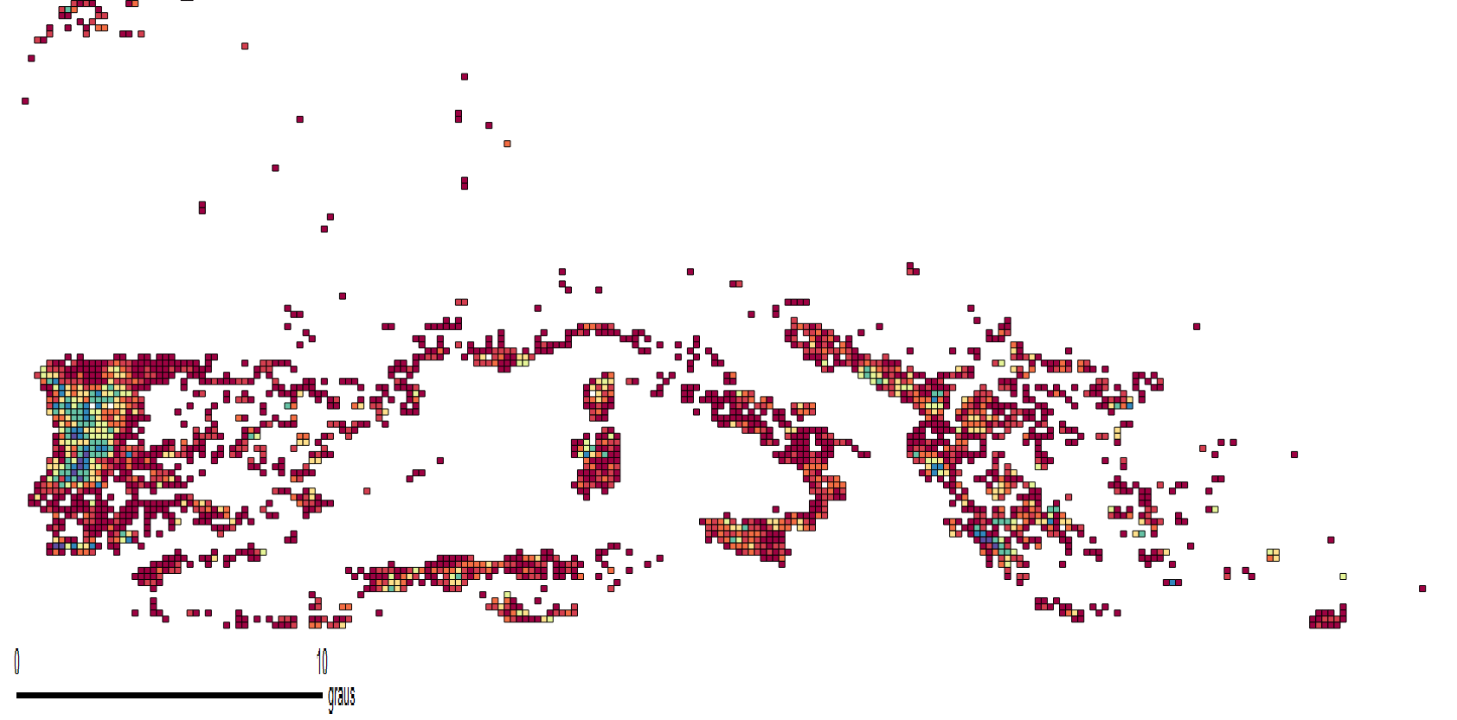
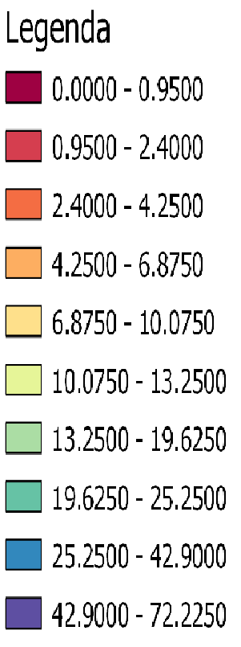
Burnt Area Percentage
2000-2011
Total area Burned (2000 – 2011)/COSMO cell area

Slide 12
COSMO model
High resolution model (only three MIROC grid points cells over Portugal)
Two runs for current climate (C20) and future (A1B and B1) scenario conditions
Cover entire Europe ( 35N – 70N, 10W -35E)

Slide 13
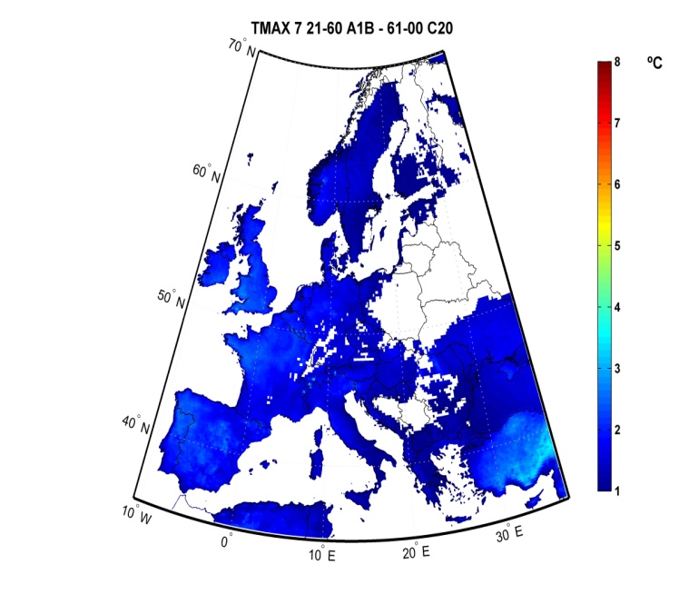
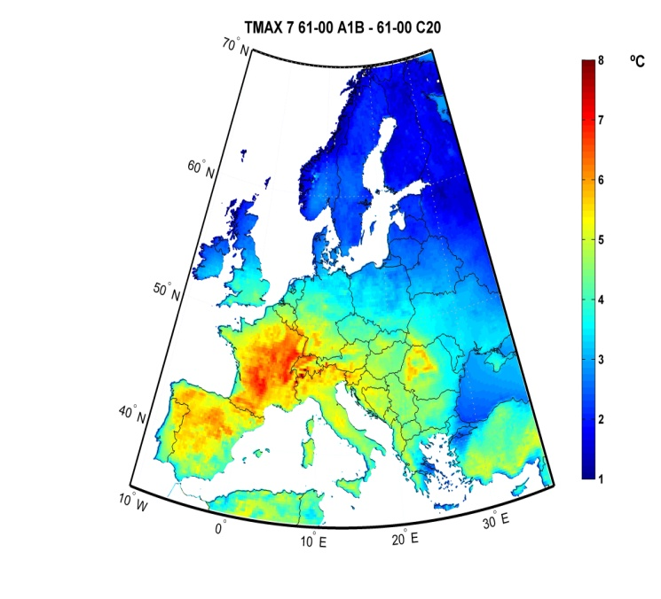
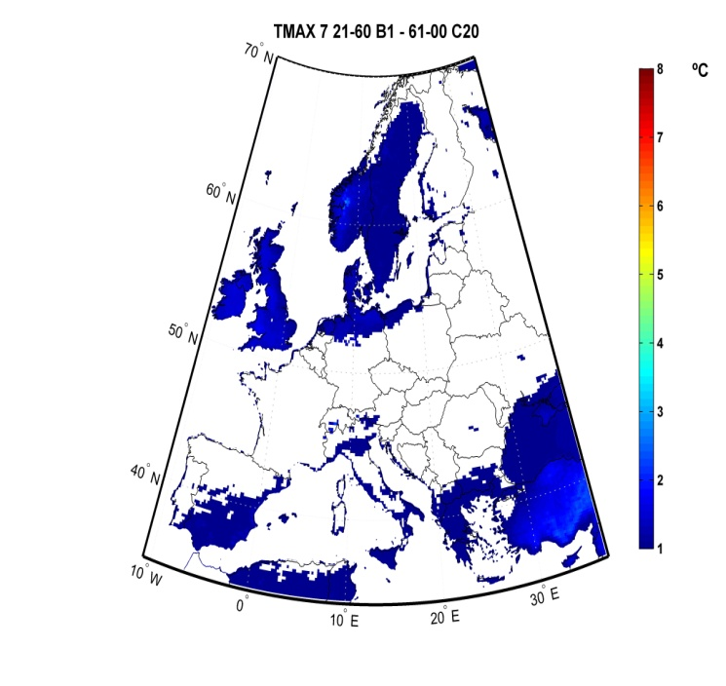
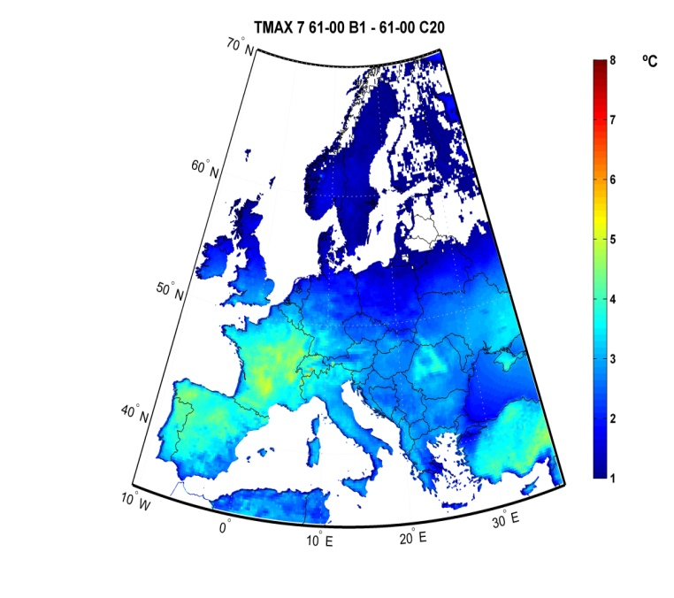
Maximum Temperature
2021-2060 2061-2100
Differences in the mean Tmax (July)
Differences between the mean projected temperatures for each period from the 21th century and the 20th century (representation restricts to where differences are statistically significant)
A1B
B1

Slide 14
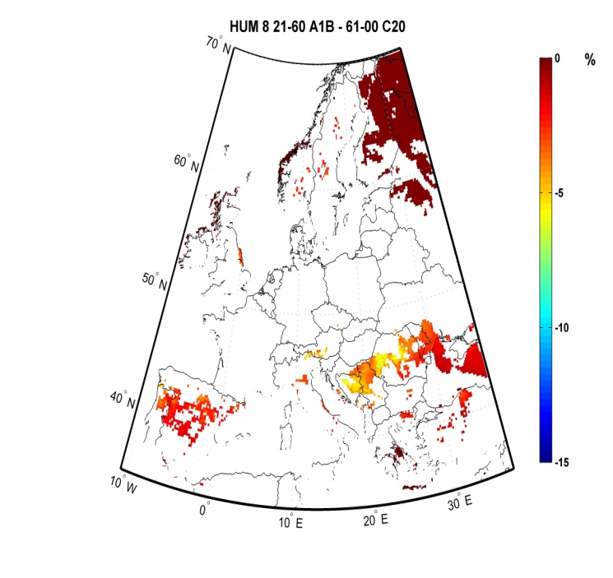
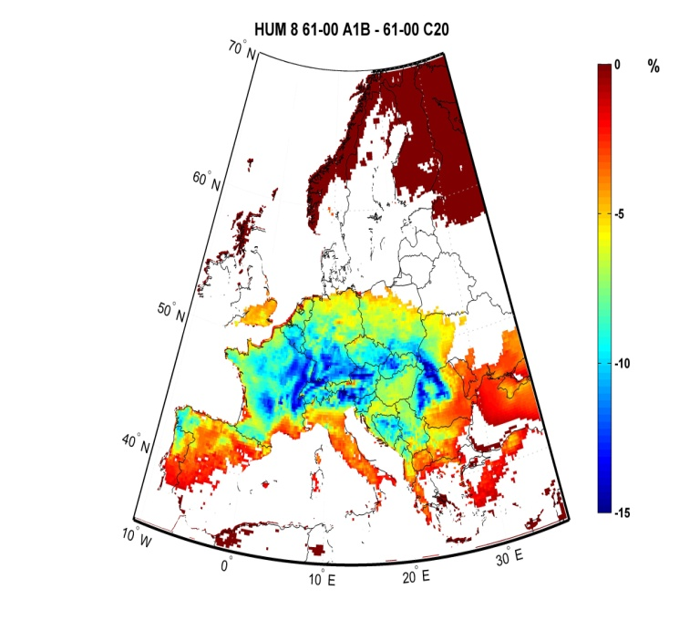
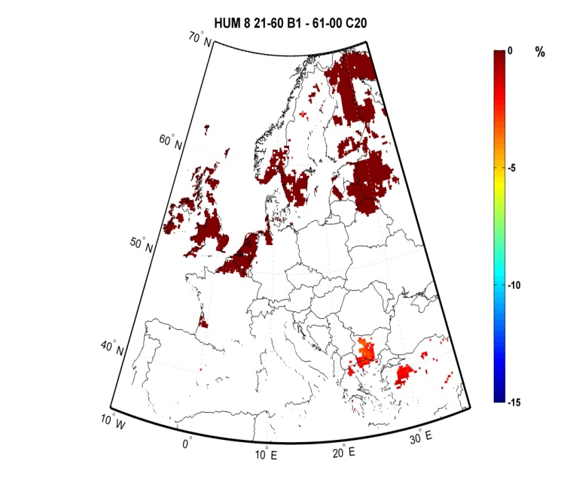
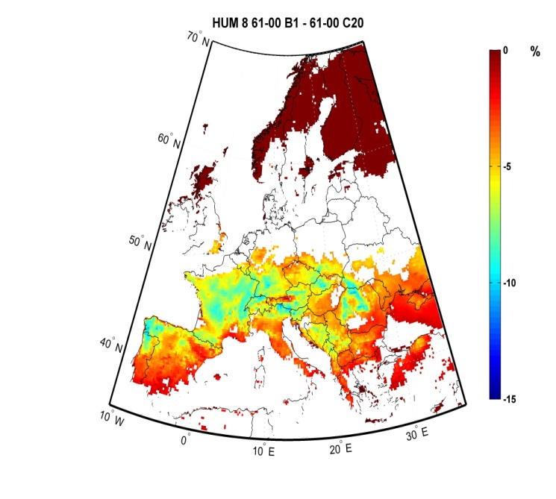
Relative Humidity
2021-2060 2061-2100
Differences in the mean Hum (August)
Differences between the mean projected relative humidity for each period from the 21th century and the 20th century (representation restricts to where differences are statistically significant)
A1B
B1

Slide 15
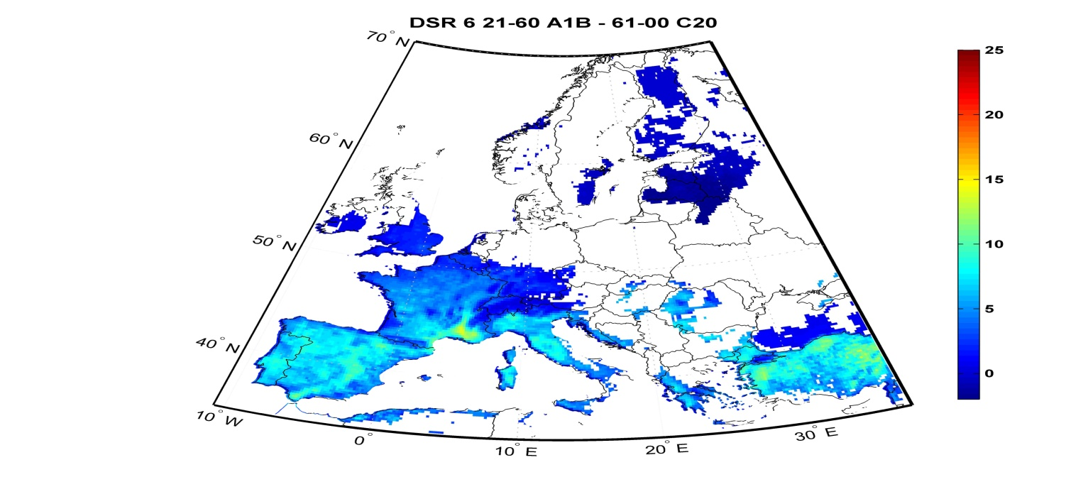
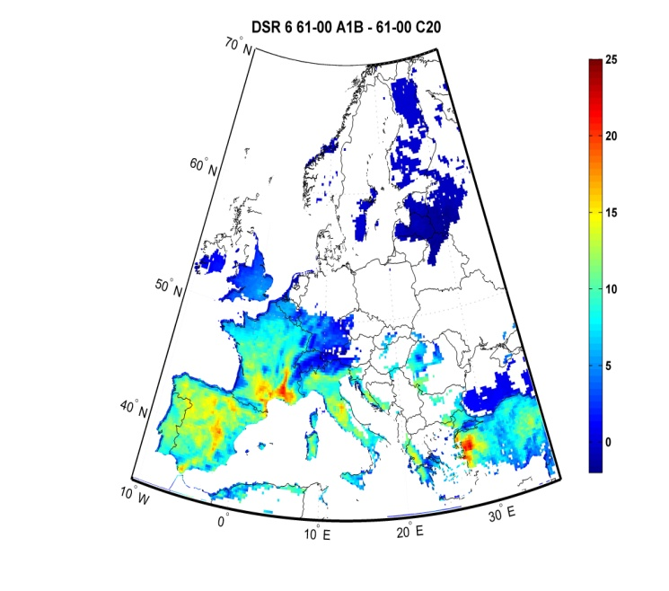
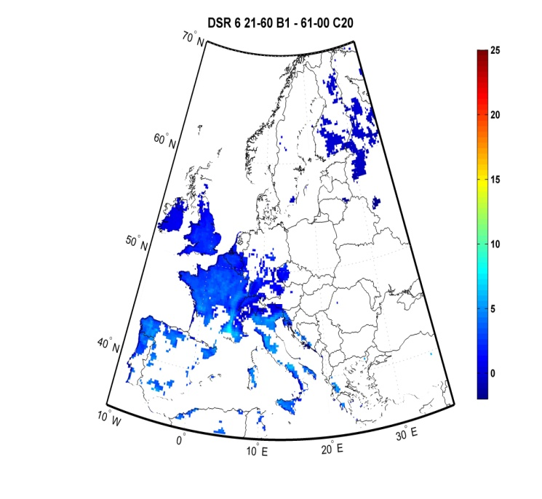
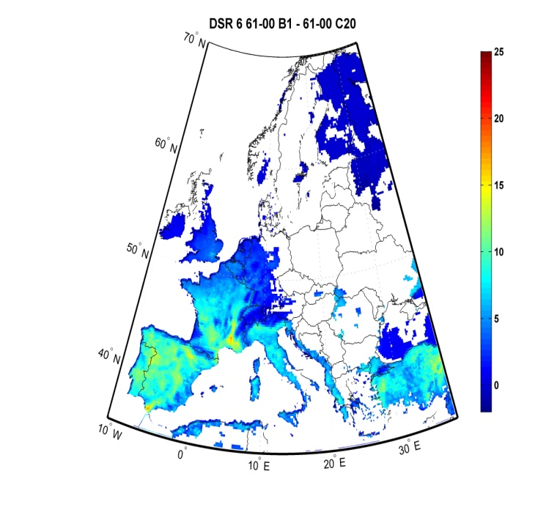
DSR pre-fire season
2021-2060 2061-2100
Differences in the mean DSR (June)
Differences between the mean projected DSR for each period from the 21th century and the 20th century (representation restricts to where differences are statistically significant)
A1B
B1

Slide 16
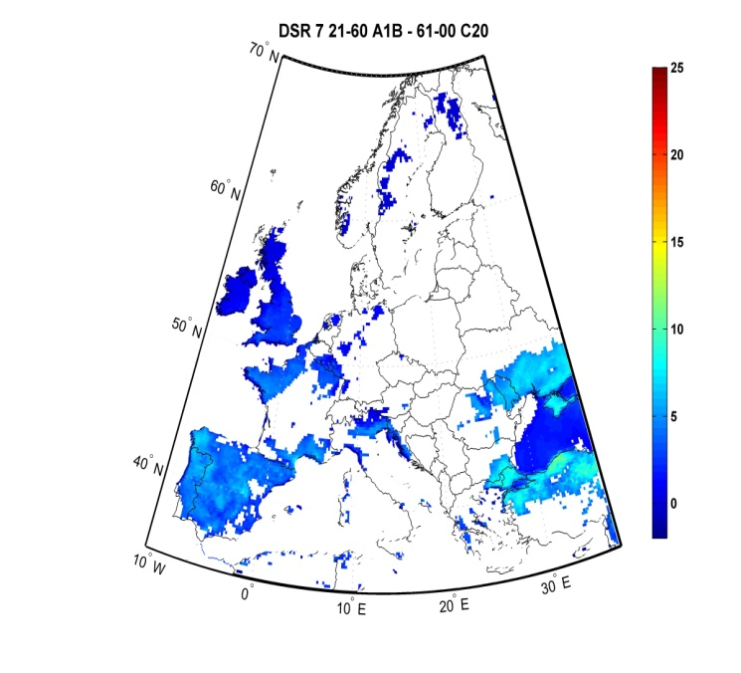
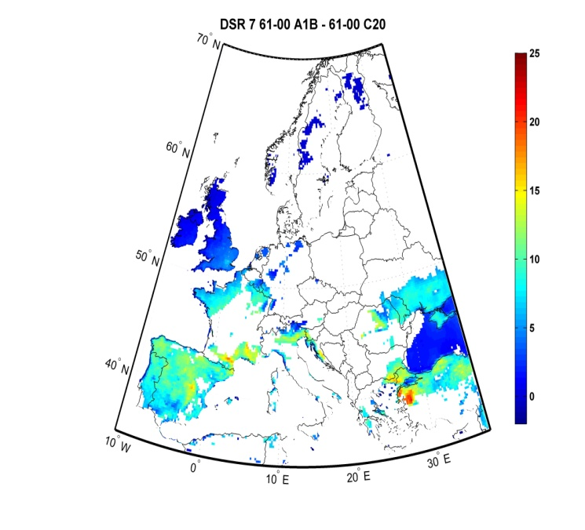
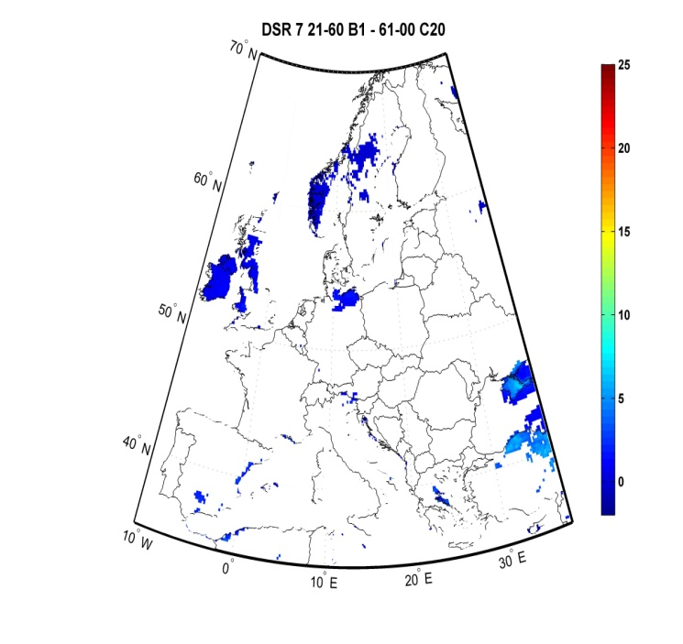
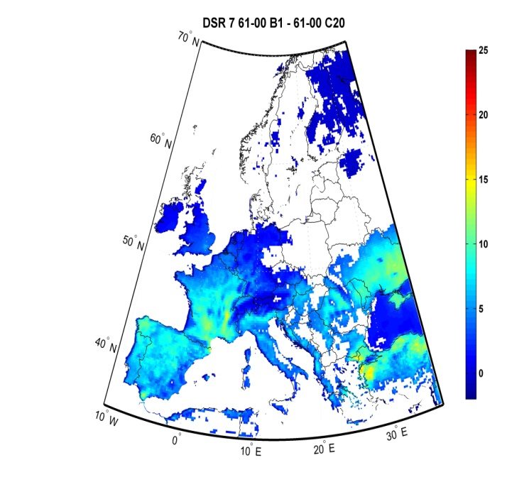
DSR fire season
2021-2060 2061-2100
Differences in the mean DSR (July)
Differences between the mean projected DSR for each period from the 21th century and the 20th century (representation restricts to where differences are statistically significant)
A1B
B1

Slide 17
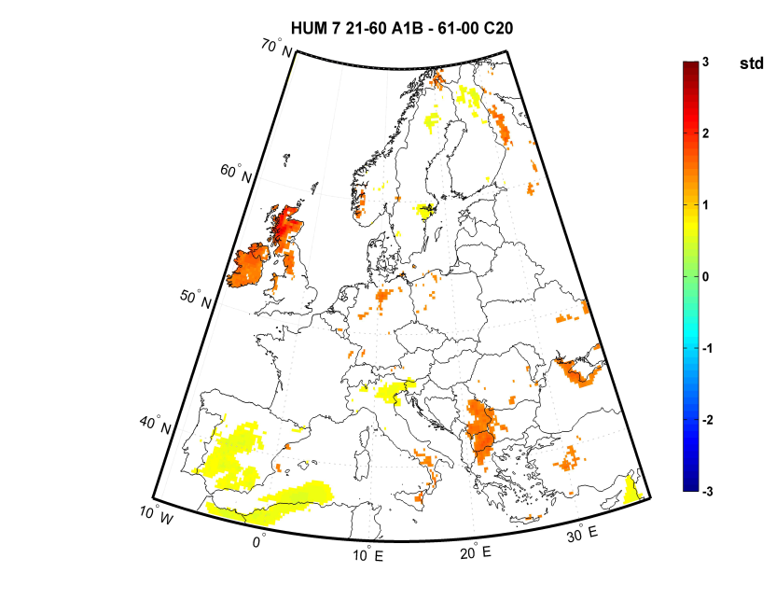
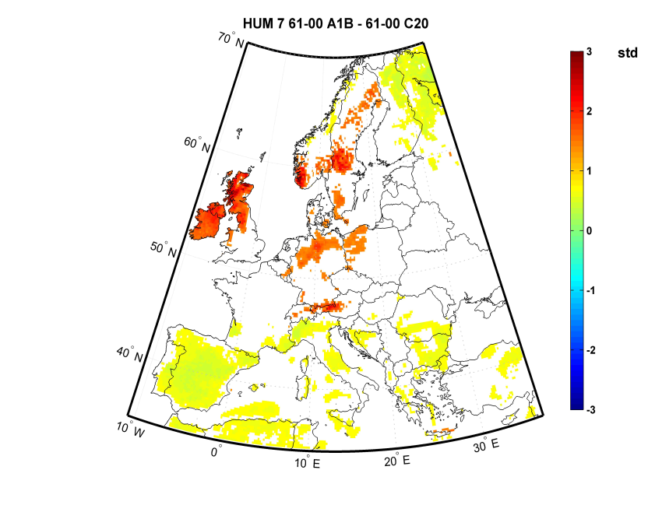
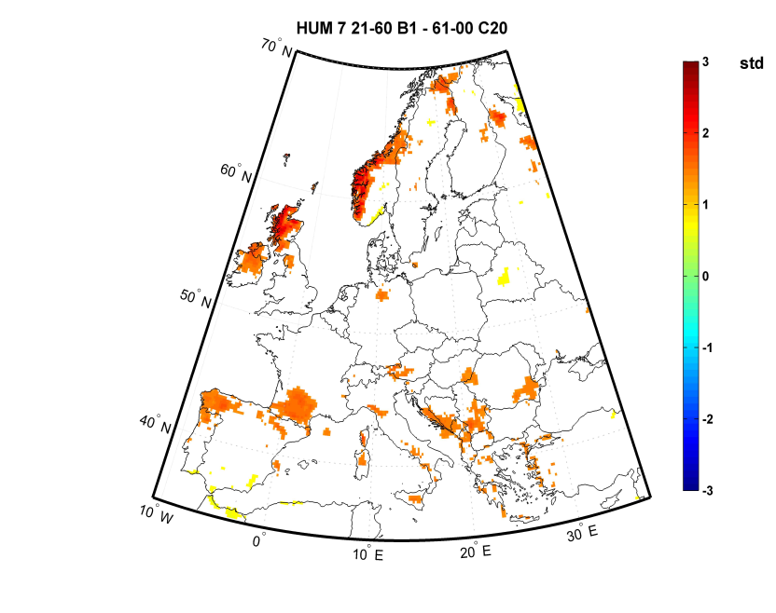
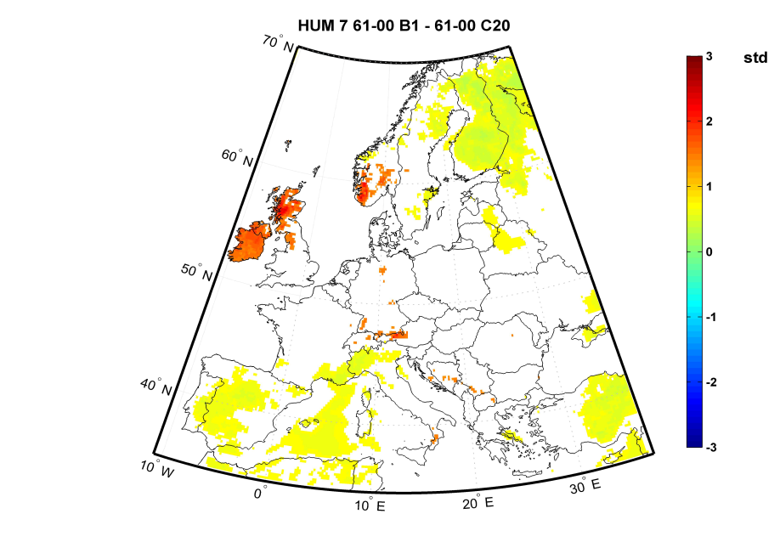
Relative Humididty
2021-2060 2061-2100
Quotient of the standard deviation Hum (July)
Quotient between the relative humidity standard deviation for each period from the 21th century and the 20th century (representation restricts to where are statistically significant)
A1B
B1

Slide 18
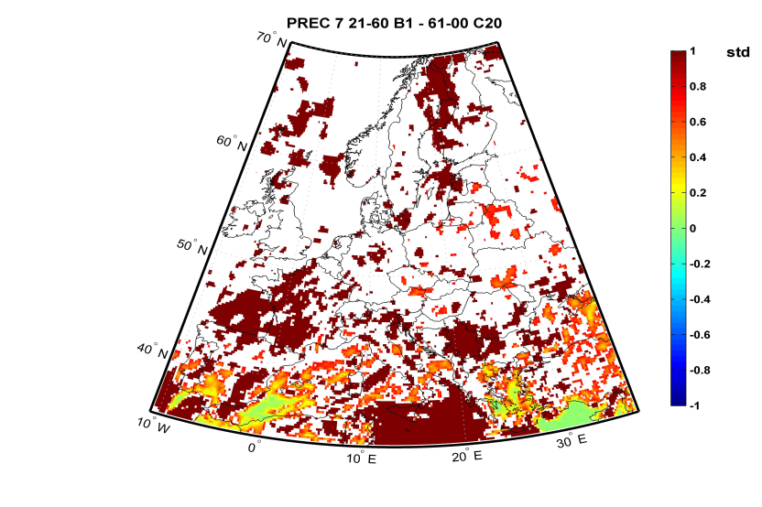
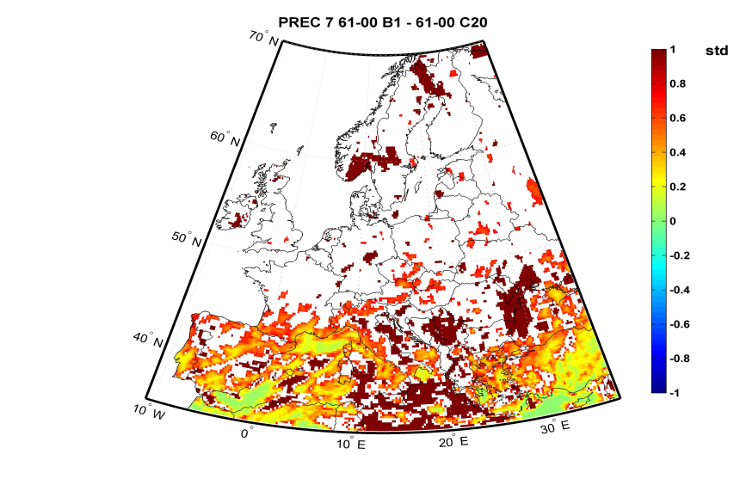
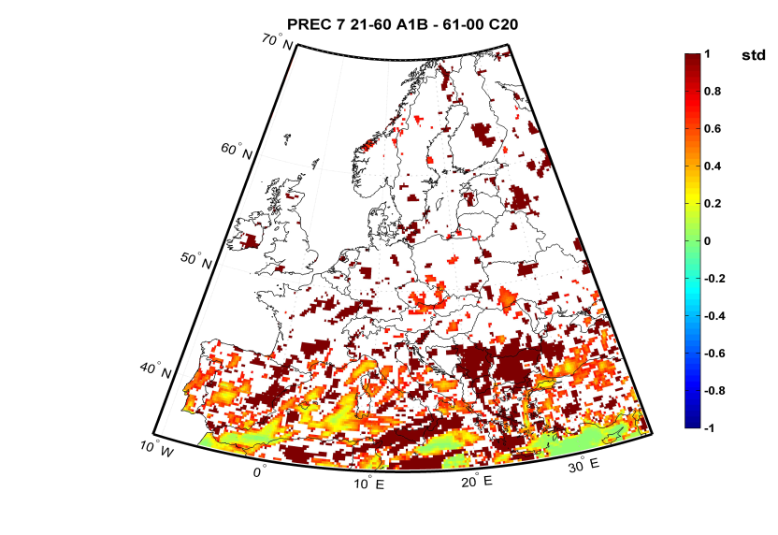
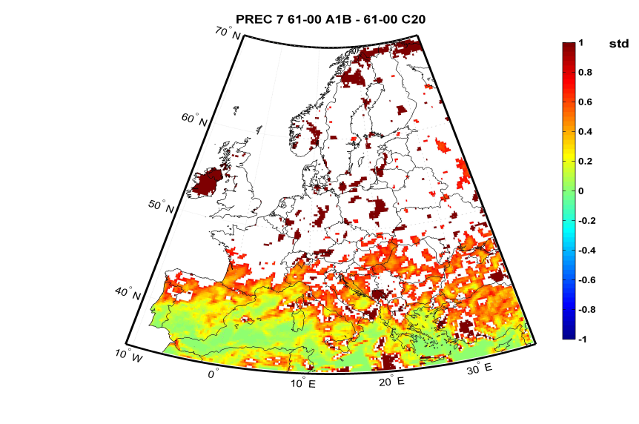
Precipitation
2021-2060 2061-2100
Quotient of the standard deviation precipitation (July)
Quotient between the DSR standard deviation for each period from the 21th century and the 20th century (representation restricts to where are statistically significant)
A1B
B1

Slide 19
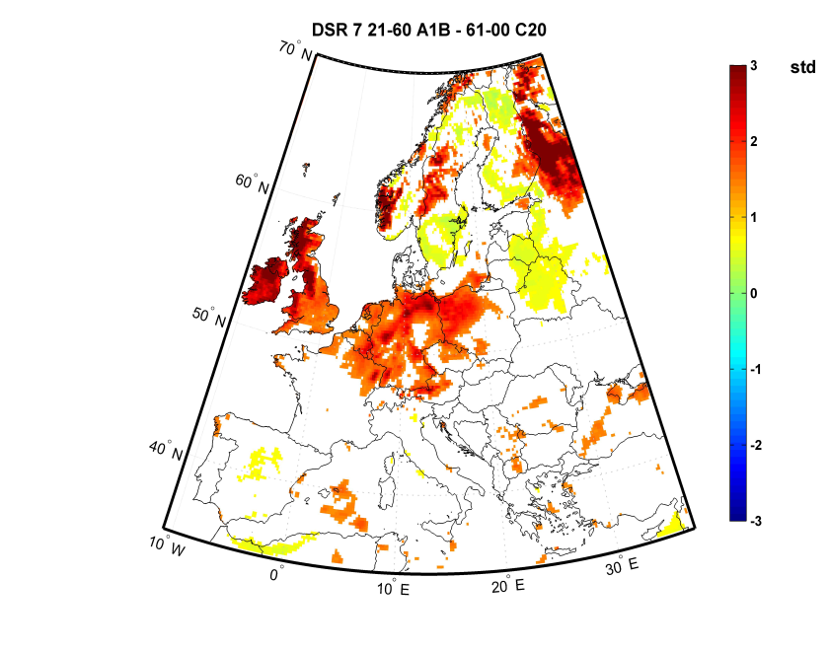
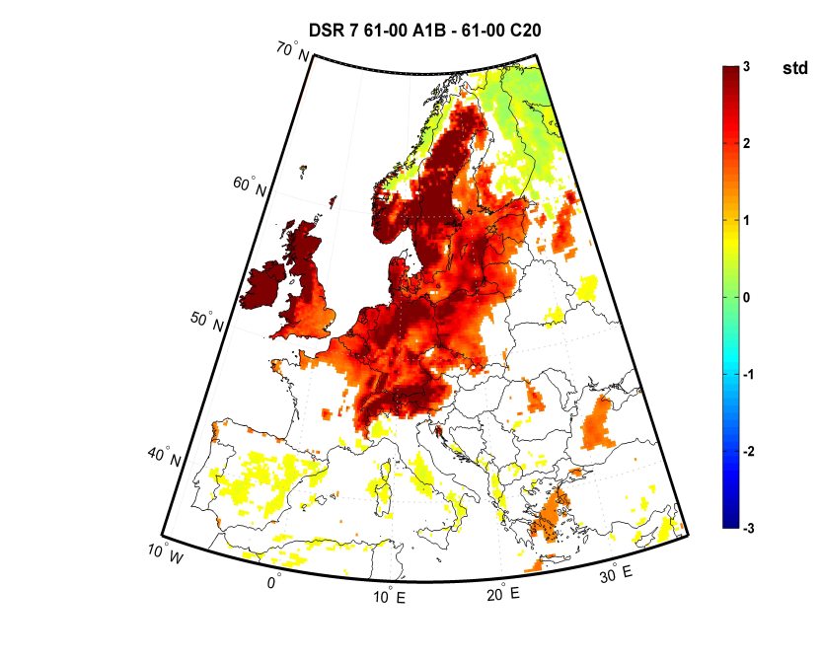
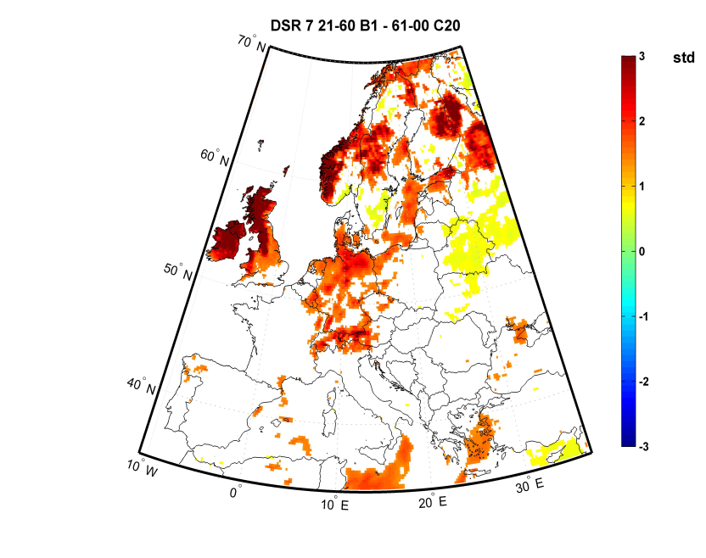
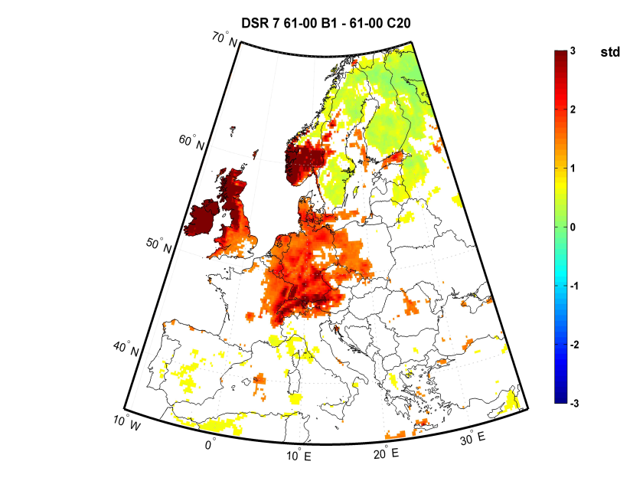
DSR fire season
2021-2060 2061-2100
Quotient of the standard deviation DSR (July)
Quotient between the DSR standard deviation for each period from the 21th century and the 20th century (representation restricts to where are statistically significant)
A1B
B1

Slide 20
Conclusions
In the future scenarios, most of Mediterranean regions will tend to have higher temperature, lower relative humidity and less precipitation.
Fire season tend to be extended to June, in some Mediterranean regions
Higher fire risk in the end of Spring and Summer
Some areas of Central and Eastern Europe will probably have an increasing fire risk
The variance of all variables will tend to increase

Slide 21
Future work
To combine these results with the burnt area models (BAM) developed for Portugal to estimate potential effects of regional climate change on rural fires with higher resolution and reliability;
To try to replicate the procedure developed for Portugal to other regions highly affected by wildfires in Europe.

Slide 22
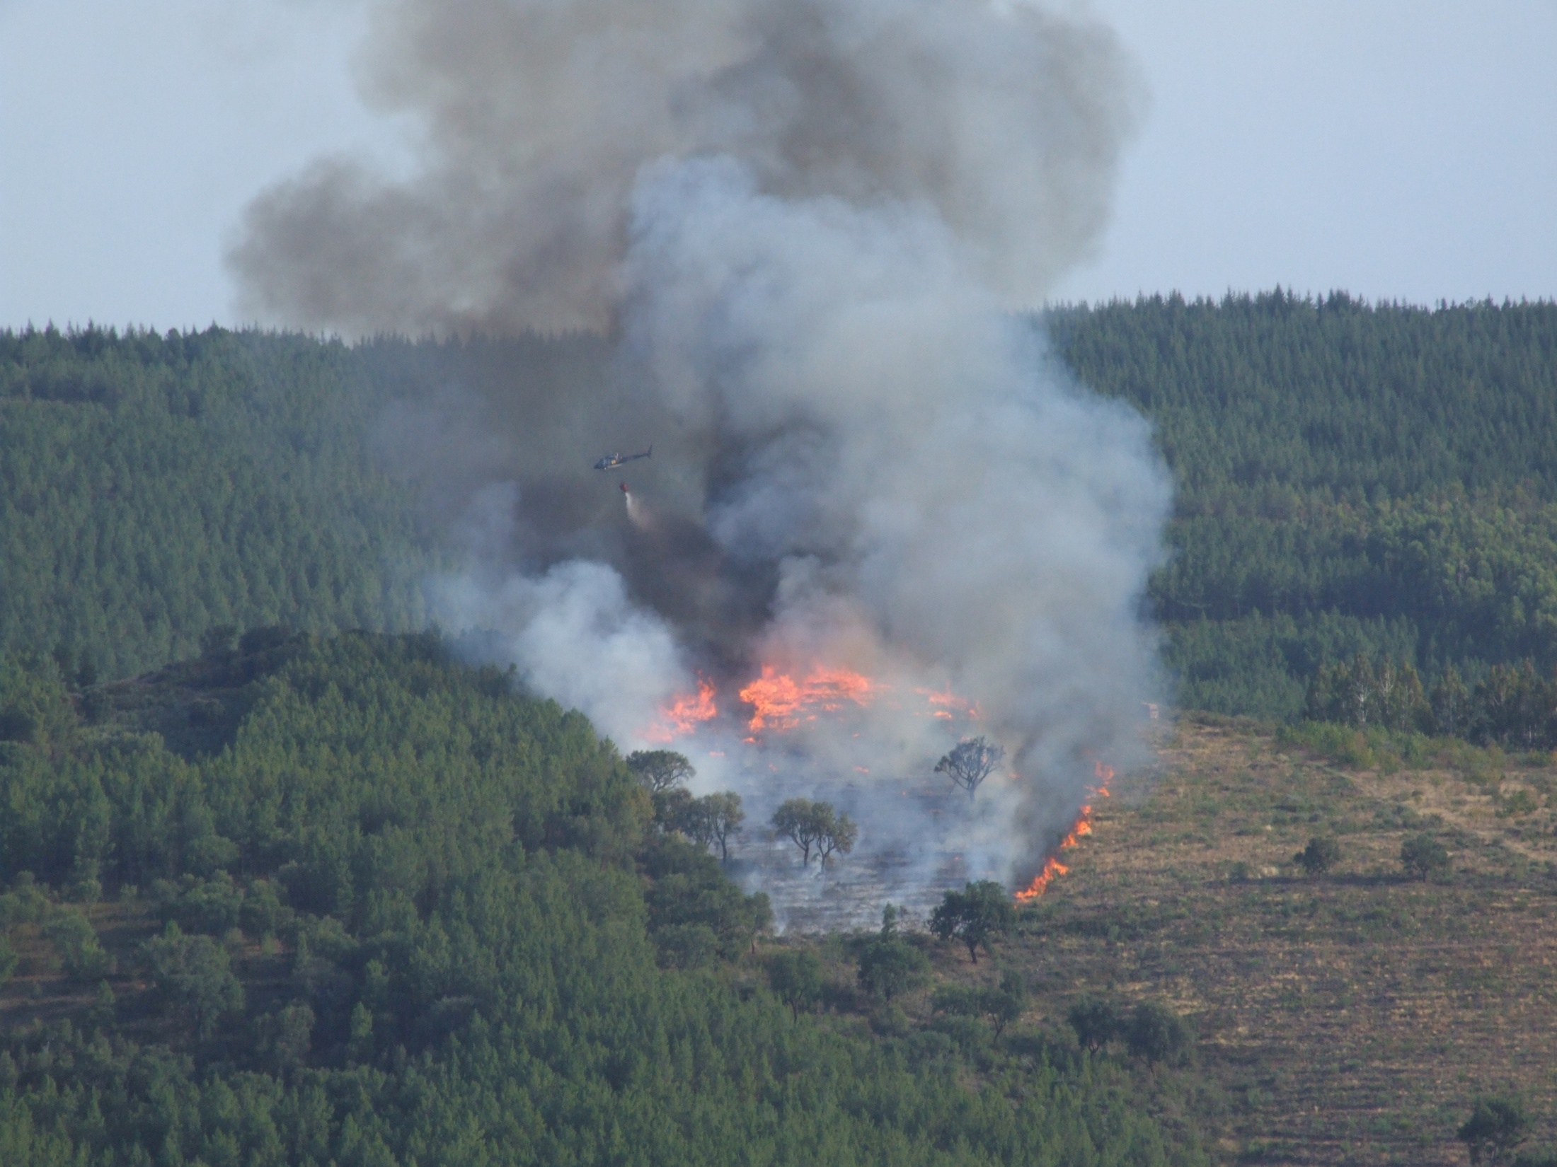
Thank you

Slide 23
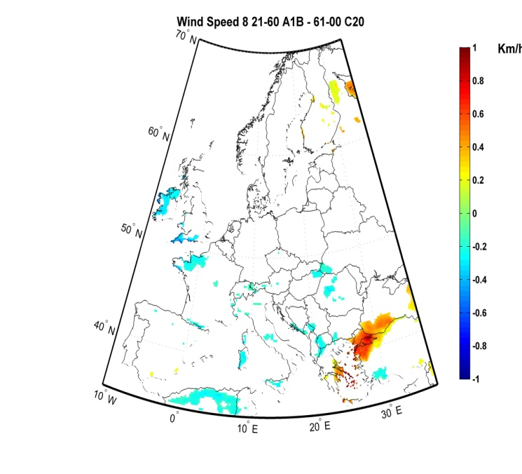
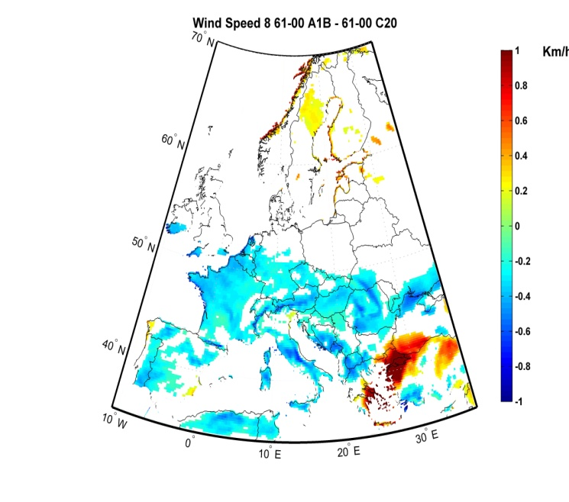
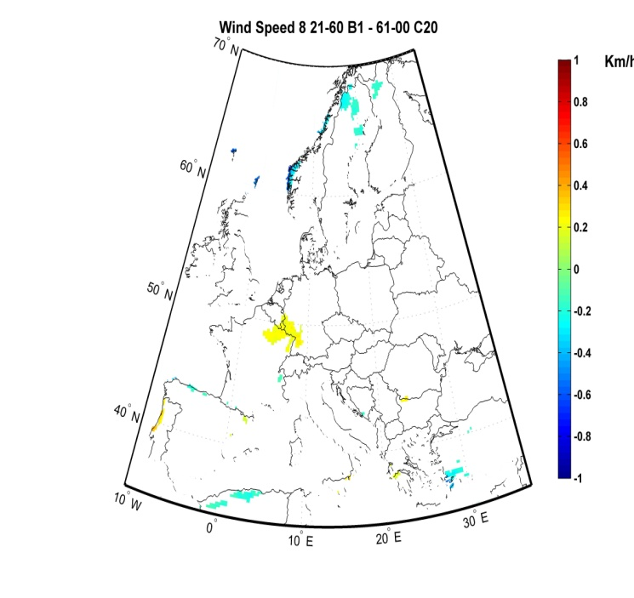
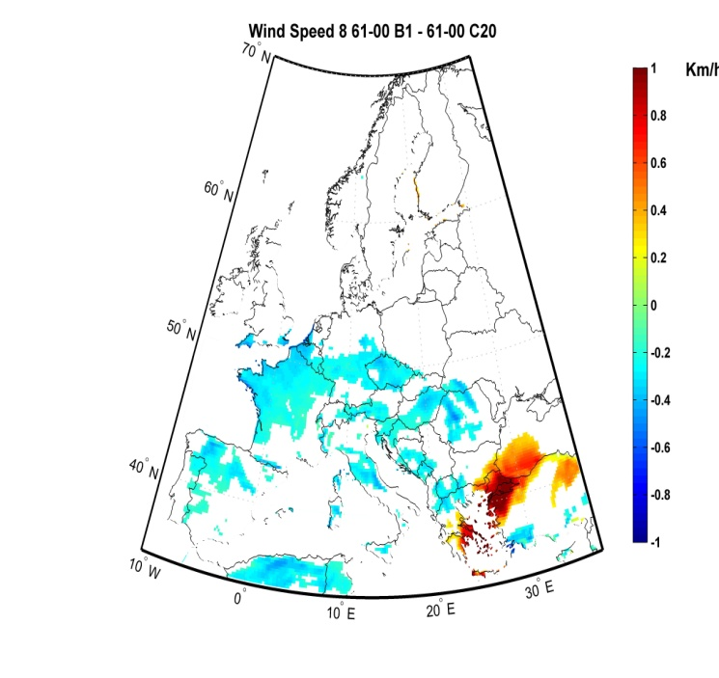
August
Wind Speed
2021-2060 2061-2100
A1B
B1
A1B
B1

Slide 24
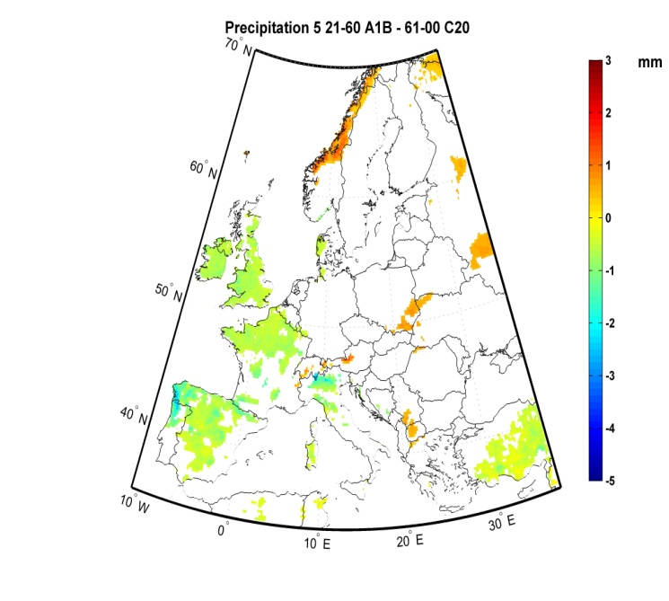
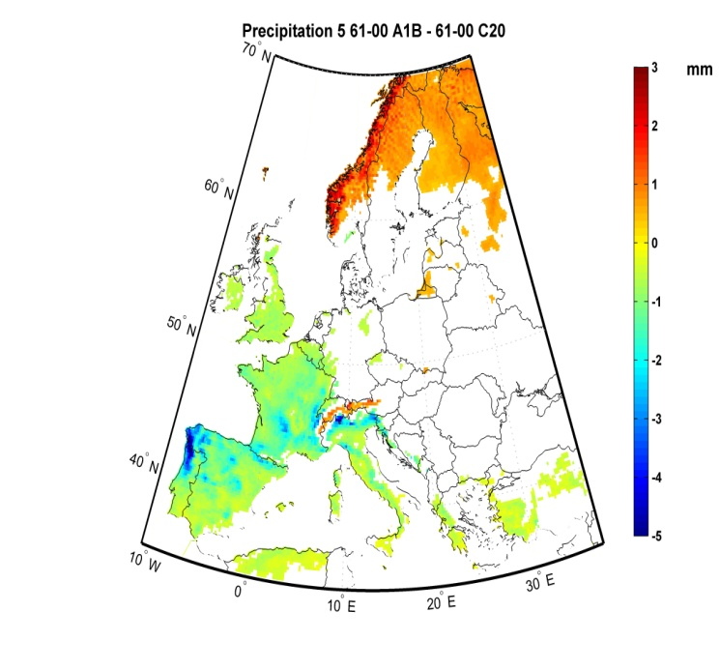
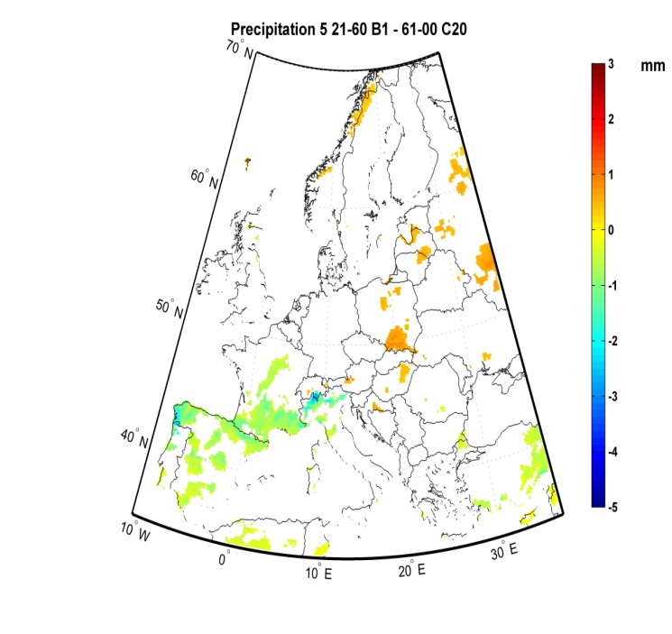
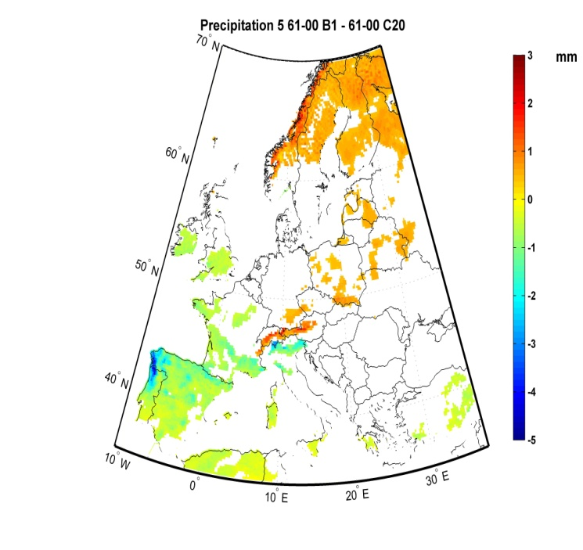
Precipitation
2021-2060 2061-2100
Differences in the mean Precipitation (May)
Differences between the mean projected precipitation for each period from the 21th century and the 20th century (representation restricts to where differences are statistically significant)
A1B
B1

