Slide 1
Vegetation stress and summer fire activity in Portugal
Sílvia A. Nunes, Carlos C. DaCamara, Teresa J. Calado
(sanunes, cdcamara, mtcalado) @fc.ul.pt
CGUL/IDL, University of Lisbon, Lisbon, Portugal
March 2013

Slide 2
Motivation
Wildfires are a major problem in Portugal; the cumulated burned area since 1980 is equivalent to 3/5 of the forested surface.
Like in other regions of Mediterranean Europe, fire activity in Portugal is linked to several atmospheric mechanisms working at different temporal and spatial scales, namely the climatological background and associated weather conditions.
For instance, rainy and mild winters followed by warm and dry summers lead to high levels of vegetation stress.
The aim of this study is to assess the added-value of remote sensed information to monitor vegetation stress during the pre-fire season in Portugal and help building up scenarios of the following fire season.

Slide 3
Goals
Characterize the annual cycles of vegetation and temperature in Portugal and link those cycles with water and thermal vegetation stress
Relate the inter-annual variability of vegetation and temperature cycles with the inter-annual variability of fire activity in Portugal
Build up a simple model that allows anticipating the level of severity of the summer fire season in Portugal

Slide 4
Data
Total annual burned area in July and August, as derived from the official database supplied by Instituto de Conservação da Natureza e das Florestas (ICNF)
15-day composites of the Leaf Area Index (LAI) as derived from the GIMMS LAI3g database, with 1 km spatial resolution, covering the period from August 1981 to November 2011
Daily values of 2-m temperature as derived from ECMWF ERA-Interim reanalyzes

Slide 5
Severe and mild years

Slide 6
Severe and mild years

Slide 7
LAI cycle

Slide 8
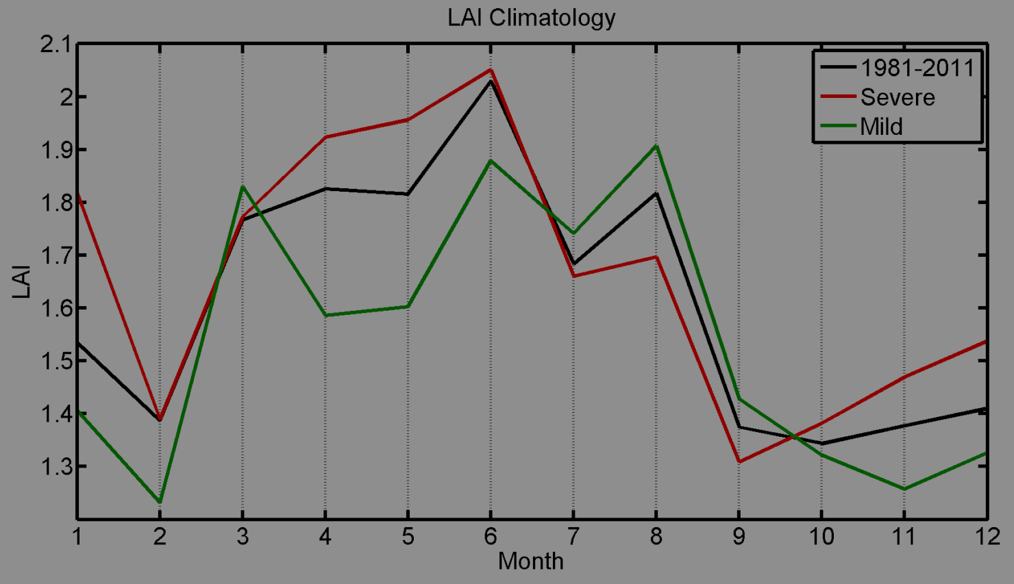
LAI cycle

Slide 9
Temperature cycle

Slide 10
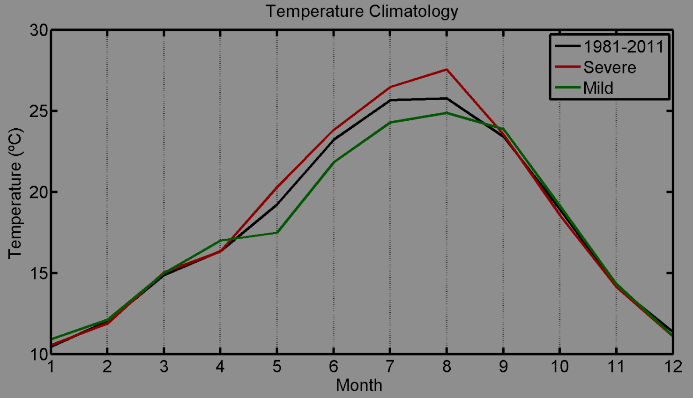
Temperature cycle

Slide 11
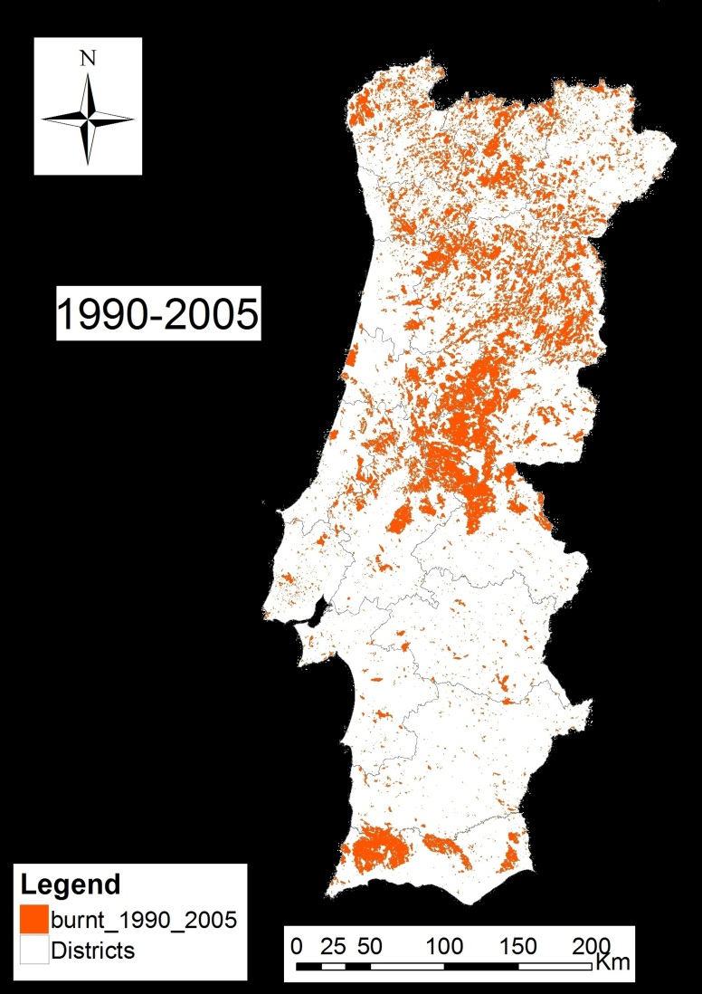
Forest cover and burnt areas
Burnt Area
Forest Cover
Global Land Cover - GLC
Instituto de Conservação da Natureza e das Florestas - ICNF

Slide 12
Vegetation Anomalies
April & May
July & August

Slide 13
Temperature Anomalies
April & May
July & August

Slide 14
Temperature versus LAI

Slide 15
Temperature versus LAI
SEVERE
MORE BIOMASS
MORE
STRESS

Slide 16
Temperature versus LAI
MILD
LESS BIOMASS
LESS STRESS

Slide 17
LAI versus Temperature

Slide 18
Sugeno Model
year | centroid | verbal description
severe | LAI=2.1 | LAI high and temperature high
 | T=26.5 °C
medium | LAI=2 | LAI high and temperature moderate
 | T=25.5 °C
mild | LAI=1.7 | LAI low and Temperature low
 | T=24.5 °C

Slide 19
Result of Sugeno model
 |  | observed
 |  | mild | medium | severe
modelled | mild | 7 | 4 | 0
 | medium | 0 | 9 | 0
 | severe | 0 | 3 | 7

Slide 20
Conclusions
Severe years of fire activity are associated to Severe positive anomalies of LAI in spring (biomass availability) followed by positive anomalies of temperature in summer (favorable conditions for ignition)
Mild years of fire activity are associated to negative anomalies of LAI in spring (lack of biomass) followed by negative anomalies of temperature in summer (unfavorable conditions for ignition)
A simple verbal model, using spring LAI and summer temperature as predictors is able to predict the level of severity of the summer season
This model may be used by forest fire managers to anticipate the degree of severity of the summer fire season in Portugal

