Slide 1
Google-Earth use as a monitoring tool for EUMETSAT’s active fire product
Assist.Prof. İbrahim SÖNMEZ
Ondokuz Mayıs University
Department of Meteorology
Samsun, TURKEY
isonmez@omu.edu.tr

Slide 2
OUTLINE
Google-Earth media
MSG data & product characteristics
Exercise : Generating a Google-Earth kml file
Operational aspect of the Google-Earth representation
Summary/Conclusions

Slide 3
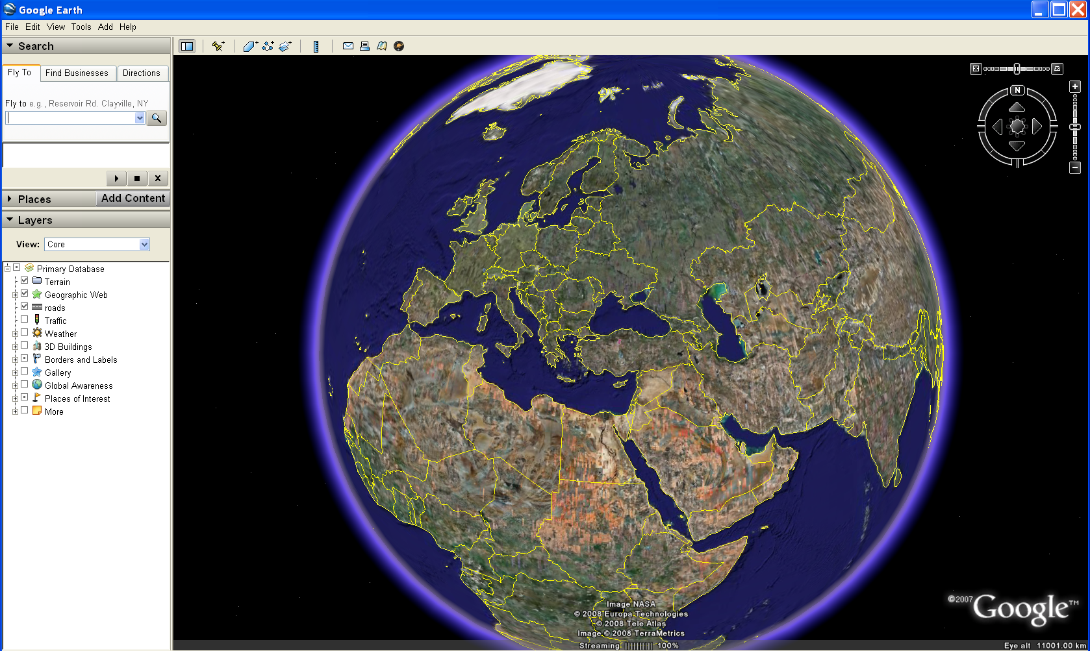
Why Google Earth?
A free application that enables 3D Earth & 2D Maps

Slide 4
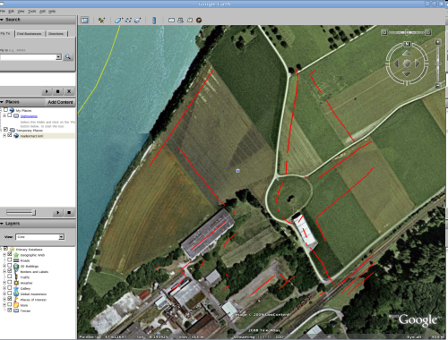
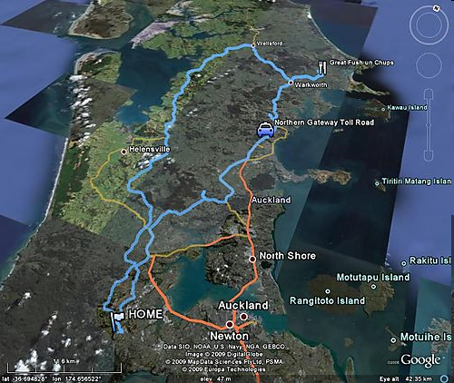
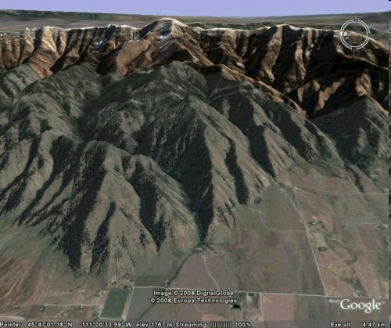
Why Google Earth?
Google-Earth combines:
Satellite images
Maps
Geographic info
vegetation type/cover
settlemets
... etc

Slide 5
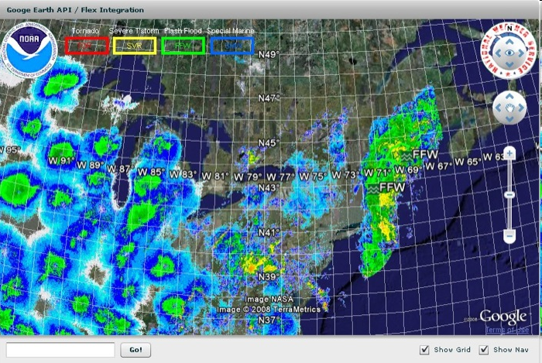
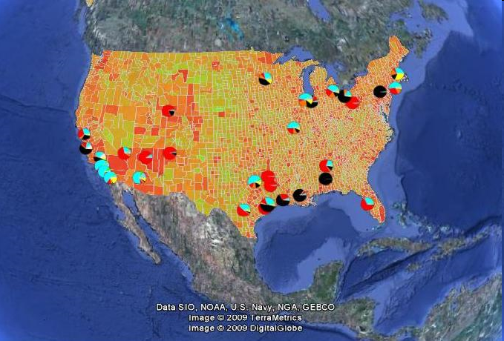
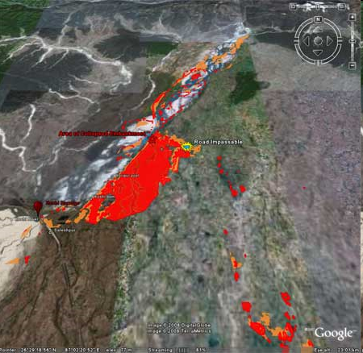
Why Google Earth?
Google-Earth media
enables;
the interaction of the geographic info and the corresponding research data
Carbon emission
Flood warning
Weather info
Why not use Google-Earth to visualize
satellite data & products?

Slide 6
MSG Data & Products
MSG
Data & Products
Continious
Discrete
* Channal raw data
* Channel reflectance & BT data
* ..etc
* Cloud mask product
* Fire product
* precipitation product(MPE)
* …etc

Slide 7
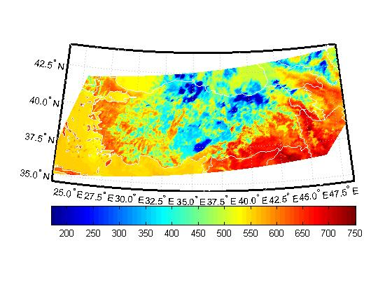
MSG Data & Products
Count data for Channel 9 (10.8 μm)
20090717 at 12:00 UTC
Continious

Slide 8
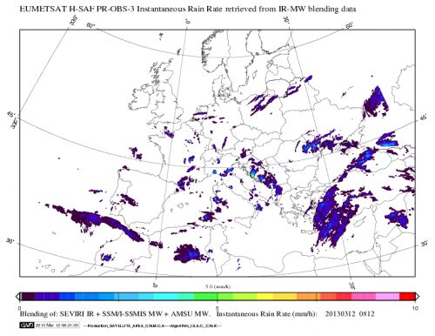
MSG Data & Products
Blended precipitation product from H-SAF
20130312 at 08:00 UTC
Discrete

Slide 9
Playing with Google Earth media
MSG data & products are pikselwise variables !
How can we write a code or macro to visualize a piksel(polygon so to speak)?
The lat-long info for the MSG pixel corners need to be determined !

Slide 10
MSG Data & Products
MSG scan frame is fixed so that row-column reference is usually preferred rather than lat-lon
A code in c language is available inEUMETSAT web page which returns the MSG pixel center lat-lon info.
[Lat, Lon] =f(row, column)

Slide 11
MSG Data & Products
raw
column

Slide 12
Sample MSG FIR Product
Data from EUMETSAT, Satellite: MET09, Date: 2008/05/27 12:15Z Row: 724 Col: 1249 Lat: -34.020 Lon: 20.994 *** Probable fire *** Row: 1161 Col: 1114 Lat: -19.733 Lon: 22.314 Possible fire Row: 1161 Col: 1115 Lat: -19.732 Lon: 22.282 *** Probable fire *** Row: 1161 Col: 1116 Lat: -19.731 Lon: 22.249 Possible fire Row: 1162 Col: 1114 Lat: -19.702 Lon: 22.309 Possible fire Row: 1162 Col: 1115 Lat: -19.701 Lon: 22.276 Possible fire Row: 1162 Col: 1116 Lat: -19.701 Lon: 22.244 Possible fire Row: 1163 Col: 1115 Lat: -19.671 Lon: 22.271 Possible fire Row: 1231 Col: 1081 Lat: -17.657 Lon: 23.042 Possible fire Row: 1232 Col: 1081 Lat: -17.627 Lon: 23.037 Possible fire Row: 1239 Col: 996 Lat: -17.489 Lon: 25.815 Possible fire Row: 1249 Col: 1040 Lat: -17.154 Lon: 24.298 Possible fire Row: 1250 Col: 1040 Lat: -17.125 Lon: 24.293 Possible fire Row: 1250 Col: 1041 Lat: -17.124 Lon: 24.260 Possible fire Row: 1255 Col: 1077 Lat: -16.948 Lon: 23.061 Possible fire

Slide 13
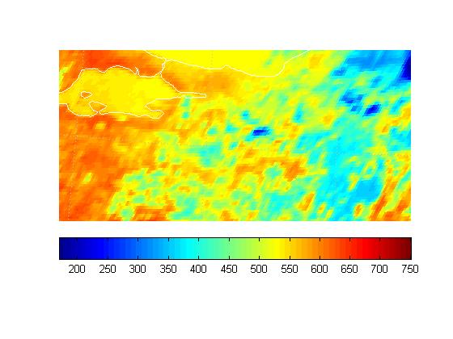
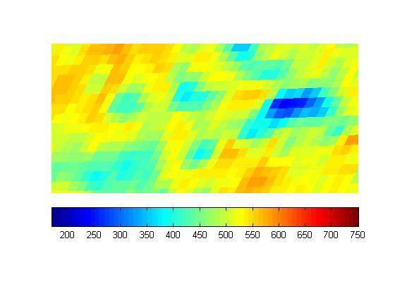
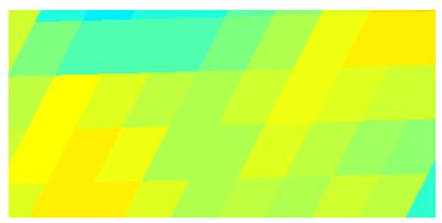
MSG data representation
Count data for Channel 9 (10.8 μm)
20090717 at 12:00 UTC
•
•
•
•
•
•
•
•
•
•
•
•
•
latitude
longitude

Slide 14
What to do?
What we have?
Row-column info of MSG pixels with PROB or POS product type info.
What can we do?
Write a code/function (in C, Fortran, MatLab, etc ) that
estimates pixel corner coordinates.
generates the kml file
using the corresponding MSG pixels’ info.

Slide 15
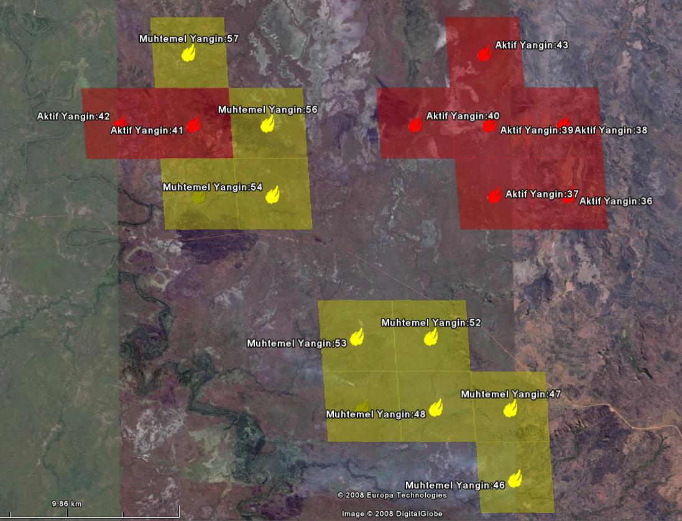
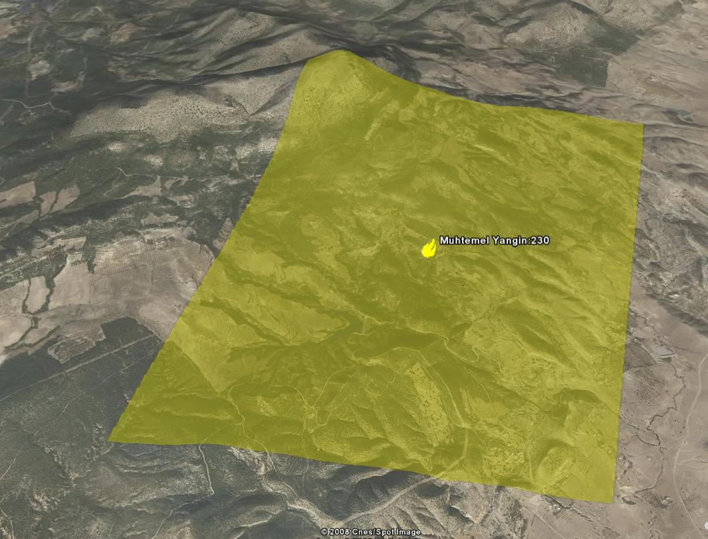
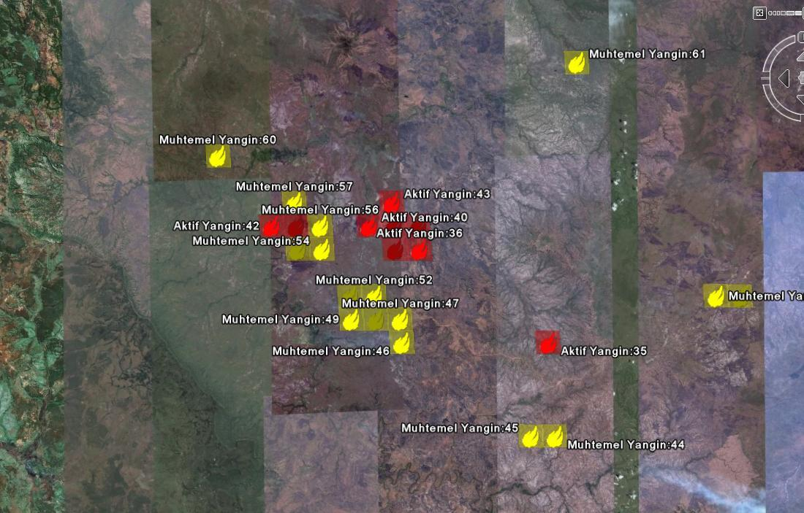
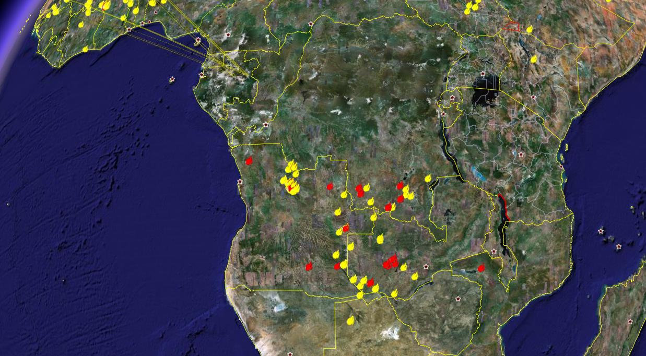
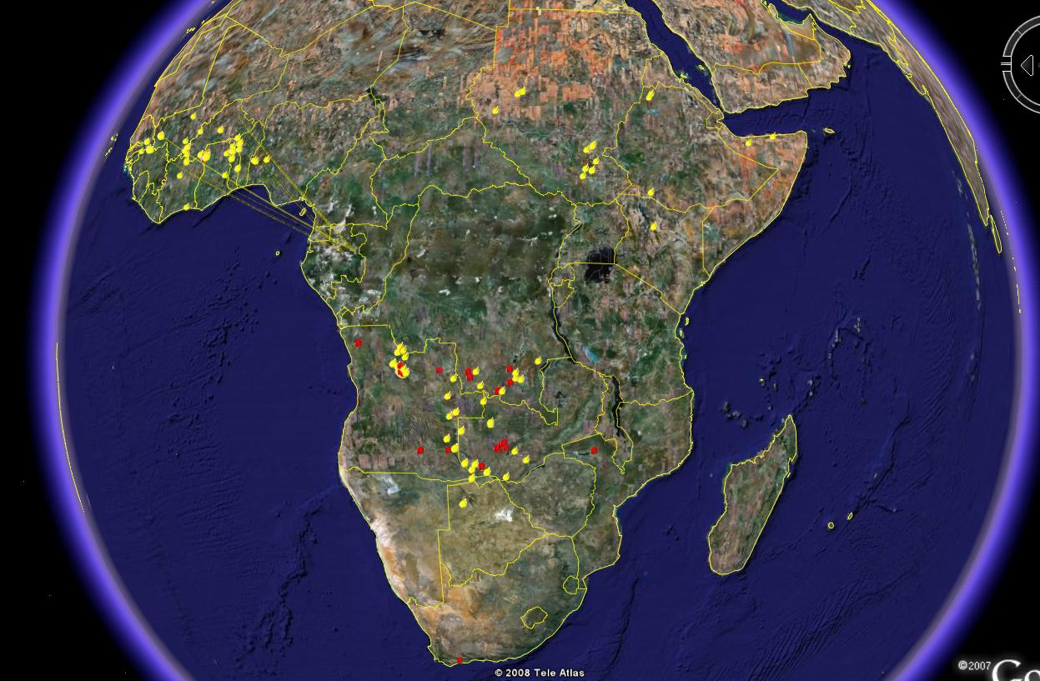
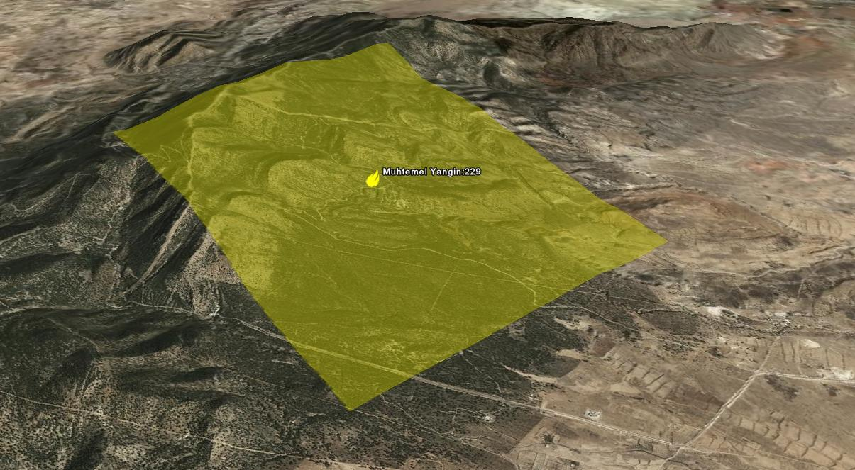
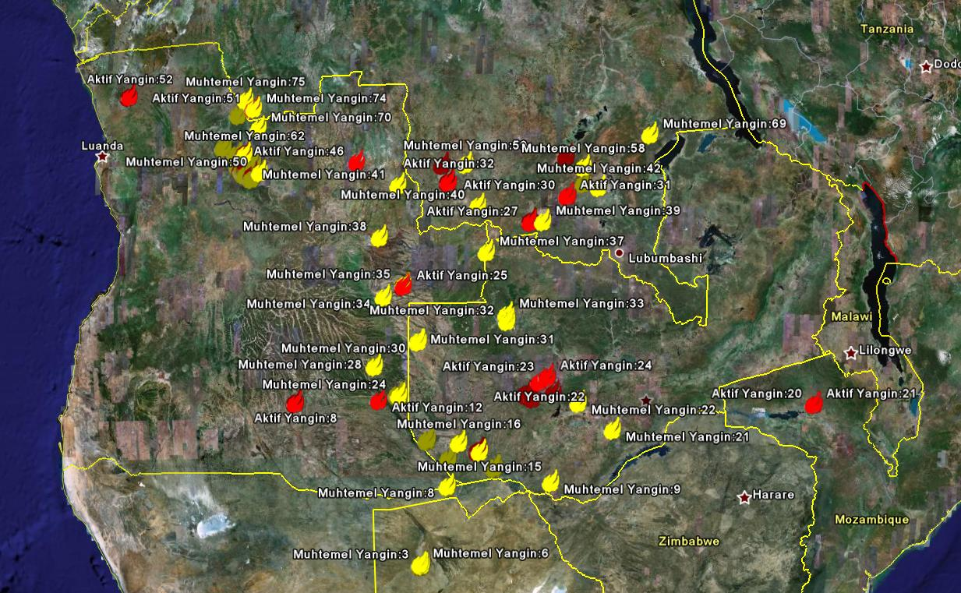
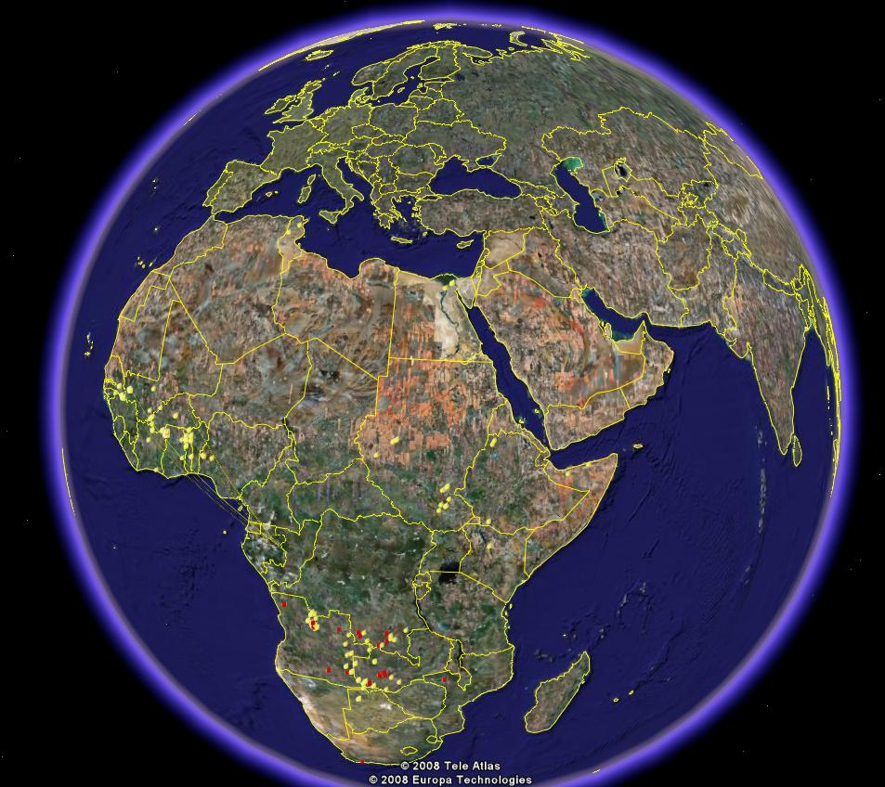
MSG FIRE PRODUCT/Global
May 27, 2008 @12:15UTC

Slide 16
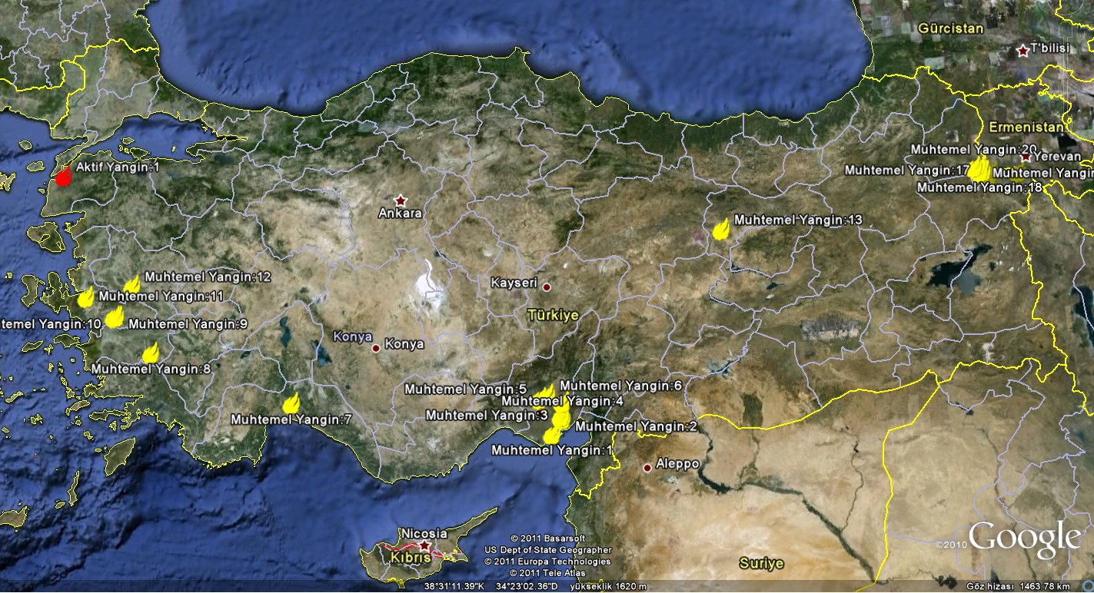
MSG FIRE PRODUCT/Turkey
July 30, 2008 @10:30UTC

Slide 17
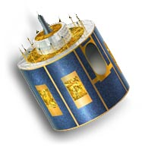
Processing chain @TSMS
Data received by EUMETCast
Wait for new scan
Date/Time Check
No new product
Subset Turkey region
No
No
Fire?
Yes
Yes
Prepere
KML file
Prepere
ASCII file
Release
WARNING
Data Storage for
further analysis
Google-Earth
representation
SMS
* Gray areas under construction

Slide 18
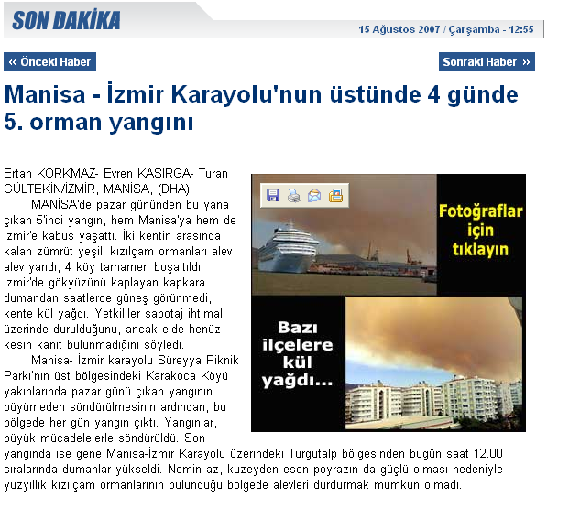
Case Study [15 August 2007]
Forest fire near Manisa-İzmir roadway...

Slide 19
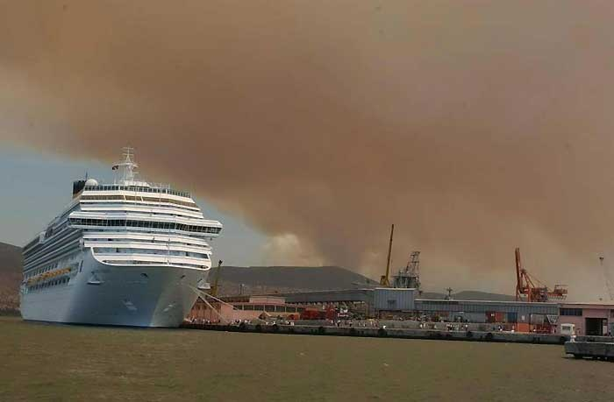
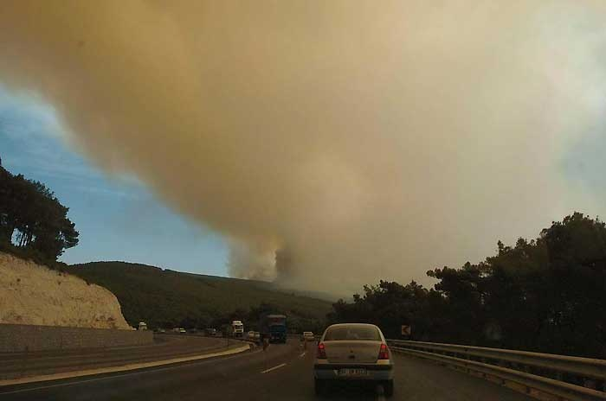
Case Study [15 August 2007 10:20]

Slide 20
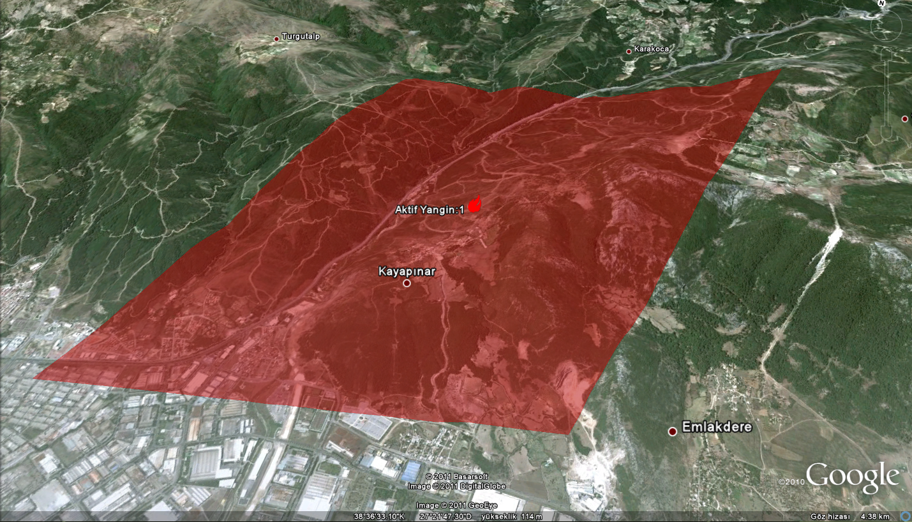
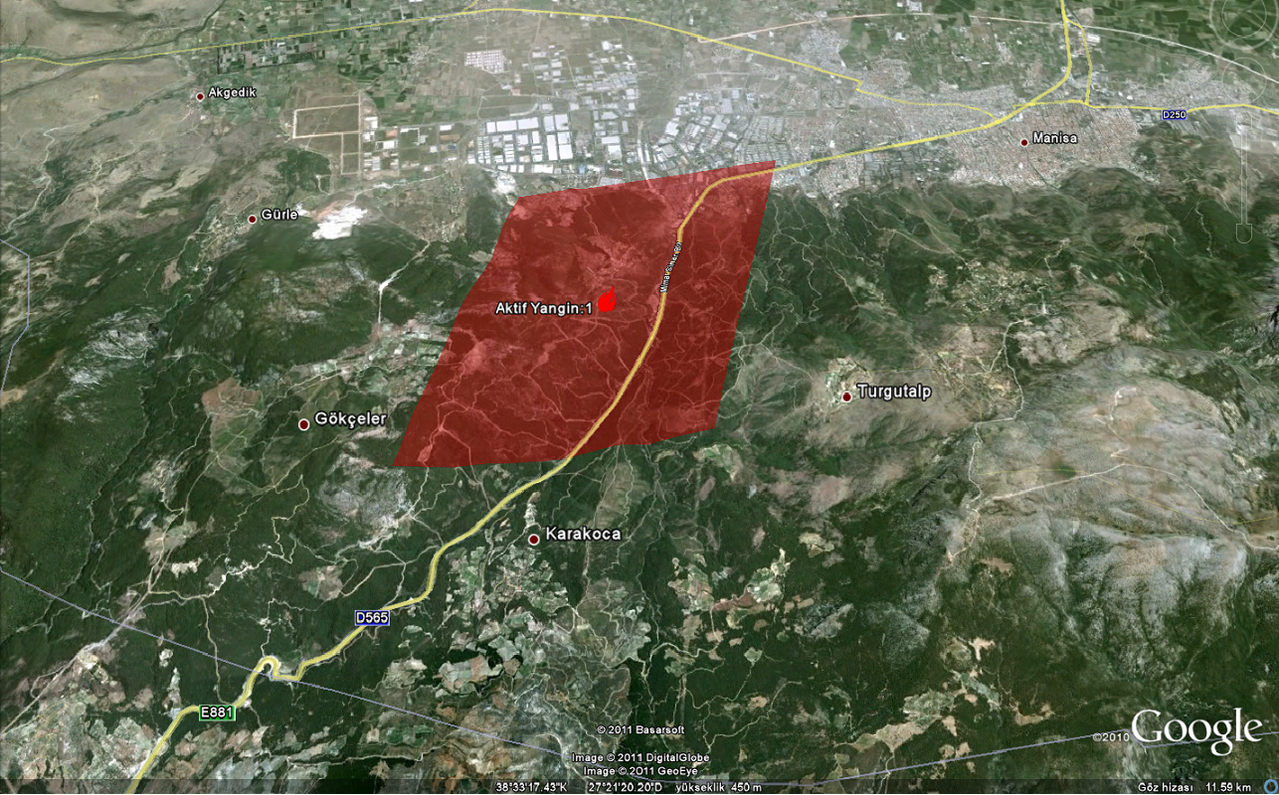
Google-Earth representation

Slide 21
Google-Earth representation
From an operational( fire fighters) point of view, Google-Earth visualization is useful for;
gathering information about
related site
vegetation type/cover underneath the satellite footprint
determination of the fire fighting strategy
accessibility information to the fire place
potential skimming water locations, such as lakes, reservoirs or rivers, for refilling tanks/carry buckets

Slide 22
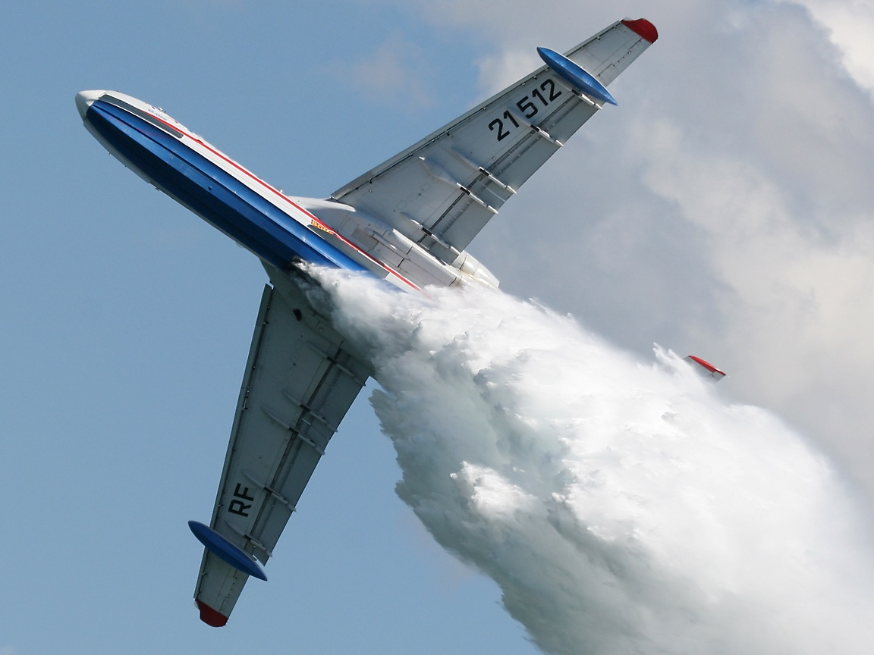
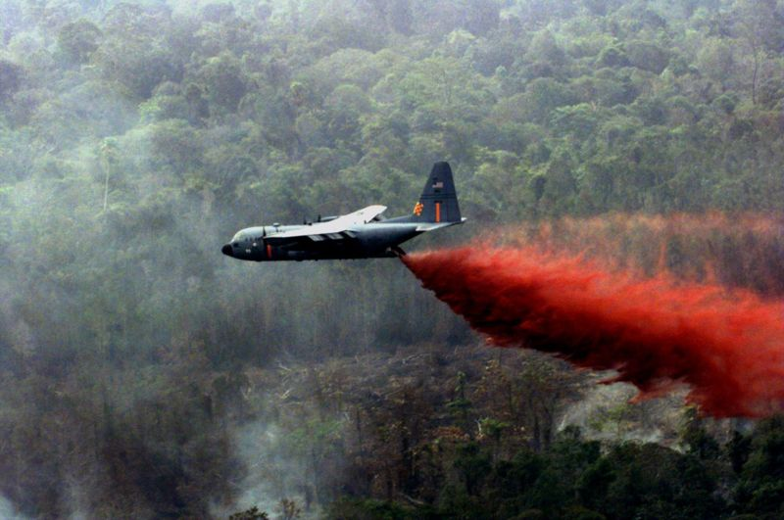
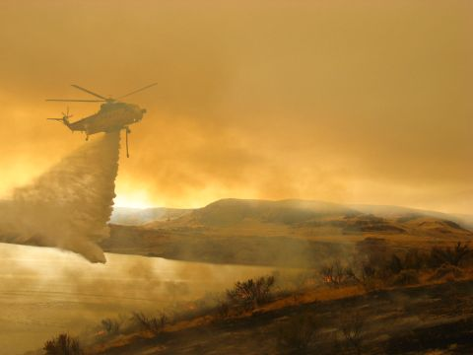
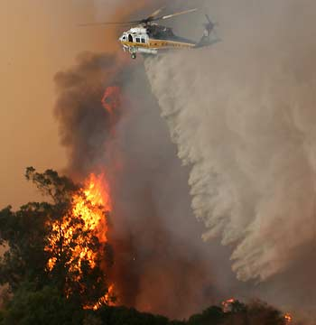
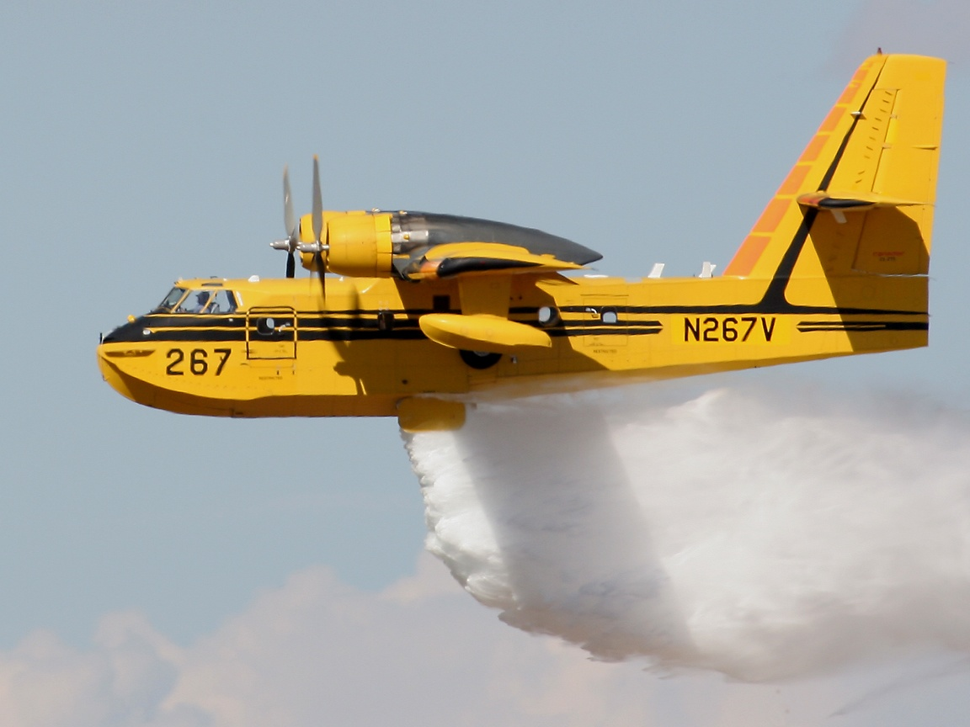
Aerial firefighting
Helicopters & Airtankers are commonly used

Slide 23
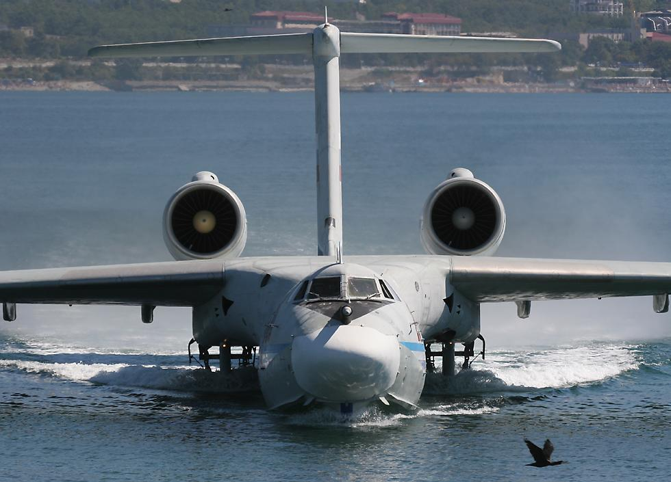
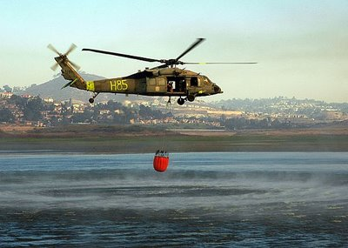
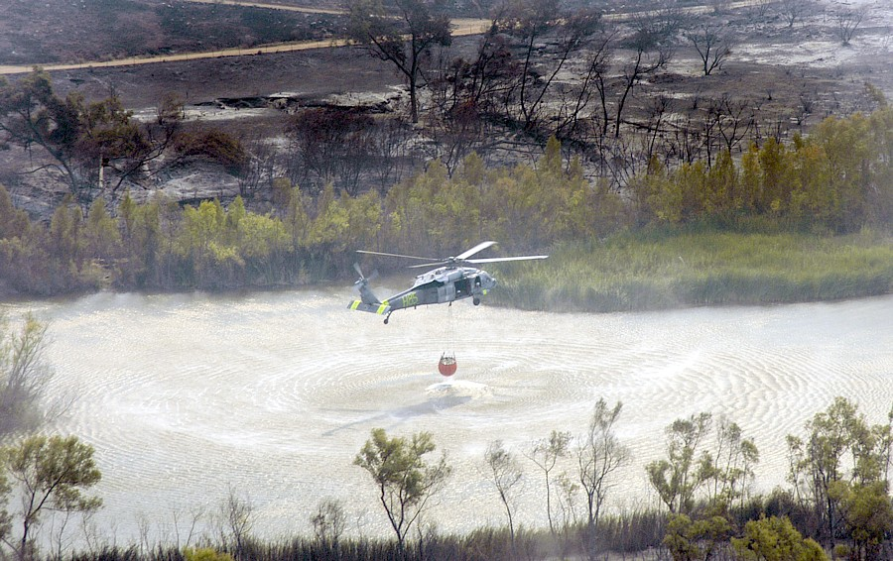
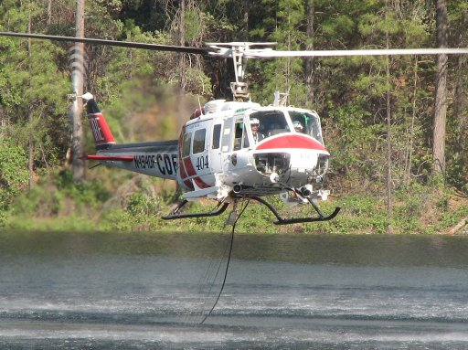
Aerial firefighting
Tanks/Carry Buckets needed to be refilled

Slide 24
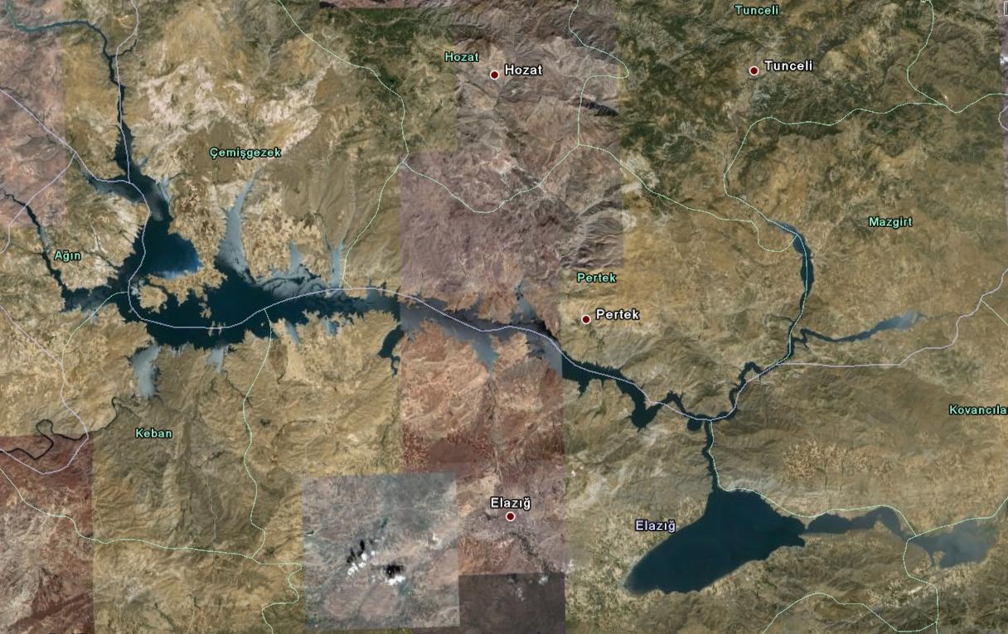
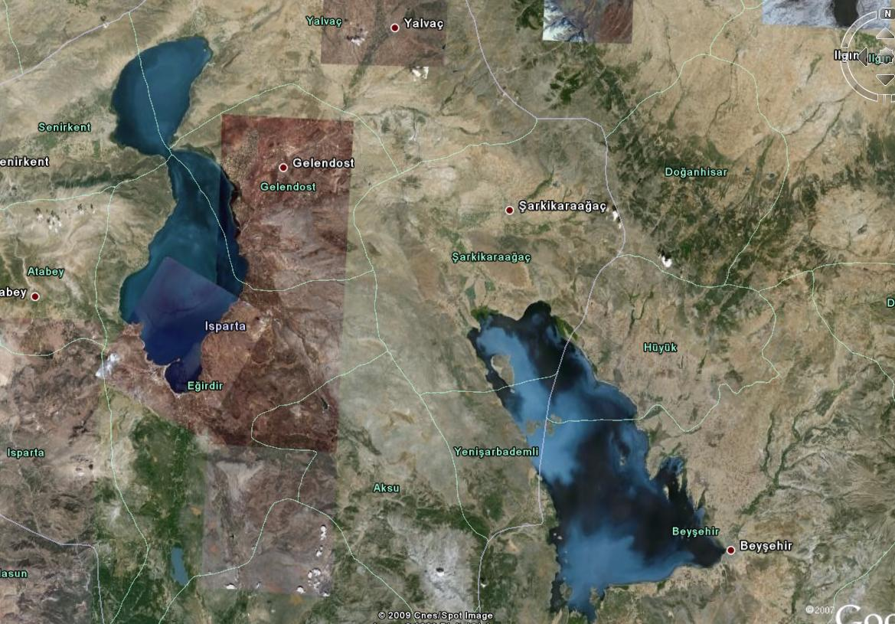
Aerial firefighting
Also useful in determination of water sources.

Slide 25
Summary/Conclusion
Google-Earth:
enables interaction of the geographic info and the corresponding research data
helps to determine the fire fighting strategy
provides info;
about the accessibility & vegetation type/cover of the fire site
potential skimming water locations, such as lakes, reservoirs or rivers, for refillingg tanks/carry buckets

Slide 26
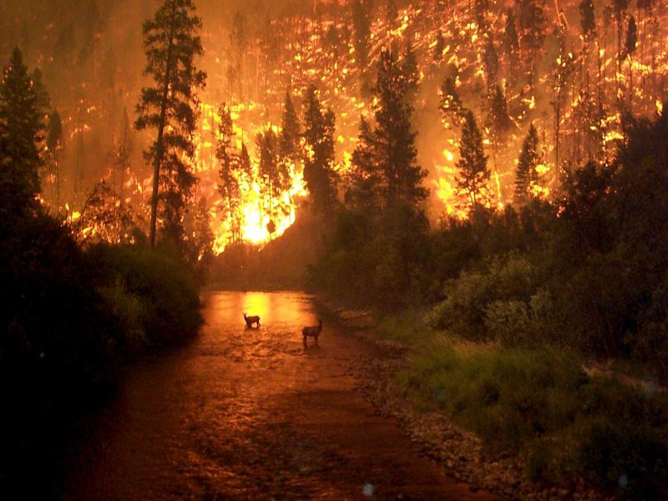
Comments/Questions

