Slide 1
Estimation of drought condition over Ukraine using ground and satellite data
Oleksii Kryvobok
Ukrainian Hydrometeorological Research Institute, Kyiv, Ukraine

Slide 2
Outline
- the scheme of processing of operational meteorological data;
operational products for estimation of drought conditions over Ukraine;
satellite based indices products;
- some examples of products.

Slide 3
The scheme of processing of operational meteorological data
Raw daily station data base
Checking
Processing
Station
database
Daily weather database
Interpolation
Daily grid weather database
Grid database
LLong Term Average Daily Grid Weather Database m
Production of weather indicator maps
Soil database
Aggregation of weather indicator to region and district levels
Aggregation of soil indicator to region and district levels

Slide 4
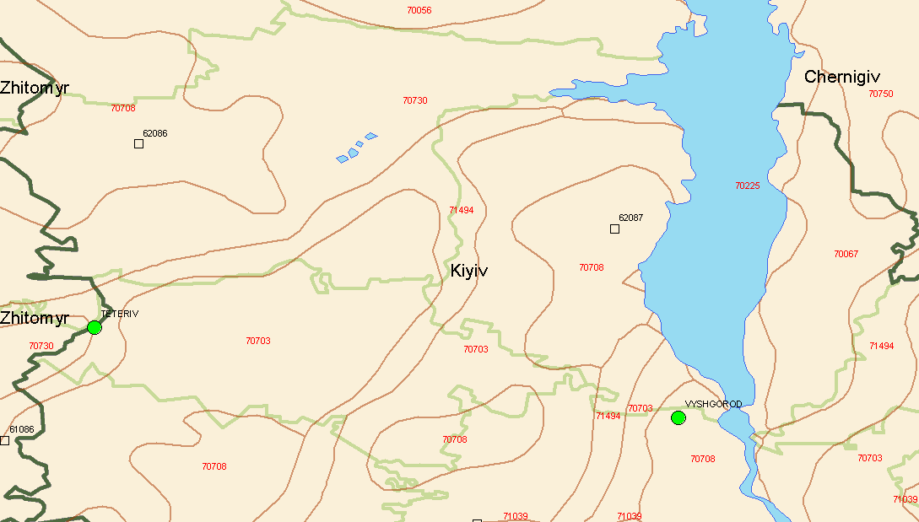
The Elementary Mapping Unit (EMU) is defined as the intersection of climatic grid cells, Soil Mapping Units (SMU’s), and administrative regions
meteodata
Soil data
admin.levels
where, Y_{N2} simulated soil parameter
at administrative level 2, n number of
EMU’s at administrative level 2,
A_{E} - EMU area [ha]
C_{E} - fraction of the EMU area
of specific type of vegetation.

Slide 5
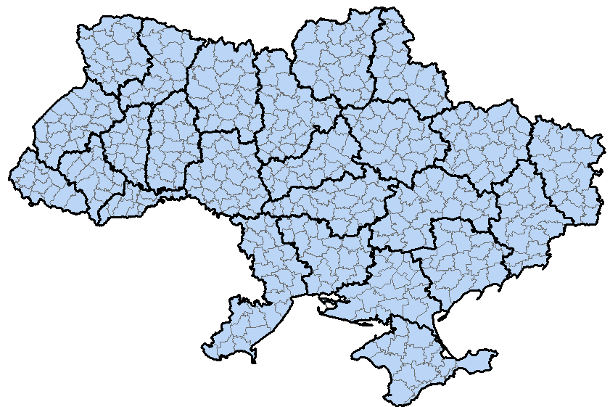
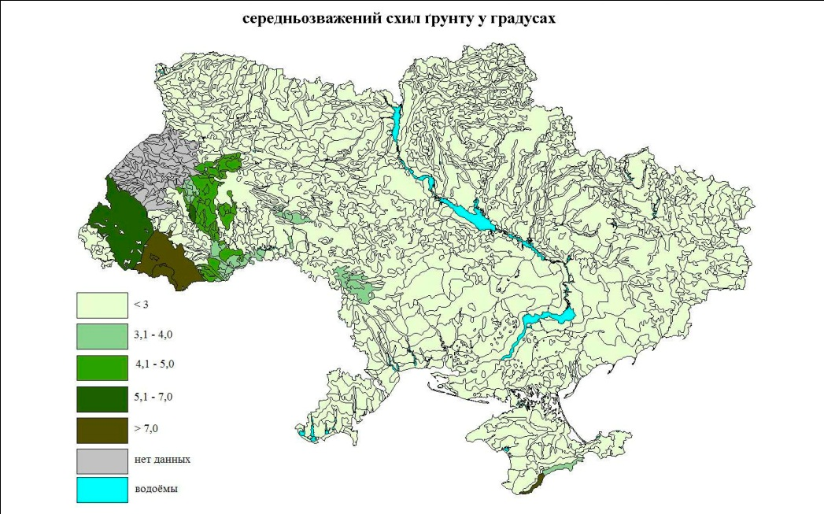
Soil Map (1:2500000) Administrative division
Slope of the surface

Slide 6
Operational products for estimation of drought conditions over Ukraine
ET0 – Potencial Evapotranspiration is calculated with the well-known Penman formula (Penman, 1948) ;
Soil Moisture Content based on Soil Water Balance calculations (Driessen, 1986);
Hydro-Termal Coefficient (GTK) (Selyaninov, 1926)
GTK=10$\sum{R/}\sum{T10},$
where R – precipitation in mm, $T10$ – temperature more than 10ºC

Slide 7
Satellite data (http://www.star.nesdis.noaa.gov/star)
Vegetation Health Indices (VCI, TCI and VTI)
VCI=(SMN-NDVImin)/(NDVImax-NDVImin) *100
where, NDVImax, and NDVImin are the multi-year maximum and minimum NDVI for a pixel; VCI is vegetation condition index, valued from 0 to 100, shows moisture conditions. Lower VCI values indicate less vegetation cover.
TCI=(Tmax-SMT)/(Tmax-Tmin) *100
where, Tmax, Tmin are the multi-year maximum and minimum temperature for a pixel. TCI is temperature condition index, valued from 0 to 100, shows thermal conditions. Higher values of TCI indicate wetter conditions at surface.
VTI=(VCI+TCI)/2.
VTI is vegetation-temperature index or the so-called "Vegetation Health Index", valued from 0 to 100.VTI is a drought indicator - the lower the value, the drier the surface.

Slide 8
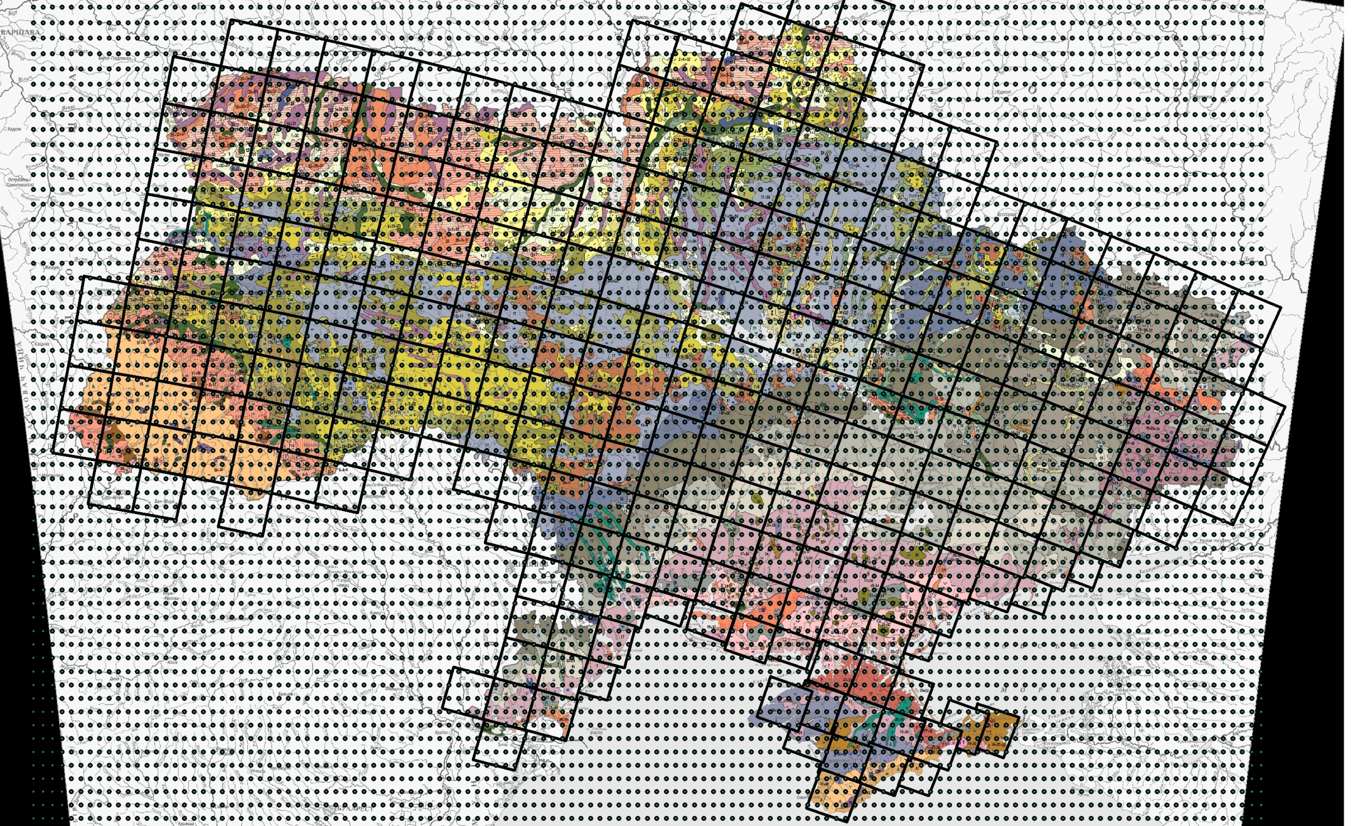

Slide 10
2003
Temperature anomalies
Precipitation

Slide 11
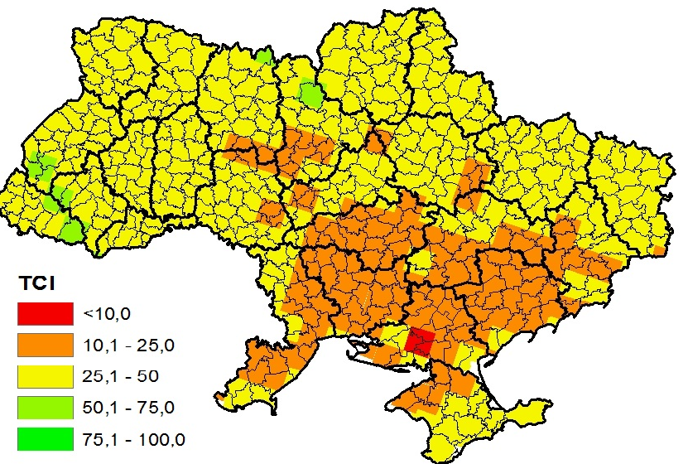
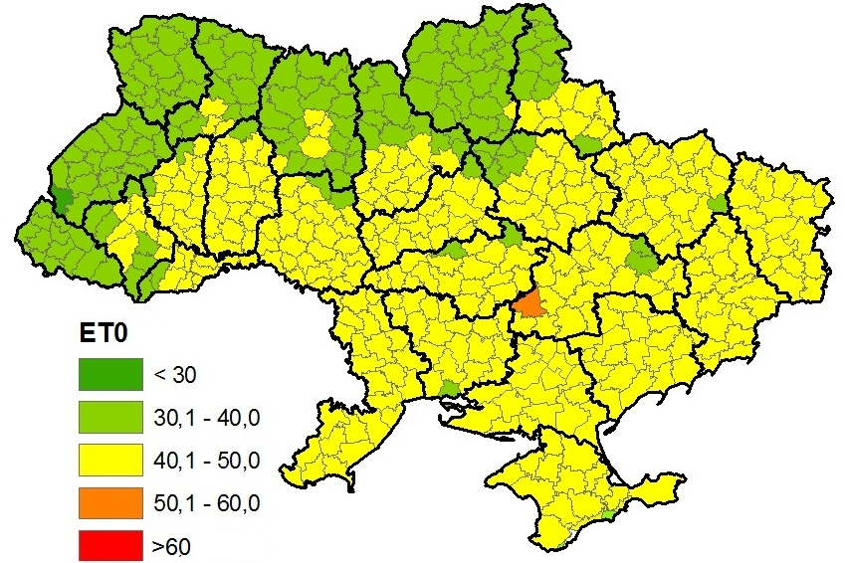
2003 ( 13th decade)

Slide 12
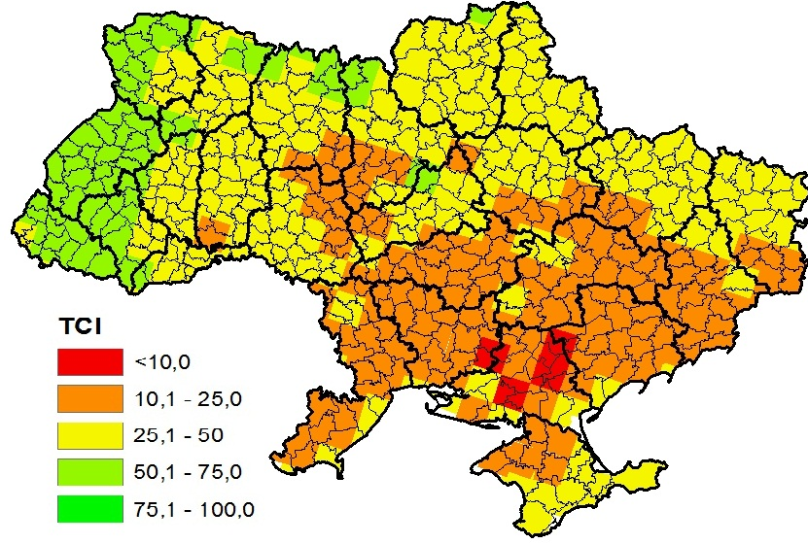
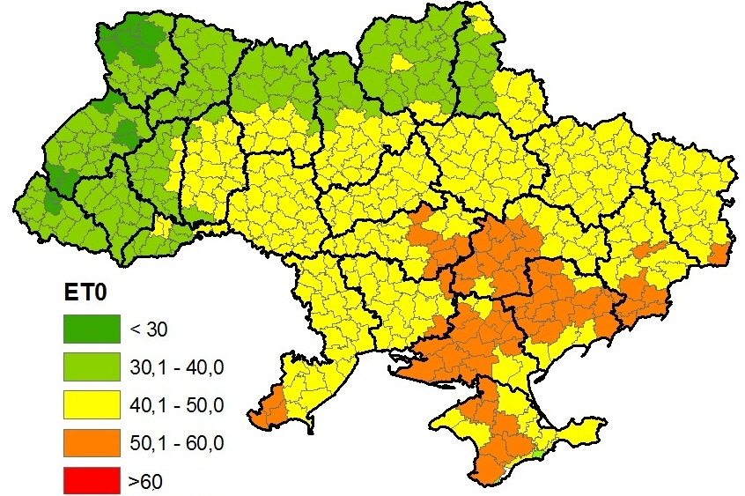
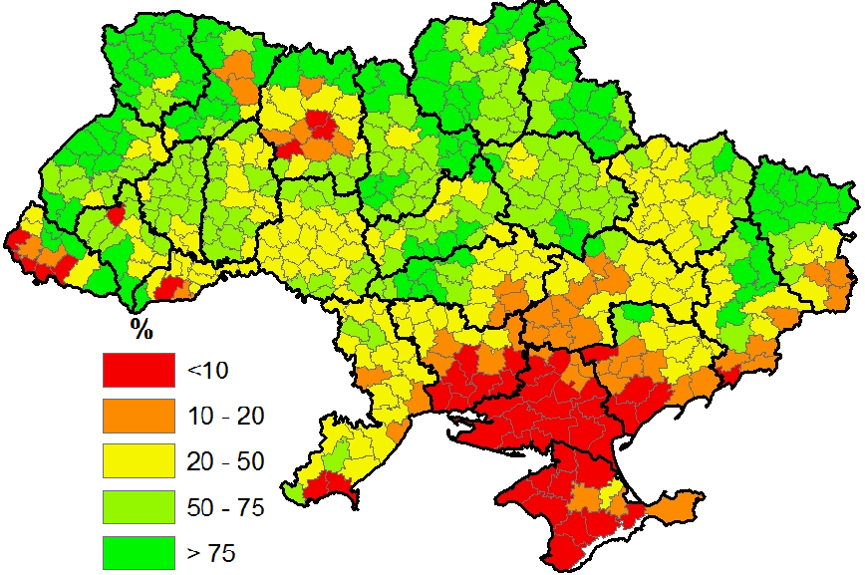
2003 ( 14th decade)

Slide 13
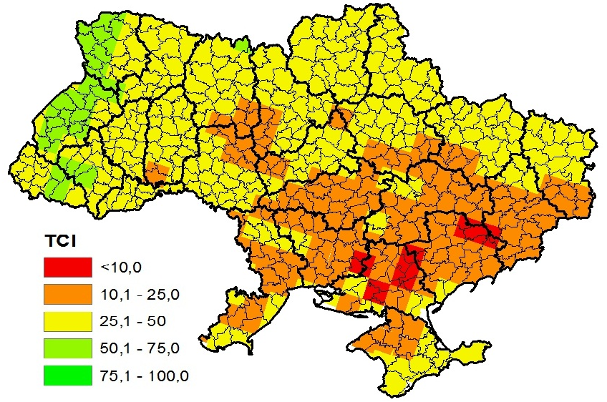
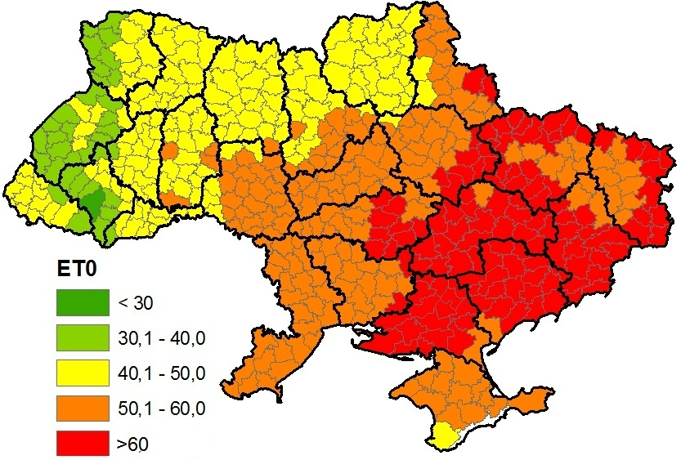
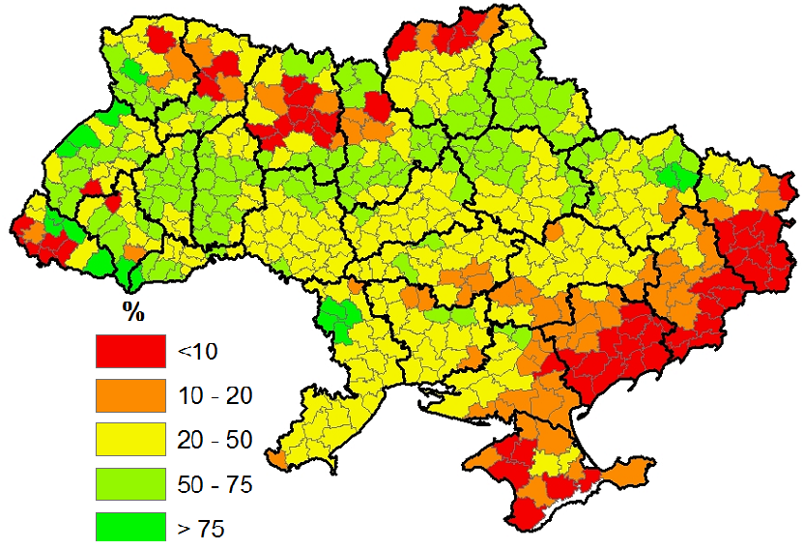
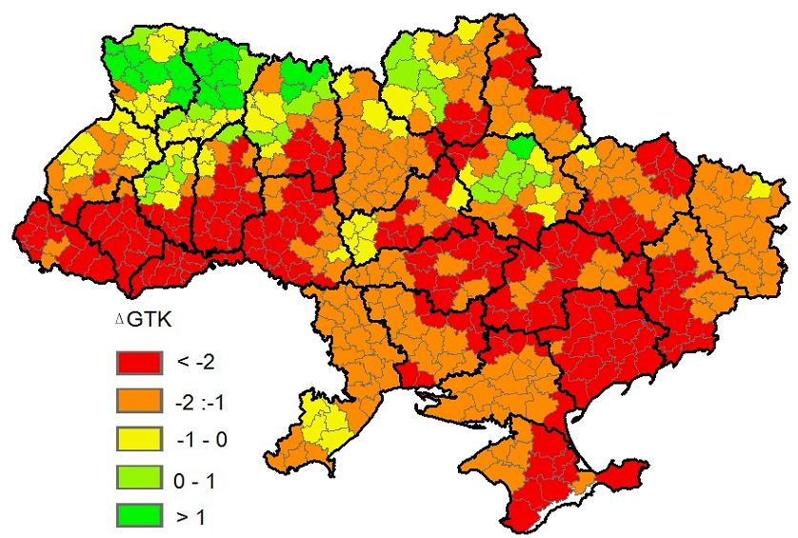
2003 ( 15th decade)

Slide 14
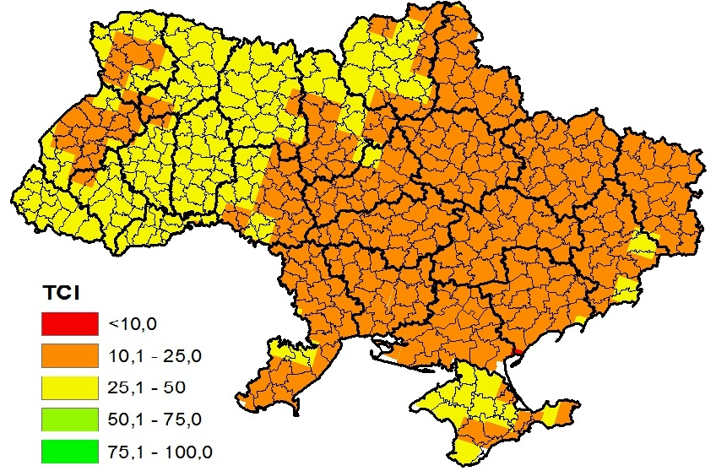
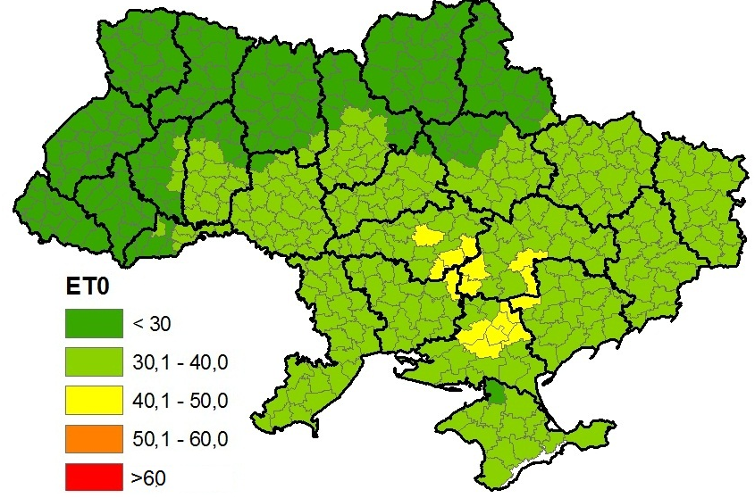
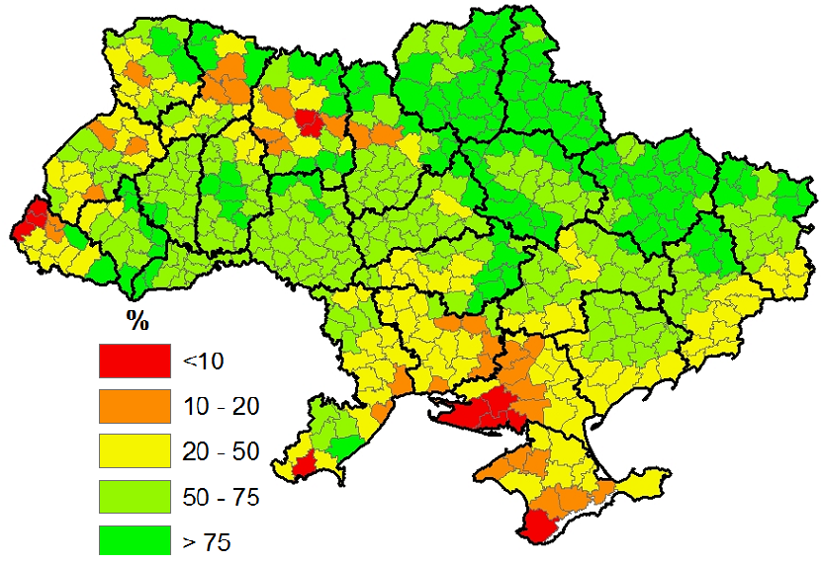
2007 (13th decade)

Slide 15
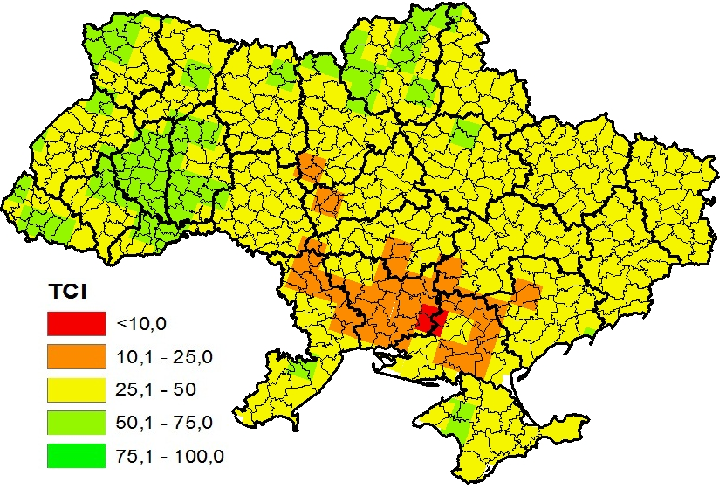
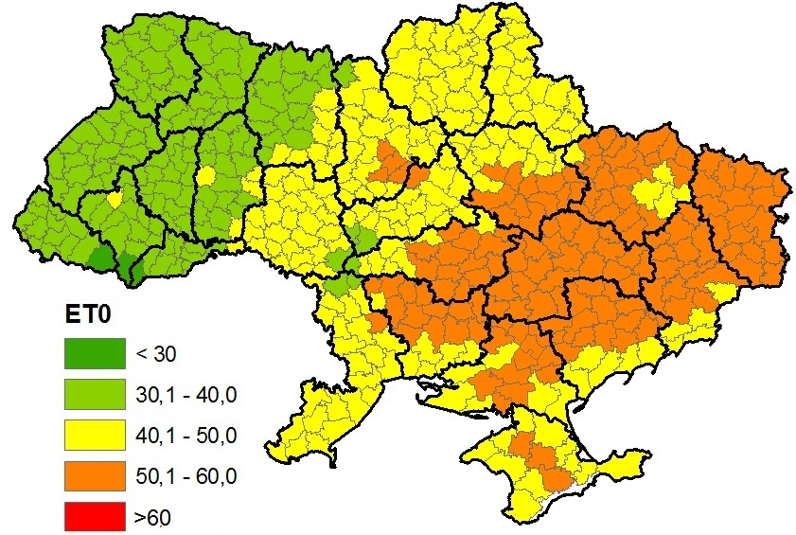
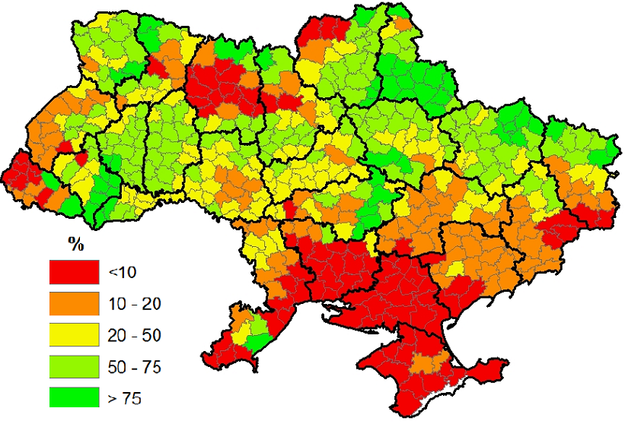
2007 (14th decade)

Slide 16
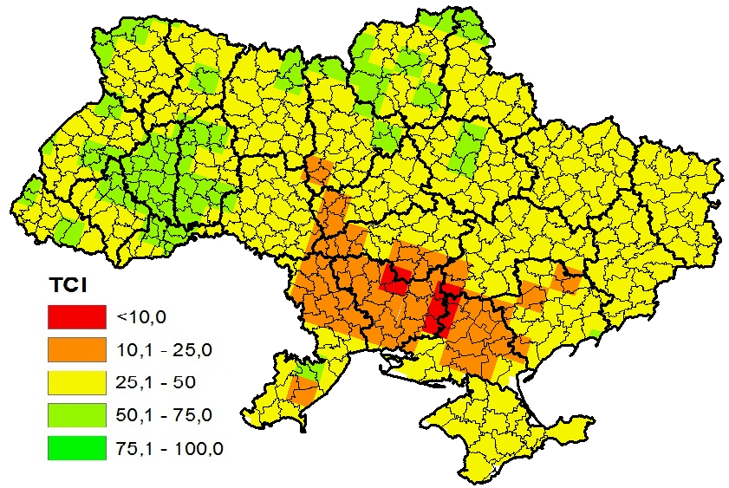
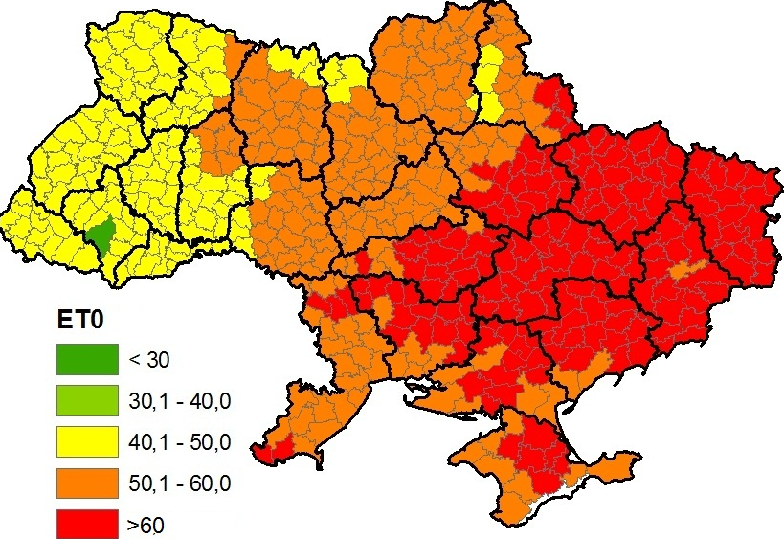
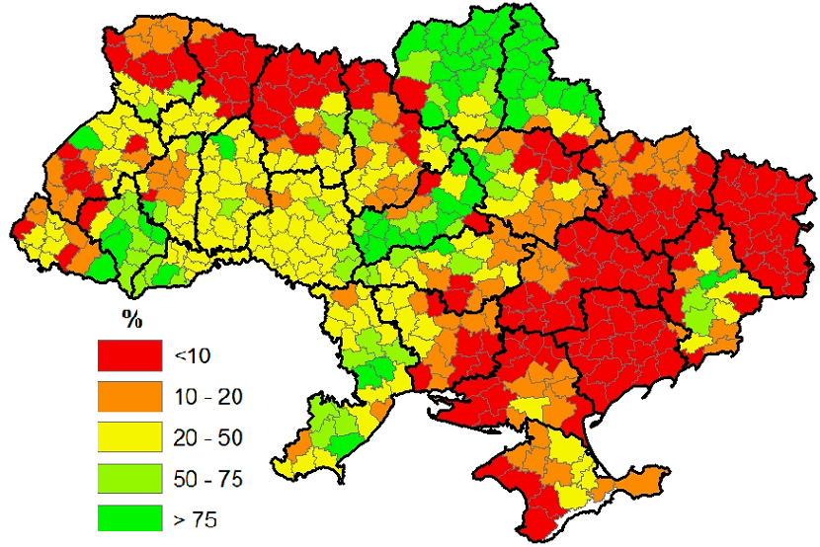
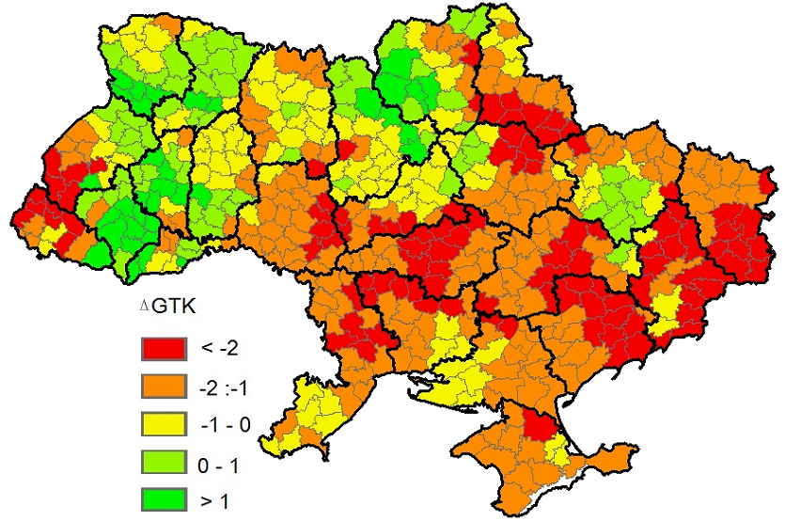
2007 (15th decade)

Slide 17
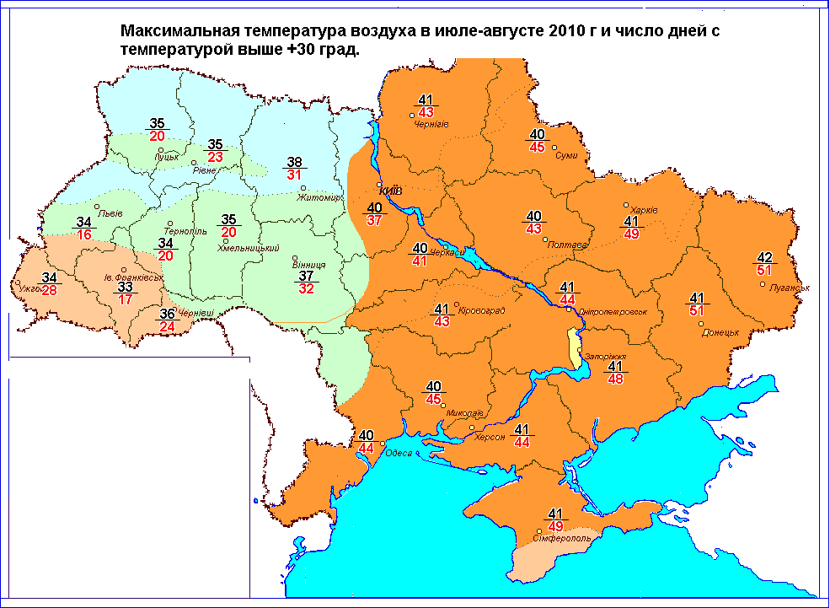

Slide 18
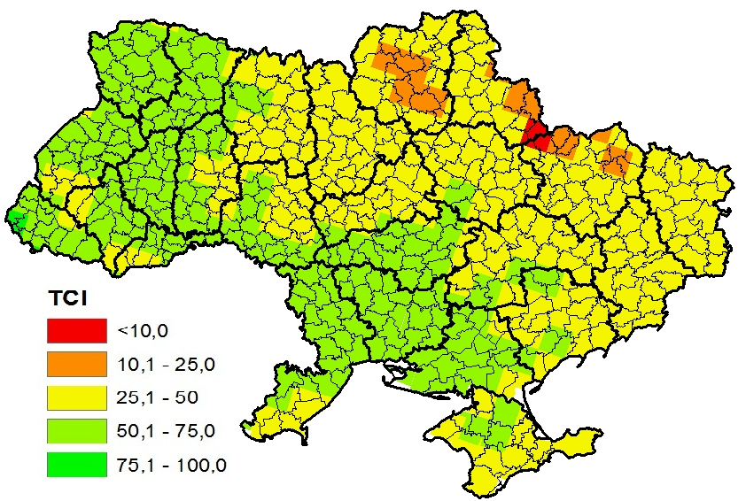
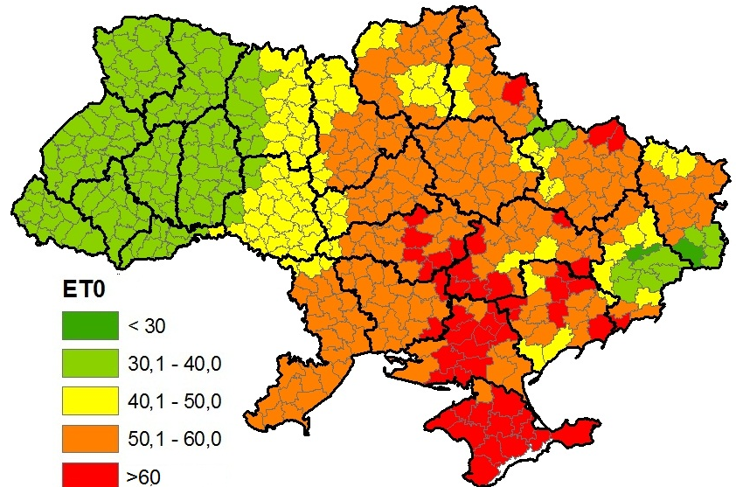
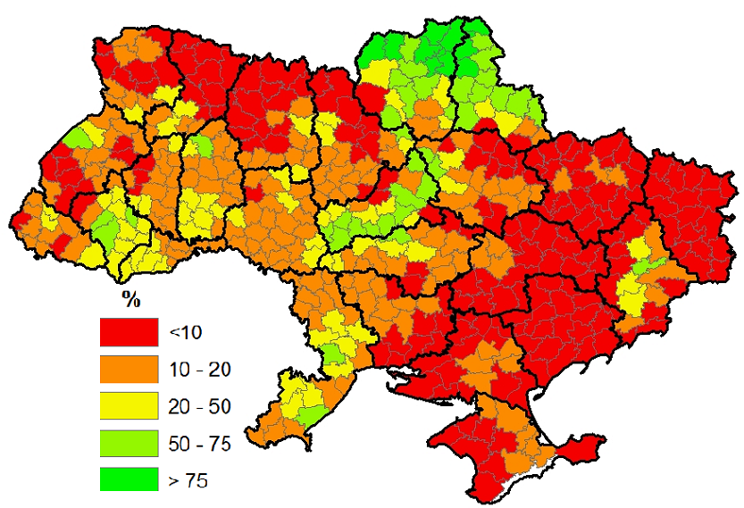
2010 (22n^{nd} decade)

Slide 19
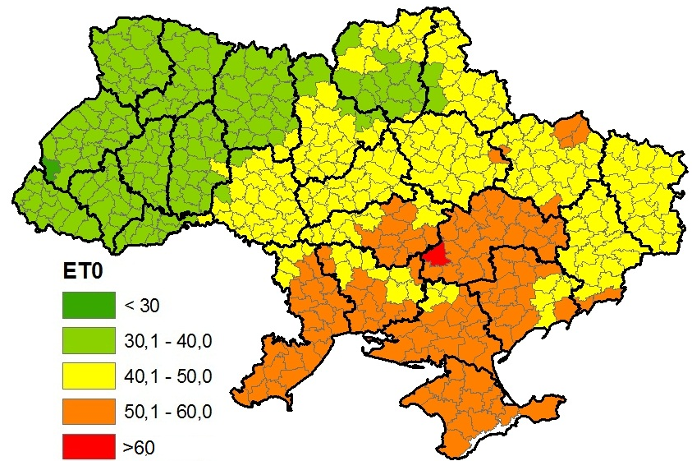
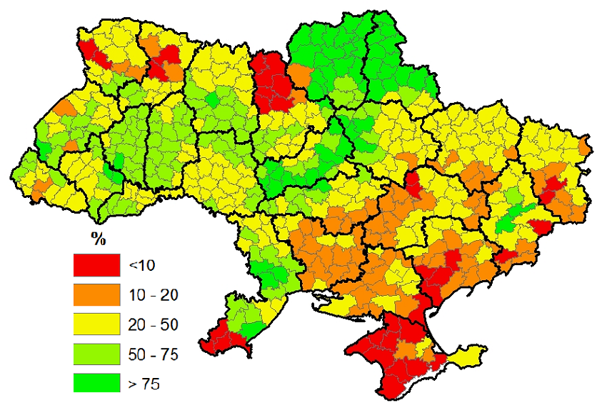
2010 (23rd decade)

Slide 20
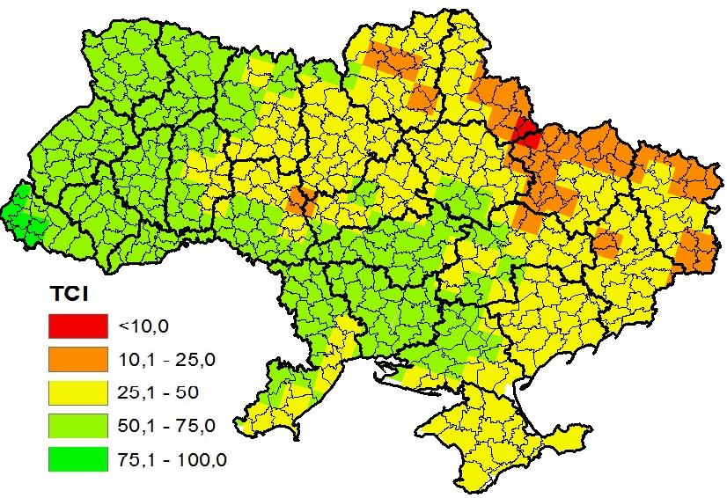
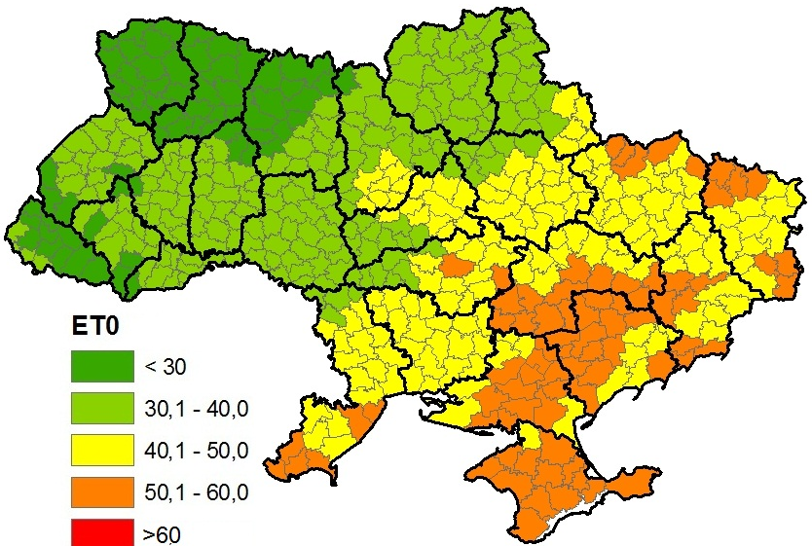
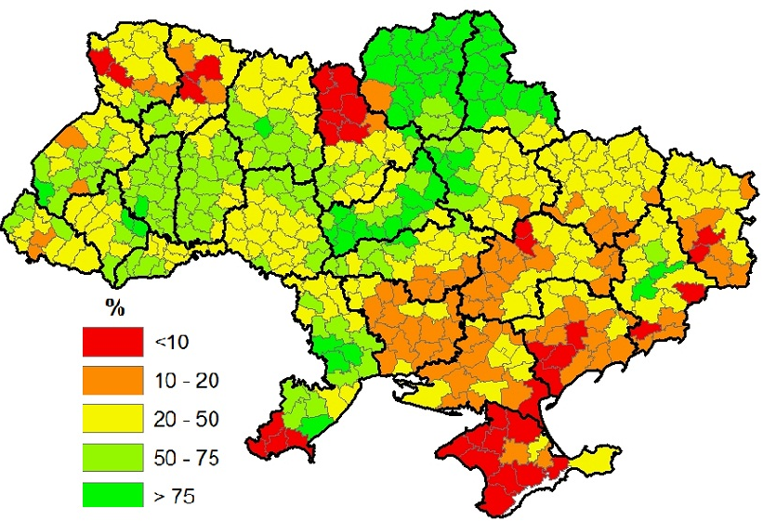
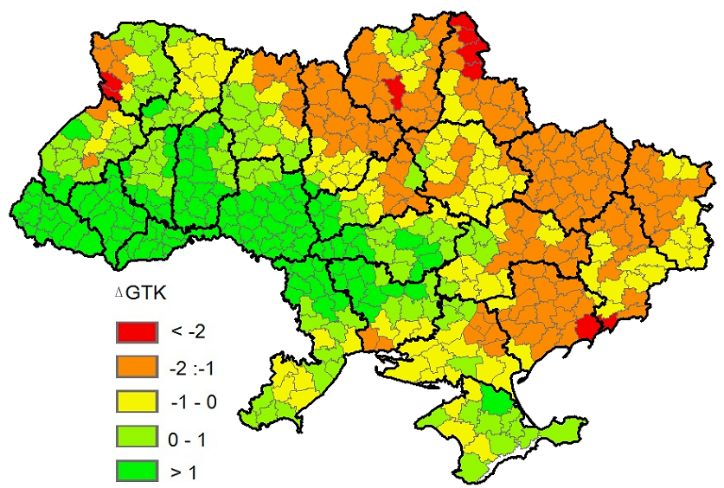
2010 (24th decade)

Slide 21
Conclusion/Further development
The system of drought conditions monitoring, which is based on ground and satellite data is developed. The results shows that only the joint analysis combination of different products based on different kind of data could provide more reliable information about the drought conditions;
Reprocess of ground and satellite data based on high resolution climatic grids (25*25 km);
Validate FRP, LST, ET and other LSA SAF products.

