Slide 1
EUMETSAT Training

Slide 2
Training directions 2014-2018
Basic training on satellite meteorology and other application areas, in cooperation with external experts
Training on applications, mostly in cooperation with SAFs
Development of online case studies and training materials, often through EUMeTrain
Graduate Trainees at EUMETSAT and Training Placements at Met Services
Support to training programmes in our Member States (e.g. Iberoamerican courses)
Support to user meetings and projects (EUMETSAT conference, African forum, SALGEE, Convection Working Group, MESA, DAWBEE, SADACA, SAGEO)

Slide 3
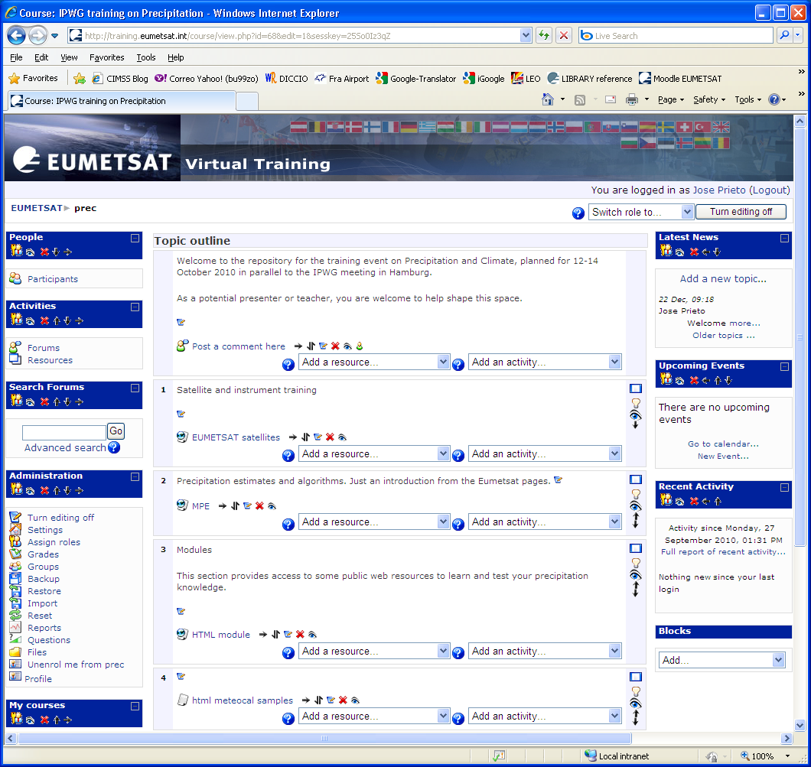
Blended courses (Moodle repository)

Slide 4
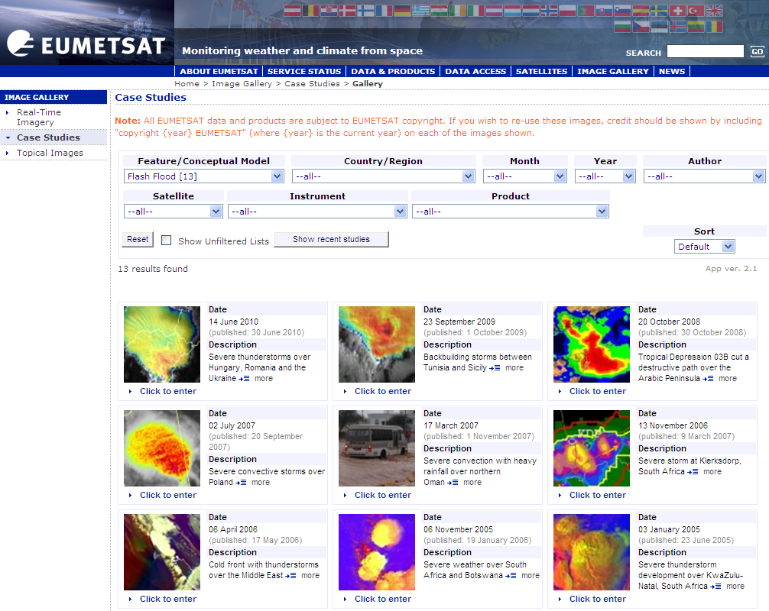
Image gallery (repository of case studies)

Slide 5
Joint Training together with LSA SAF
EXAMPLE: Land, fires, drought
Brasilia, Course on Land applications of Satellites. December 2008. Portuguese
Sofia, biennial workshop on drought and fires. September 2009 English
Maputo, Use of satellite products to monitor the soil. November 2009. Portuguese
Barcelona, course on Dust and Sand storms. November 2010 and Nov 2012 English
Antalya, biennial workshop on Drought and Fire applications. April 2011 English
Niamey, Cours applications agro-meteorologiques, November 2012. French
Lisbon, biennial workshop on Drought and Fire applications, March 2013. English
Accra, Agrometeorological applications course, June 2013. English
Thessaloniki, Extreme weather events as seen by satellites, October 2013. English

Slide 6
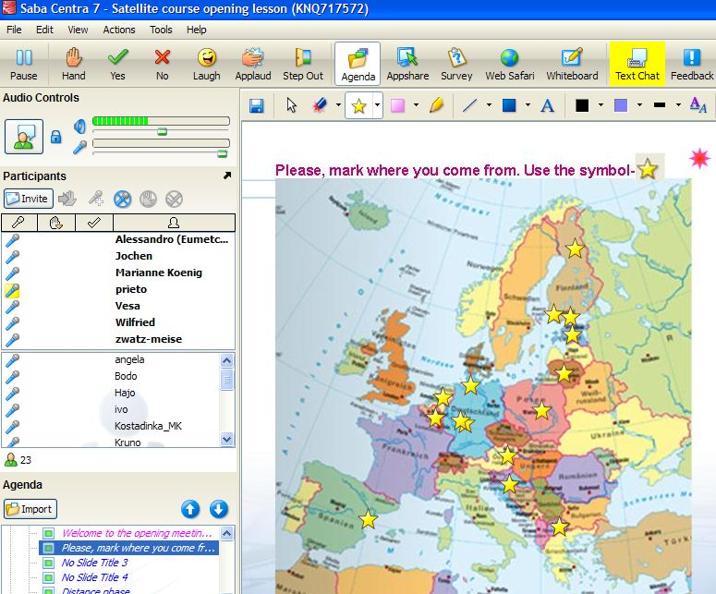
Blended courses
Centra screen-shot
Centra is the on-line session manager
Participants click on their home towns (or on quiz image features)

Slide 7
Blended courses
Mixture of distance and classroom phases
Covering a period of two to three months
Based on communication tools
Centra Saba: on-line presentations
Moodle: tidy repository of materials and training activities and discussions (forum, chat, quiz, glossary, exercise, documents)

Slide 8
Willing to contribute to training?
Training.eumetsat.int
Presenting a topic via distance training in the next topic week
(Supply materials for) building on-line training
Satrep-online subscription: http://satreponline.org/
You are welcome as a presenter in our courses/conferences
Prepare case studies on a special occasion

Slide 9
Image gallery (repository of case studies)
Thank you

